Slide 1


Slide 2

The University of Iowa
College of Dentistry
Department of Endodontics
William T. Johnson D.D.S., M.s.
Diplomate, American Board of Endodontics

Slide 3
CRACKED TEETH
William T. Johnson D.D.S., M.S.
Diplomate, American Board of Endodontics

Slide 4
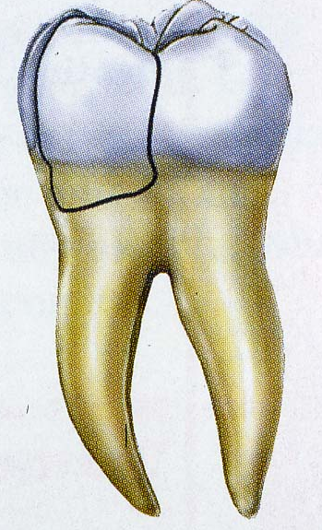
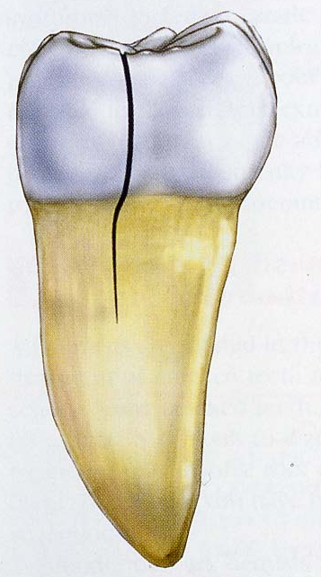
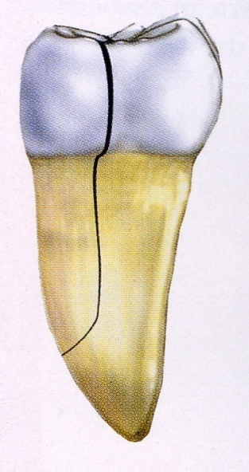
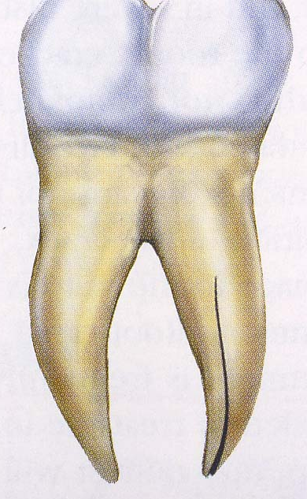
Fracture Types
CUSP
CRACK
SPLIT
VRF

Slide 5
Craze Lines
  confined to enamel
  occur naturally
  increase with age
  are of little clinical significance
Treatment is not required

Slide 6
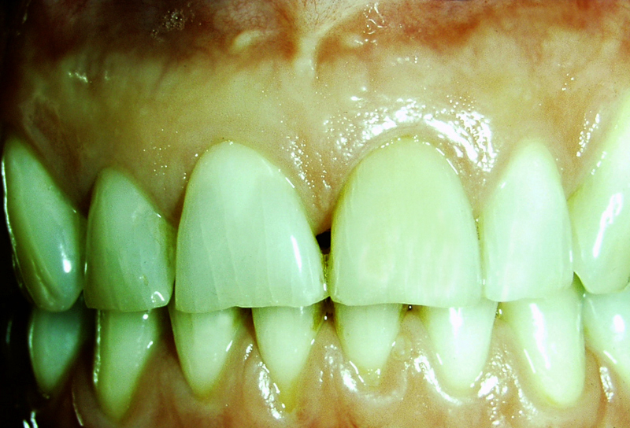

Slide 7
Fractured Cusp
  frequently occur in teeth with extensive restorations
  generally the pulp is not exposed
  patients may exhibit thermal sensitivity or pain to biting pressure
  pulp tests generally indicate tooth vitality
  periradicular structures are generally normal
  fractures can be complete or incomplete
Treatment depends on the pulpal status and restorability

Slide 8
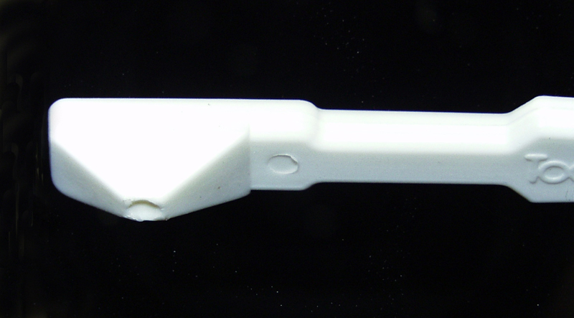

Slide 9
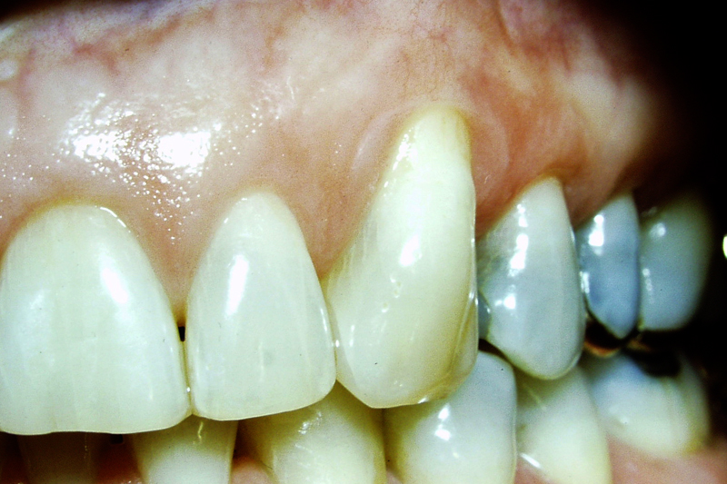
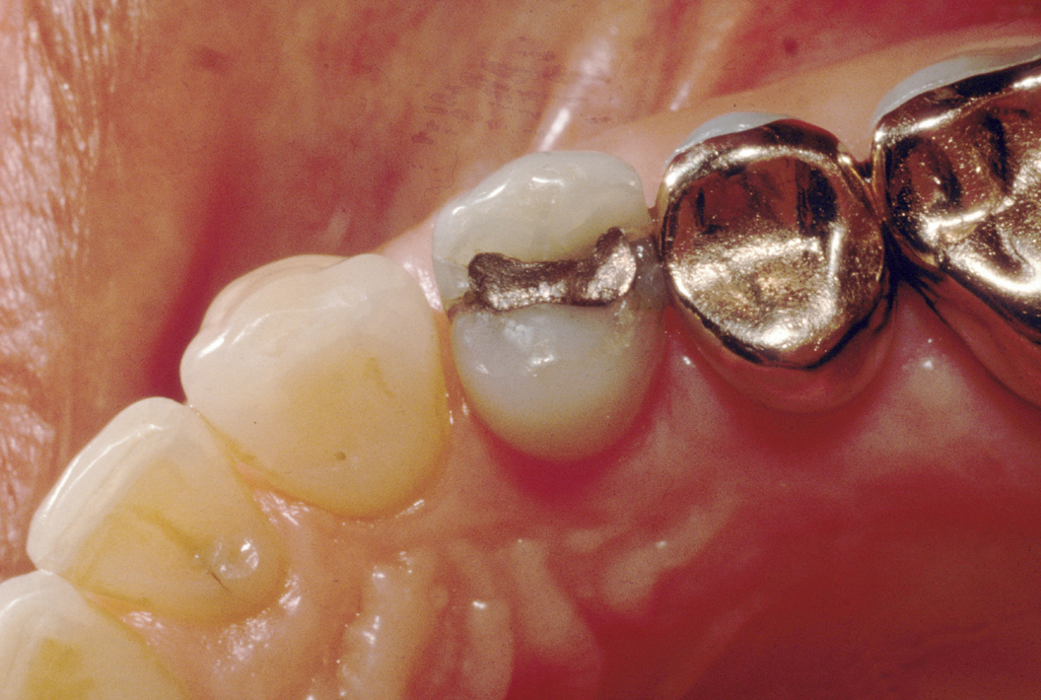

Slide 10
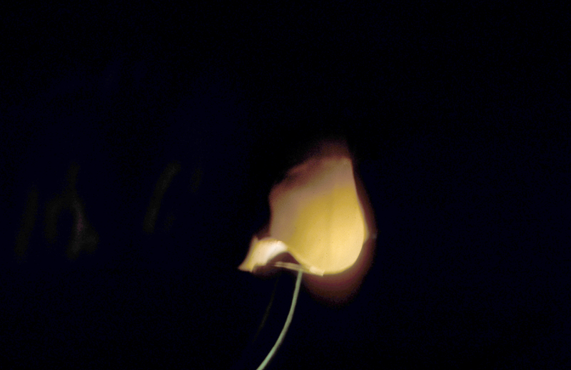

Slide 11
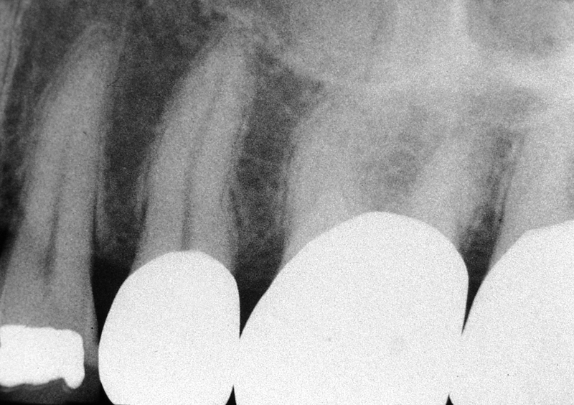

Slide 12
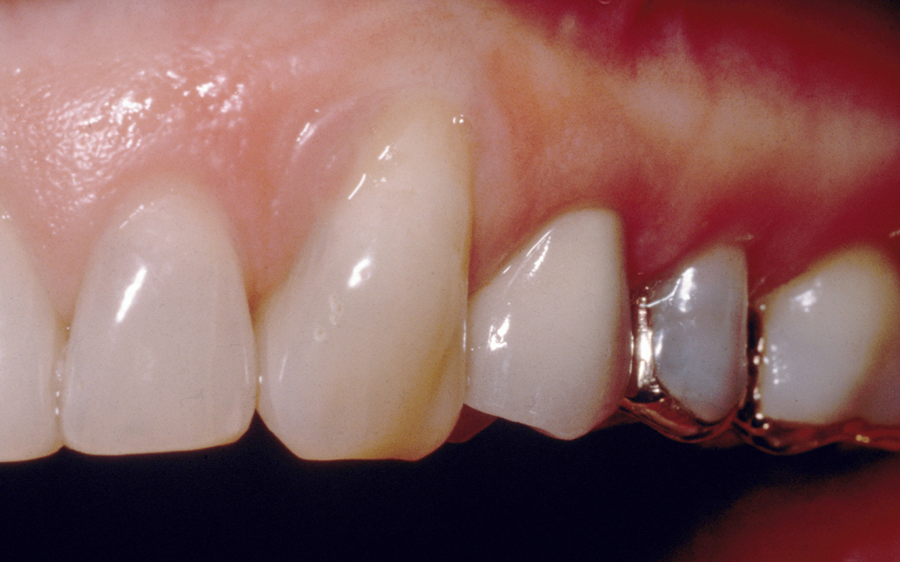

Slide 13
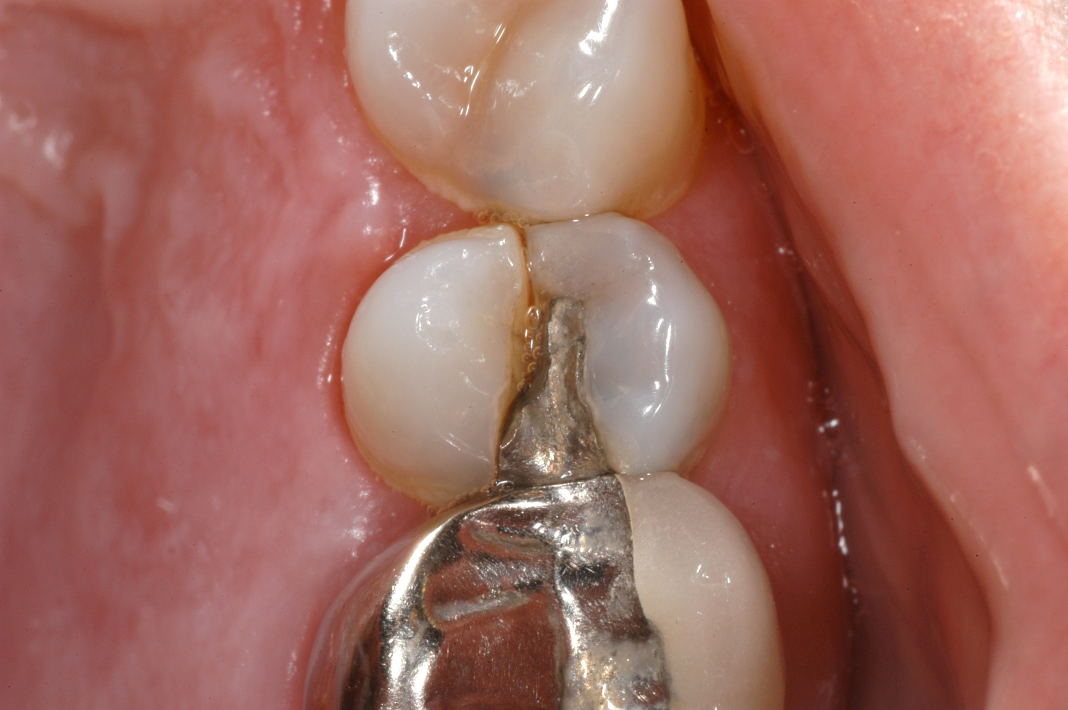

Slide 14
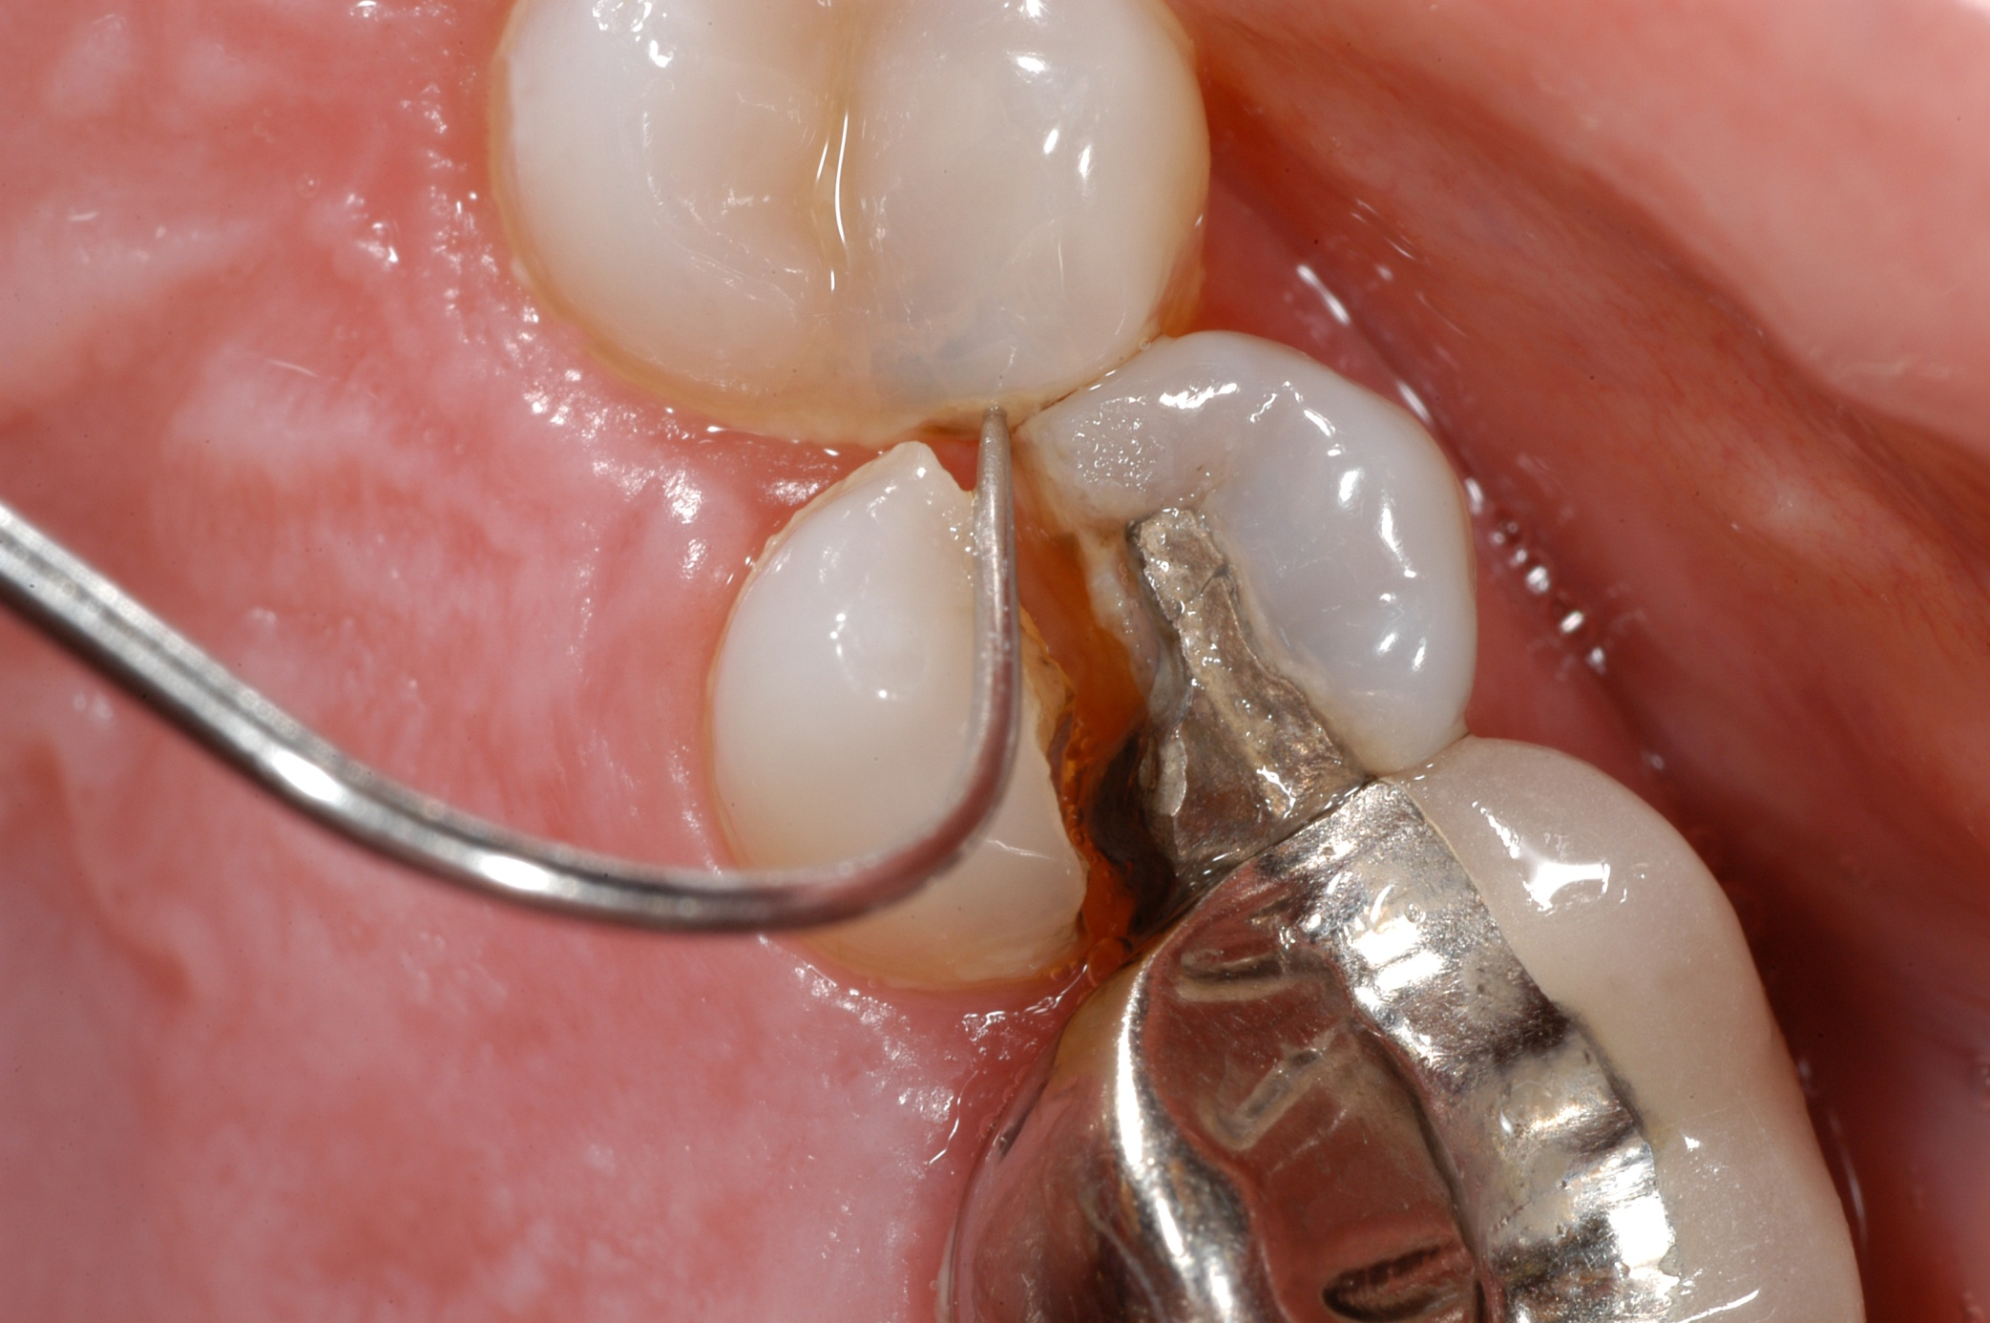

Slide 15
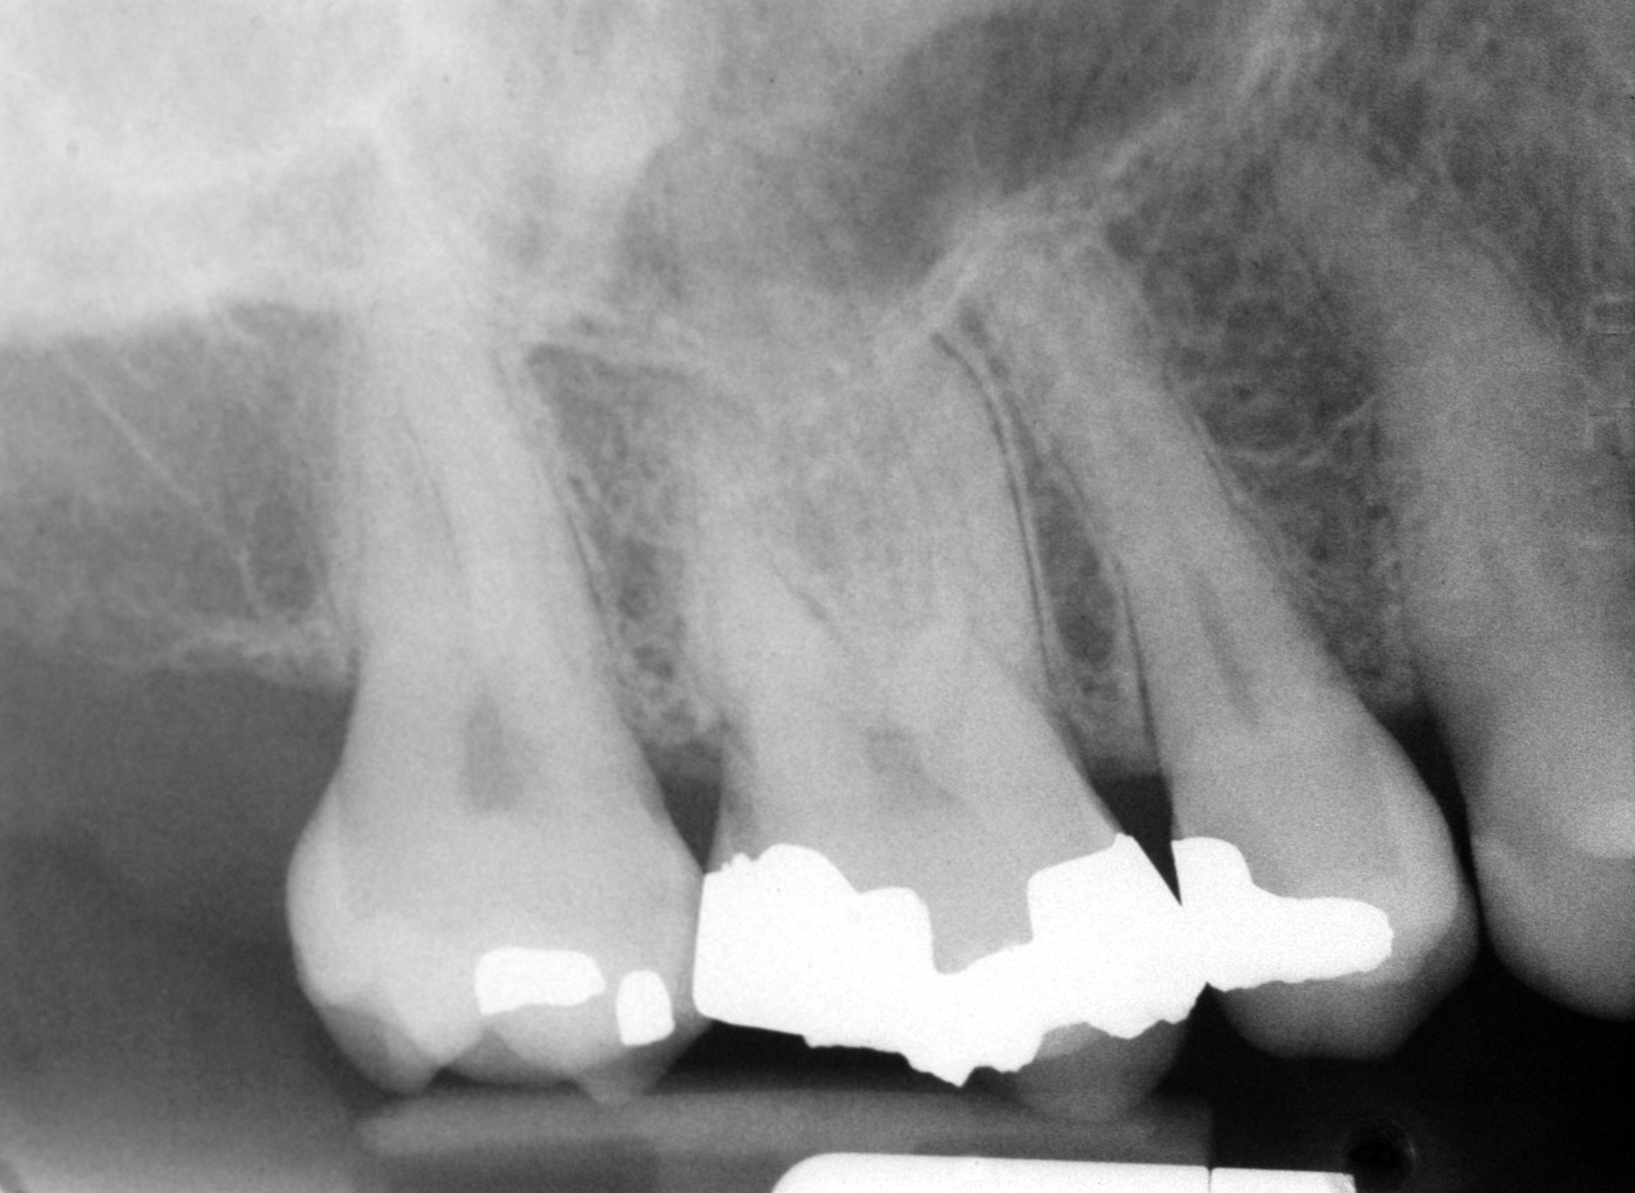

Slide 16
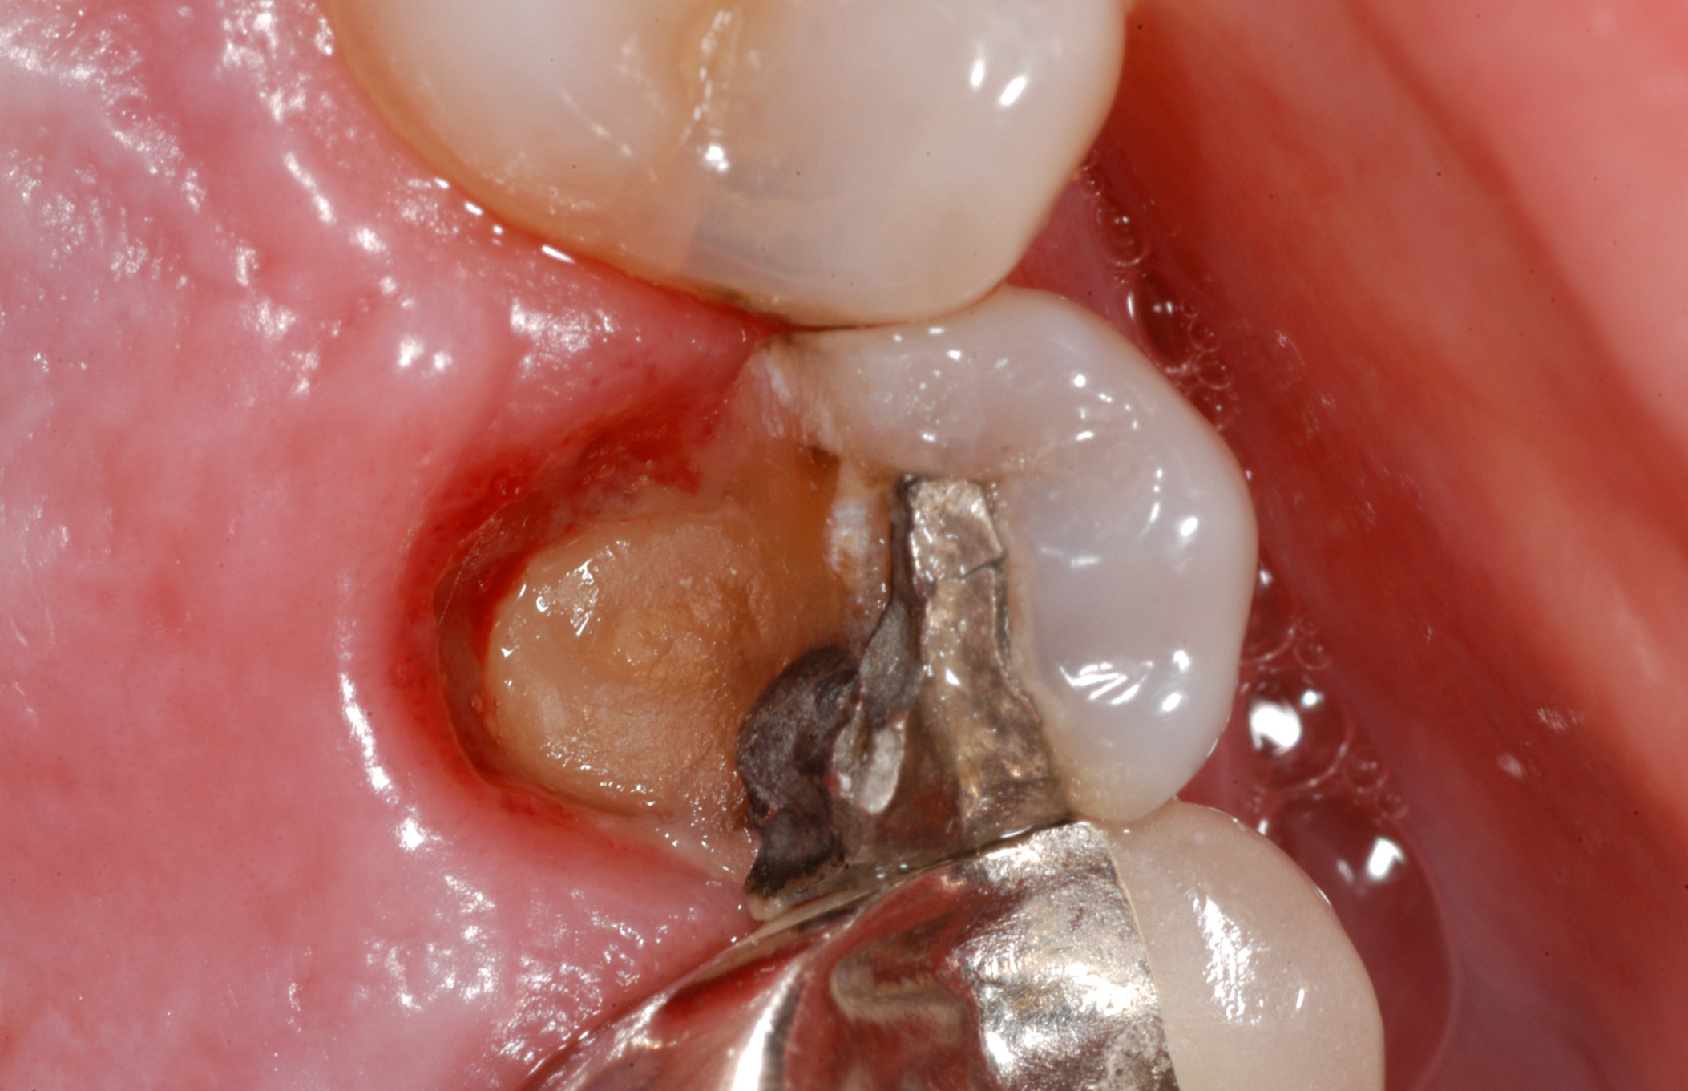

Slide 17
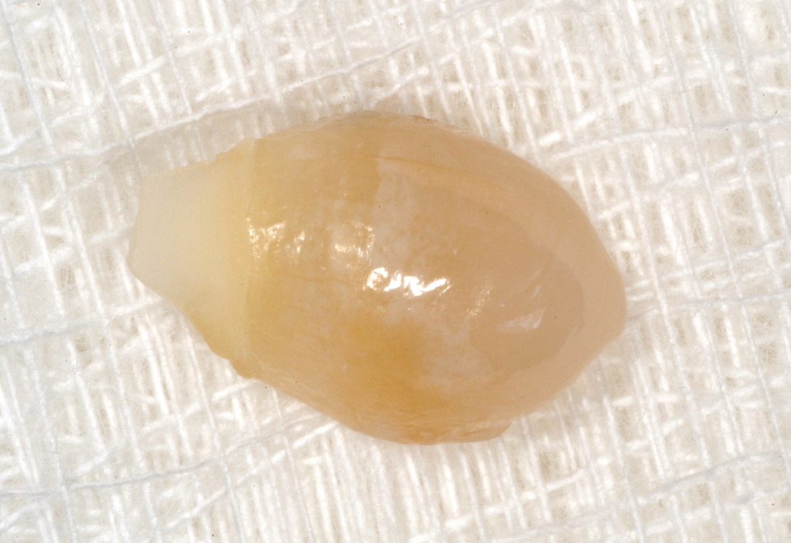
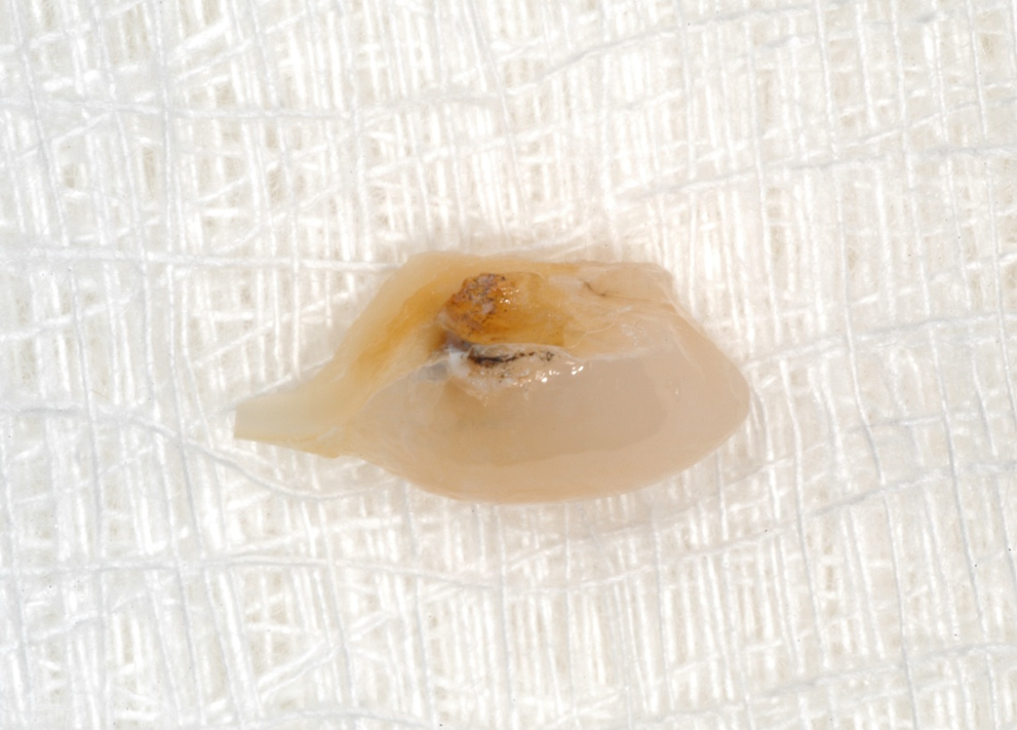

Slide 18
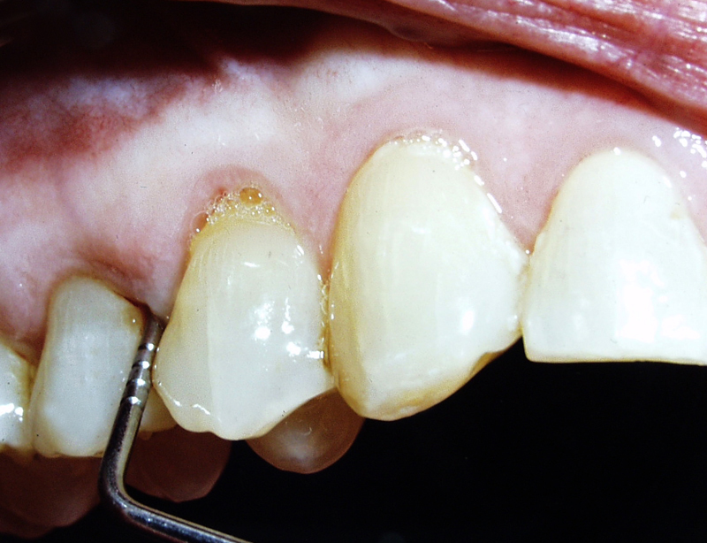

Slide 19
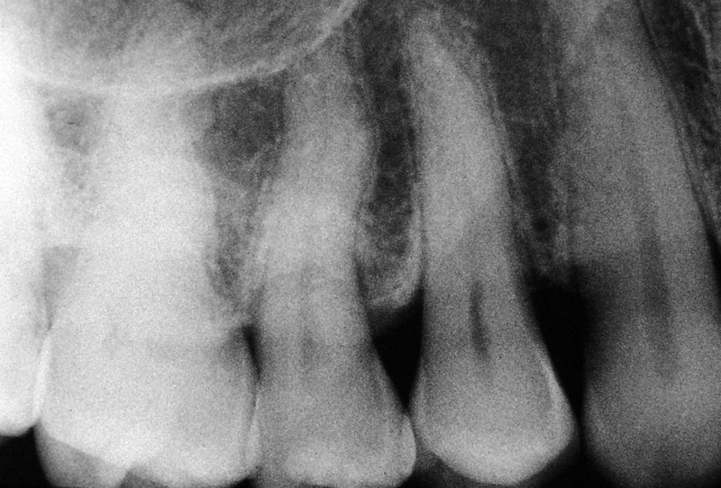

Slide 20
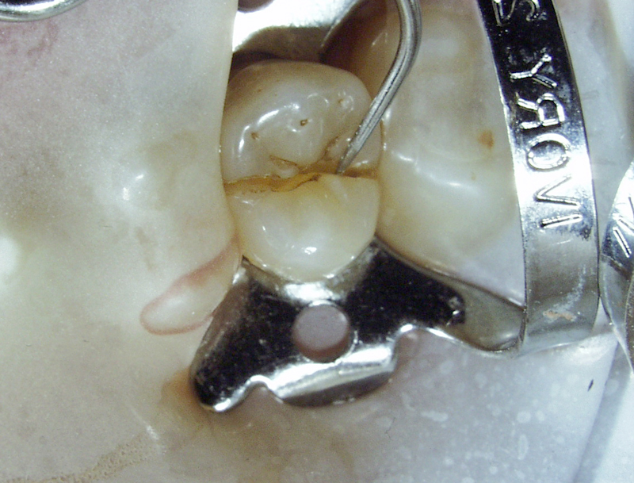

Slide 21
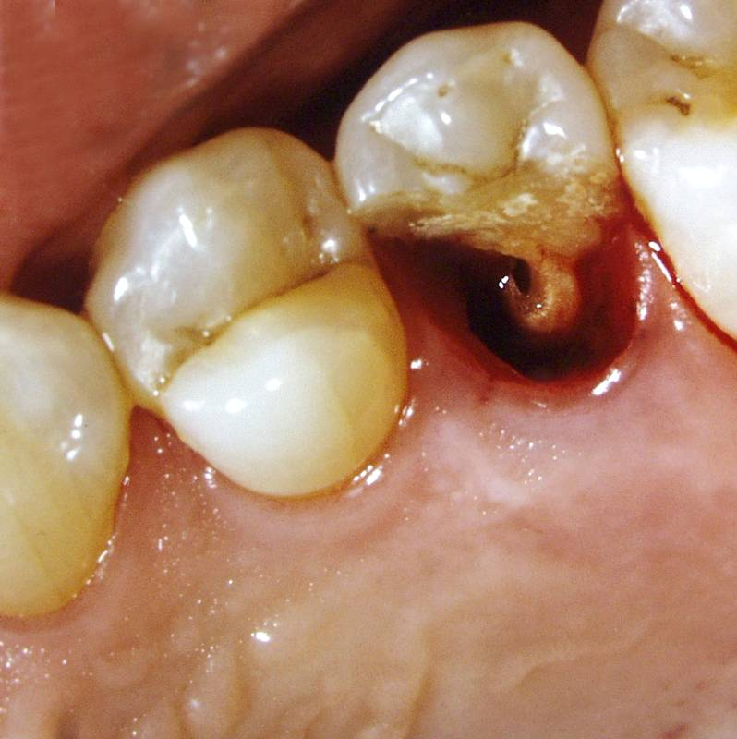

Slide 22
Cracked Tooth
  described as an incomplete fracture
  often occurs in posterior teeth
  cracks generally run in a mesial to distal direction
  occur primarily in molars
  the fracture may or may not involve the pulp
  symptoms include pain to mastication and thermal sensitivity
  the pulp may or may not be vital
  radiographs usually reveal normal periradicular structures

Slide 23
Etiology
  Thermal Cycling
  Pin Placement
  Cementation of Inlays
  Piercings
  Masticatory / Occlusal Forces

Slide 24
Diagnostic Aids
  A Good Dental History
  Dye Staining
  Transillumination
  Periodontal Probing
  Biting on a Tooth Slooth

Slide 25
Cracked Teeth
Gibbs, J.W. Dental Digest 1954;60:158
  Described the clinically undiagnosed, incomplete cuspal fracture, and the symptom of pain during mastication in the absence of other findings.

Slide 26
Cracked Teeth
Hiatt, J Periodontol 1973;44:369
  Teeth with incomplete crown-root fractures have good cusp-fossa relationships.
  The fractures run in a mesial-distal direction.
  Only posterior teeth were involved.
  74% of the teeth Involved had no proximal restorations.
  71 % of the fractures were found in mandibular molars.
  The primary diagnostic symptom is pain when chewing.

Slide 27
Cracked Teeth
Cameron, J Am Dent Assoc 93:971, 1976
  Two-thirds of the 102 fractures occurred in mandibular molars.
  Twenty-five percent of the patients could make their own diagnosis.
  Thirty-five percent of the patients gave a history of a previous cracked tooth pulp testing and radiographs often do not contribute to the diagnosis.
  75% of the fractured teeth were vital.
  81 % of the teeth revealed normal radiographic structures.

Slide 28
Cracked Teeth
Benenati FW. Coping with cracked tooth syndrome. Journal of the Oklahoma Dental Association. 1996;86:16-8
The cracked tooth syndrome poses a diagnostic challenge for the dentist. Symptoms include tenderness to biting, often poorly localized, and occasional thermal sensitivity. Treatment of the tooth depends on the degree of pulpal involvement and the extent of the crack.
  Cuspal coverage is required of all cracked posterior teeth that are retained to prevent crack propagation. (diagnostic procedure)
  Root canal treatment is indicated if symptoms persist or if pulpal pathosis exists at the outset.
  Cracks extending beyond the osseous crest indicate a poor prognosis.

Slide 29
Cracked Teeth
Guthrie RC., DiFiore PM. Treating the cracked tooth with a full crown. Journal of the American Dental Association 1991;122:71-3
  Twenty-eight teeth diagnosed as having a crack were immediately treated with full coverage acrylic resin crowns.
  Twenty-five of these teeth became asymptomatic after full coverage acrylic crown placement and continued to be asymptomatic one year after restoration.

Slide 30
Cracked Teeth
Liu HH. Sidhu SK. Cracked teeth - treatment rationale and case management: Case reports. Quintessence International. 1995;26:485
  Reported successful management of six teeth with cracks in the form of incomplete vertical fractures. Further crack propagation was prevented by placement of either stainless steel orthodontic bands, aluminum or acrylic resin provisional crowns, and subsequent endodontic treatment.
  The teeth were restored with intraradicular amalgam cores and complete veneer crowns. The teeth were re-examined periodically for up to 3.5 years after treatment. During the period of review, all teeth remained asymptomatic.

Slide 31
Signore, A et al. A 4- to 6-year retrospective clinical study of cracked teeth restored with bonded indirect resin composite onlays. Int J Prosthodont 2007 ;20:609-16
Retrospectively evaluated the clinical performance of bonded indirect resin composite onlays for the treatment of painful, cracked teeth over a 6-year period in 43 posterior teeth.
Inclusion criteria were sensitivity to biting and cold and a clinically visible crack.
Onlay restorations were cemented with an adhesive technique using a 3-step total etch system and a dual-cure composite cement. And patients were clinically examined at 1 week, 4 weeks, and every 6 months.
At 1 week, 88.37% restored teeth were free of pain, 7%) had sensitivity to cold, and 5% cold and chewing.
At 4 weeks, 93% teeth were free of pain, 5% had sensitivity to cold and chewing, and 2% needed endodontic treatment.
Two other teeth, 5%, also needed endodontic treatment
93% of the teeth were free of symptoms with a 6-year survival rate.
Three restorations failed,
From the findings of this study, it appears that cuspal protection should be incorporated into the design of coronal restorations.

Slide 32
Roh, BD, Lee, YE. Analysis of 154 cases of teeth with cracks. Dent Traumatol. 2006;22:118-23
Teeth with cracks were identified over a one year period. Teeth were analyzed in terms of the classification of cavity and restorative material, the nature of opposing tooth, the location in the arch, the age and gender, and the clinical signs and symptoms, and treatment result.
Cracked teeth were observed most frequently in the teeth with no restorations (60%) and with class I restorations (29%).
96% of the cracked teeth responded to the biting pressures.
81% of the cracked teeth were in the mesio-distal direction.
The most prevalent age was in those over 40 years of age and the prevalence was similar in men and women.
Cracked teeth were found most frequently in the
  maxillary first molars 34%
  maxillary second molars 23%
  mandibular first molars 20%
  mandibular second molars 16%

Slide 33
Tan, L, et al. Survival of root filled cracked teeth in a tertiary institution. Int Endod J. 2006;39:886-9
Assessed the survival rate of 50 root filled cracked teeth over a 2-year period in forty-nine patients who had root canal treatment completed on their cracked teeth.
The 2-year survival rate was 85.5%
Cracked teeth which were the terminal teeth in the dental arch, teeth with pre-root filling, periodontal pocketing and teeth with multiple cracks were more likely to be extracted and are significant prognostic factors for the survival of root filled cracked teeth.

Slide 34
Krell, KV, Rivera EM, A Six Year Evaluation of Cracked Teeth Diagnosed with Reversible Pulpitis: Treatment and Prognosis. J Endodon 2007;33:1405-1407
Identified cracks in 9.7% (796 of 8175) of all teeth evaluated over six years.
Of 127 patients specifically diagnosed with reversible pulpitis, 27 converted to irreversible pulpitis (N = 21) in 58 days or to necrotic pulp (N = 6) in 149 days.
None of the original remaining 100 cases of reversible pulpitis required root canal treatment.
Outcomes of this study suggest that if a marginal ridge crack is identified early enough in teeth with a diagnosis of reversible pulpitis and a crown is placed, root canal treatment will be necessary in about 20% of these cases within a 6-month period.

Slide 35
Percentage of Cracked Teeth per Tooth Group
Maxillary First Molar 8.9 %
Maxillary Second Molar 8.5 %
Maxillary First Premolar 4.5 %
Maxillary Second Premolar 6.1 %
Mandibular First Molar 11 %
Mandibular Second Molar 17.6 %
Mandibular First Premolar 0.5 %
Mandibular Second Premolar 2.6 %

Slide 36
Percentage of Cracked Teeth with Reversible pulpitis
Treatment planned for a crown and Requiring NSRCT
By tooth group
Maxillary First Molar 27 %
Maxillary Second Molar 25 %
Maxillary First Premolar 0 %
Maxillary Second Premolar 0 %
Mandibular First Molar 17 %
Mandibular Second Molar 28 %
Mandibular First Premolar 0 %
Mandibular Second Premolar 0 %
Overall, 21% of the cracked teeth diagnosed with
reversible pulpitis required non-surgical rot canal treatment

Slide 37
Crack Location
56% involved only the distal marginal ridge
15% involved only the distal marginal ridge
29% involved both marginal ridges

Slide 38
Bader JD. Shugars DA. Roberson TM.
Community Dentistry & Oral Epidemiology.
1996;24:47-51
Presented studies that provide information about dentists' use of crowns to prevent tooth fracture.
  North Carolina general dentists indicated that 44% of the crowns they placed were for the principal reason of fracture prevention.
  However, when groups of dentists examined the same patients, there was little agreement about which teeth should be crowned due to risk of fracture.
  These results suggest that the placing of crowns to prevent fracture merits a careful determination of effectiveness and appropriateness.

Slide 39
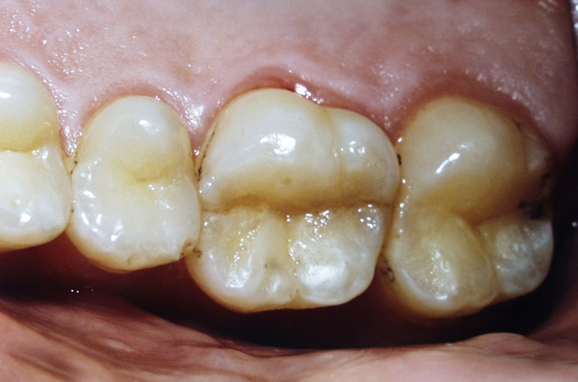

Slide 40
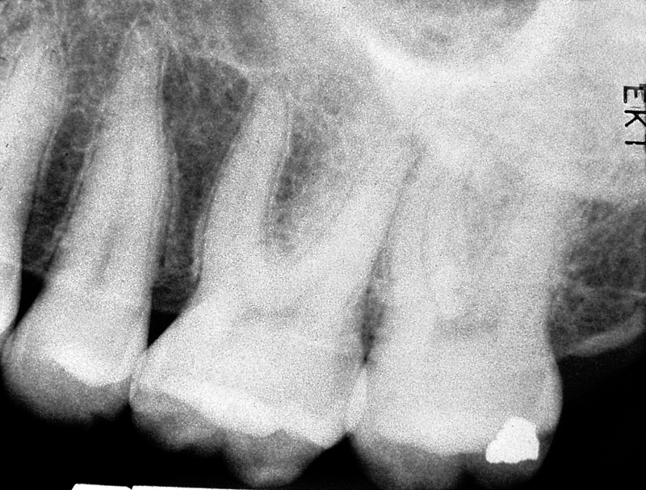

Slide 41
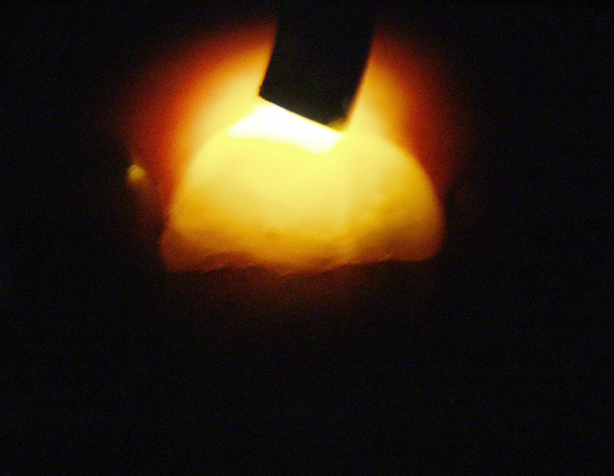

Slide 42
Cracked Tooth
Treatment depends on the signs, symptoms, pulpal status, and extent of the crack.
  If the pulp is vital and there are no periodontal defects, a provisional restoration is placed to prevent propagation of the crack.
  If endodontic and/or periodontal problems exist then they should be treated prior to fabrication of a cast restoration.

Slide 43
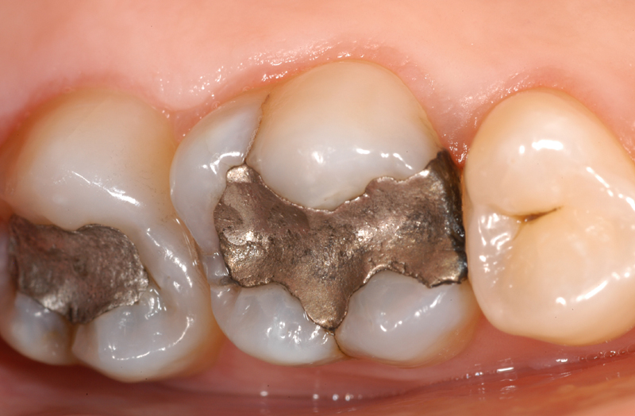

Slide 44
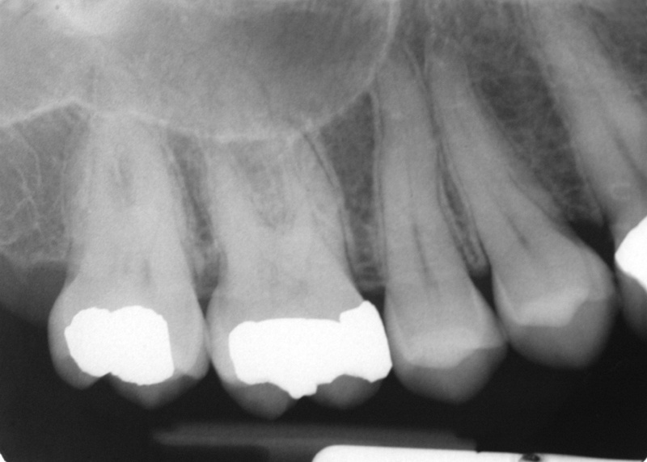

Slide 45
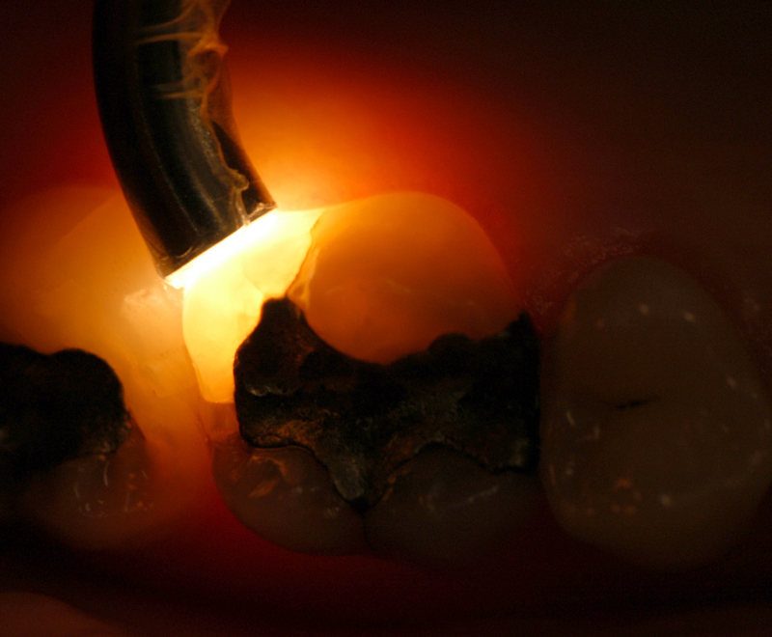

Slide 46
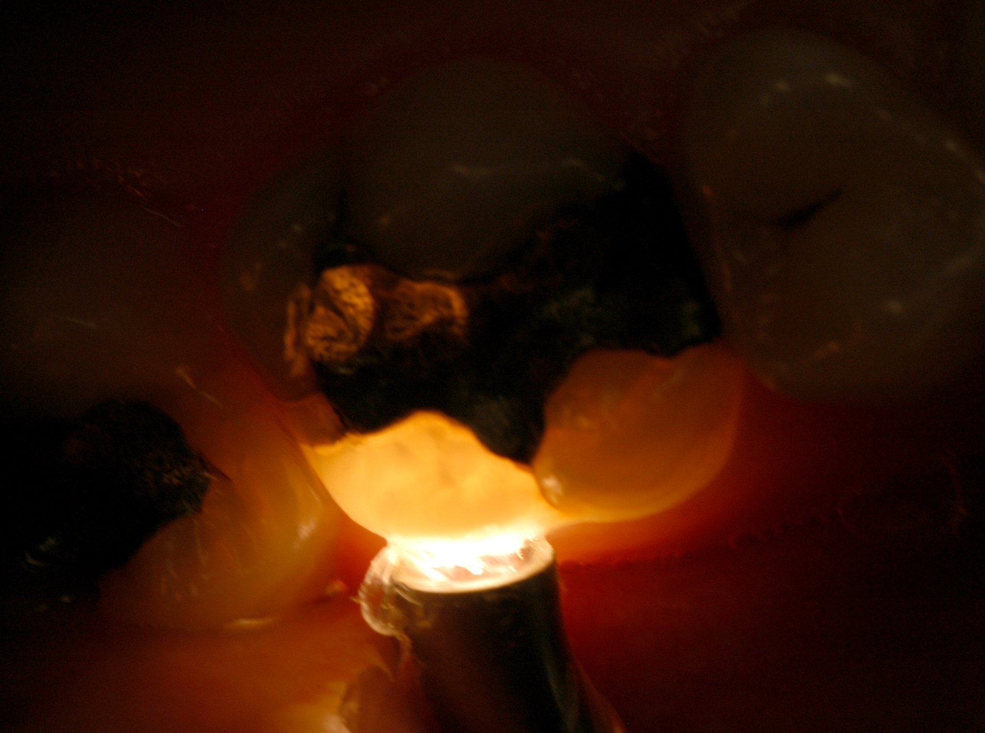

Slide 47
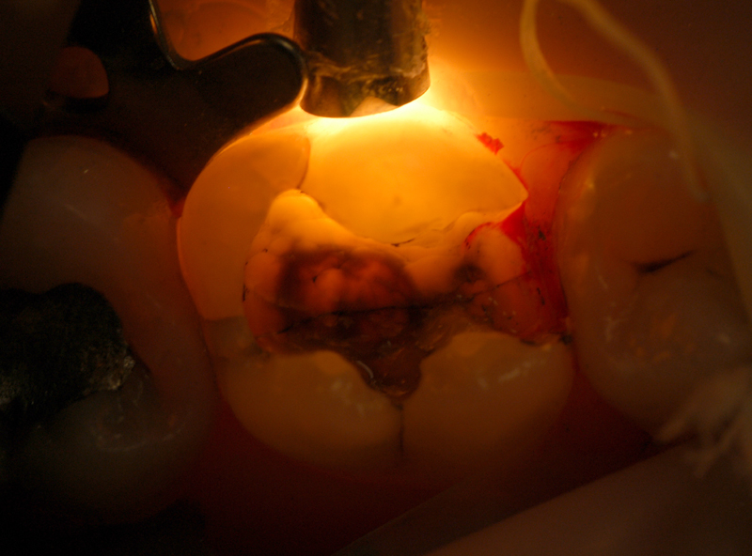

Slide 48
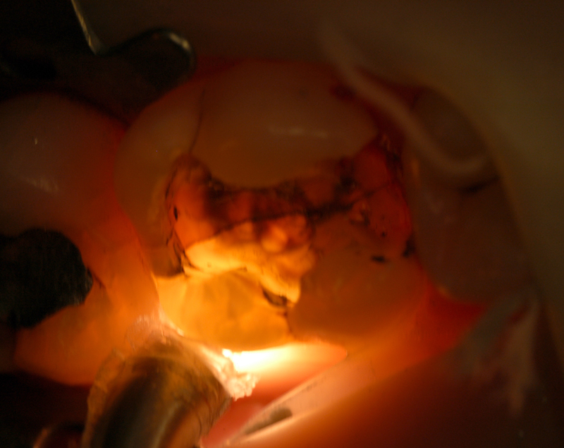

Slide 49
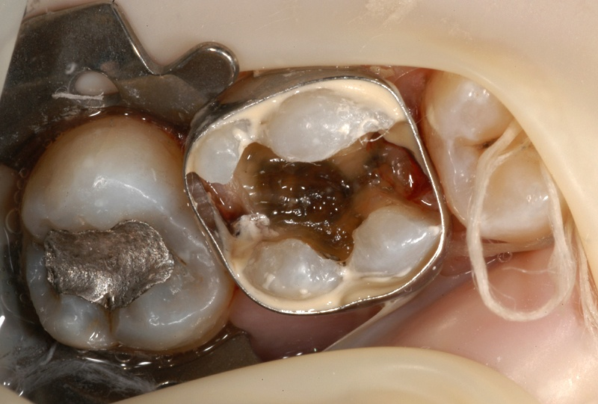

Slide 50
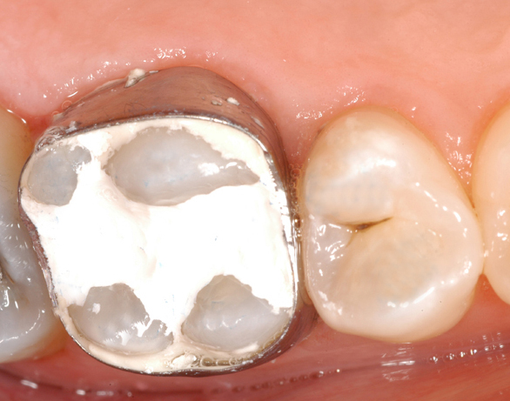

Slide 51
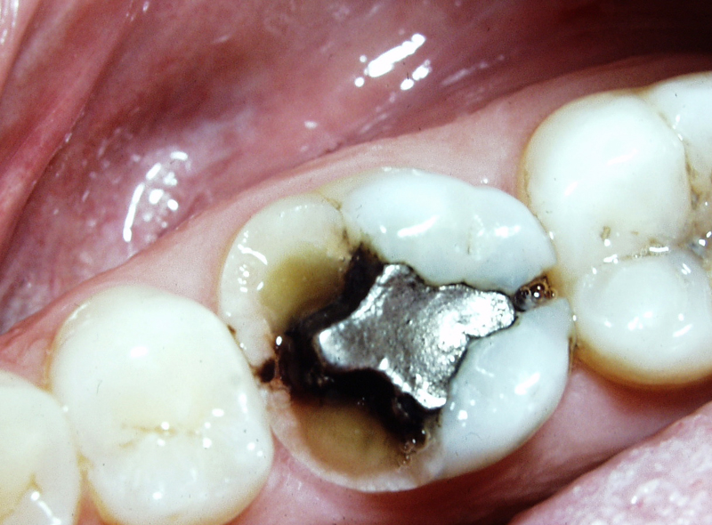
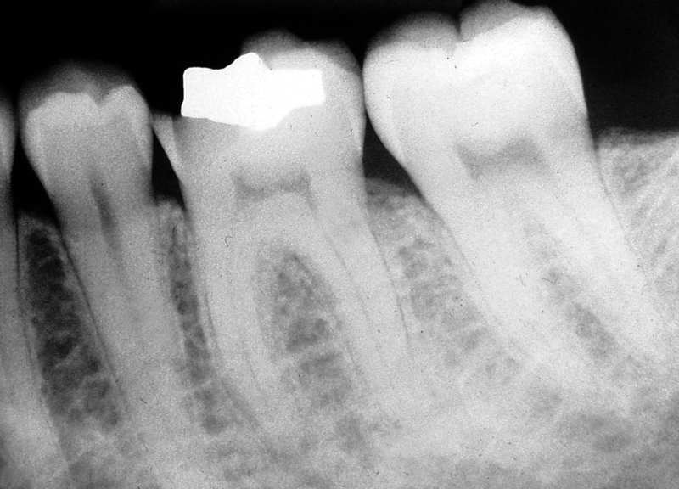

Slide 52
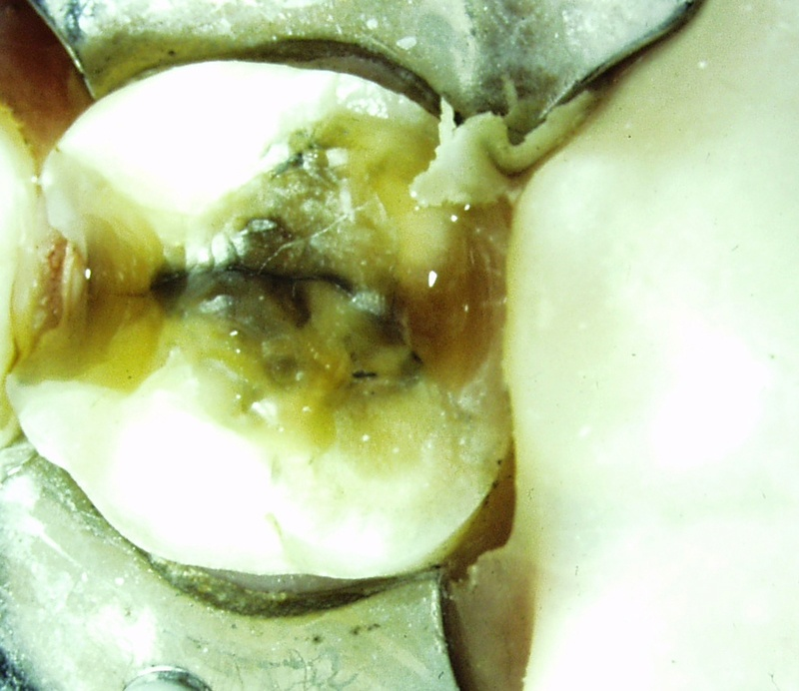
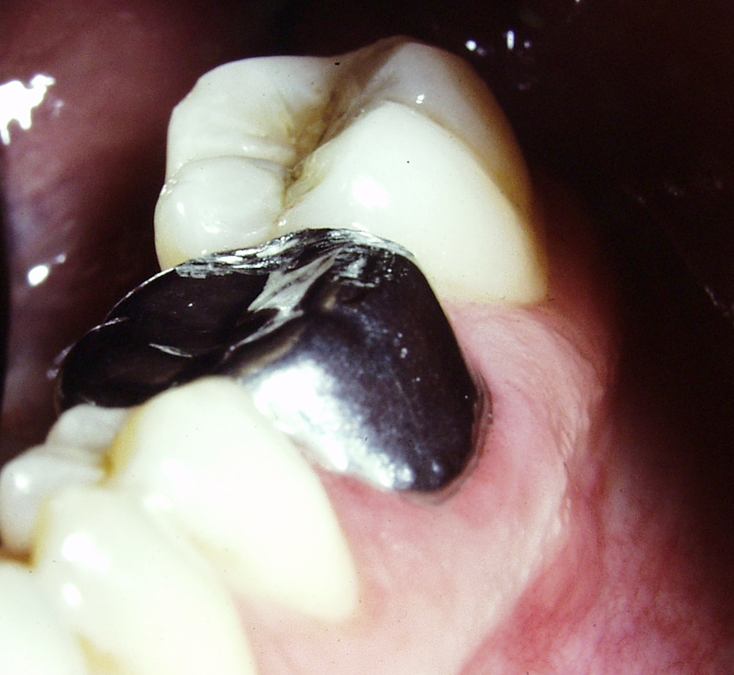

Slide 53
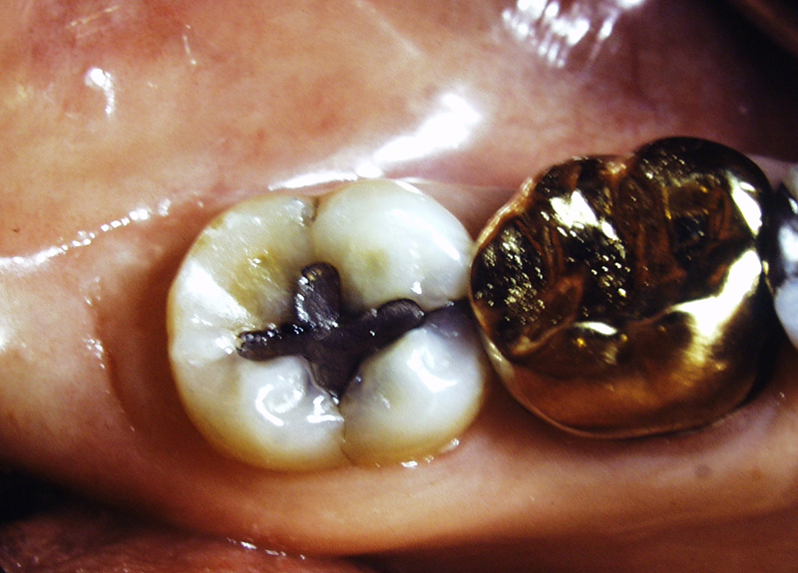

Slide 54
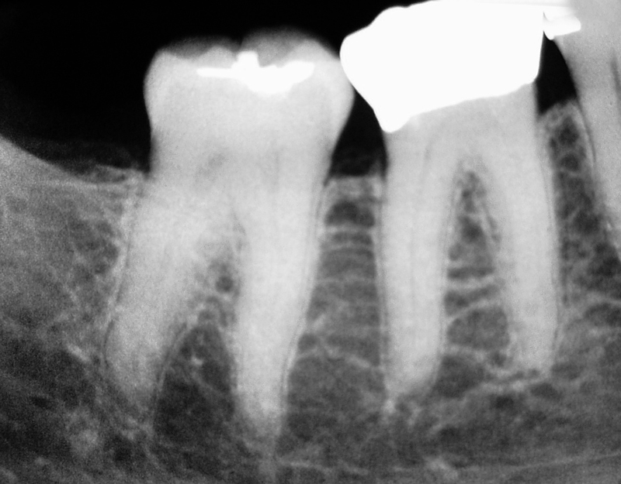

Slide 55
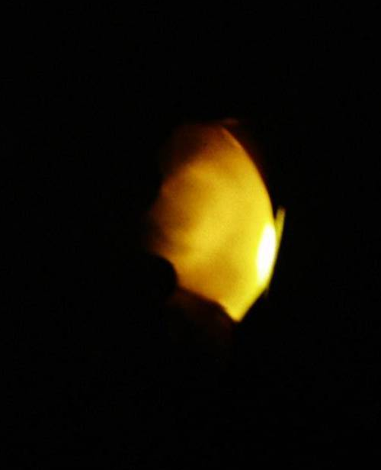

Slide 56
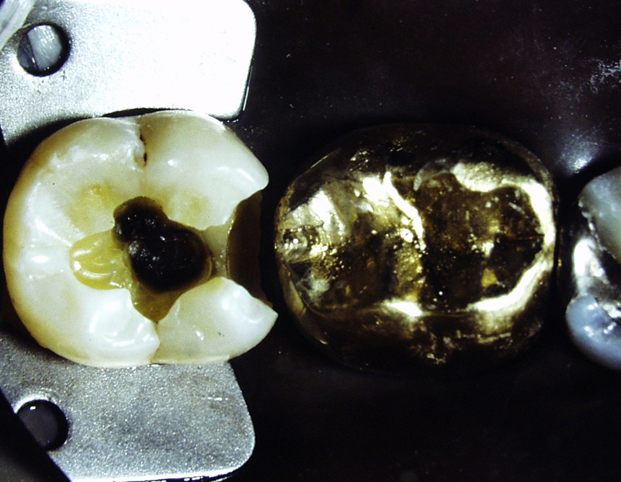

Slide 57
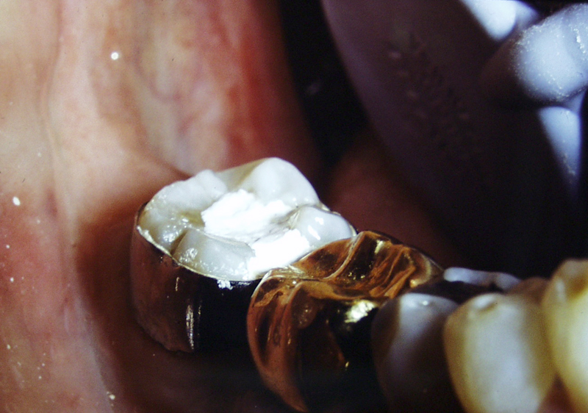

Slide 58
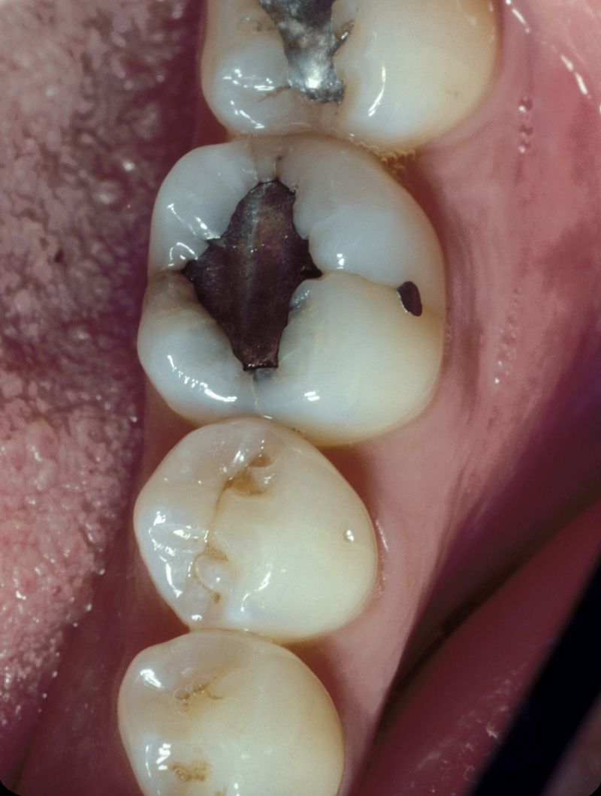

Slide 59
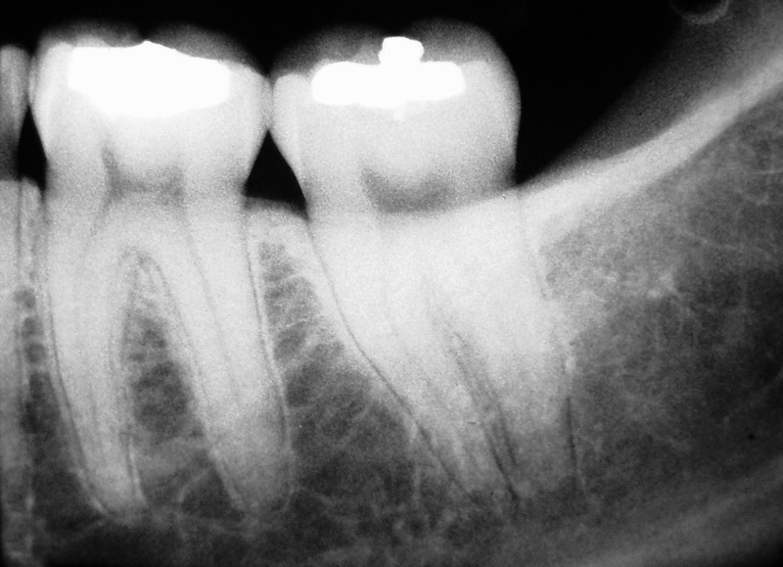

Slide 60
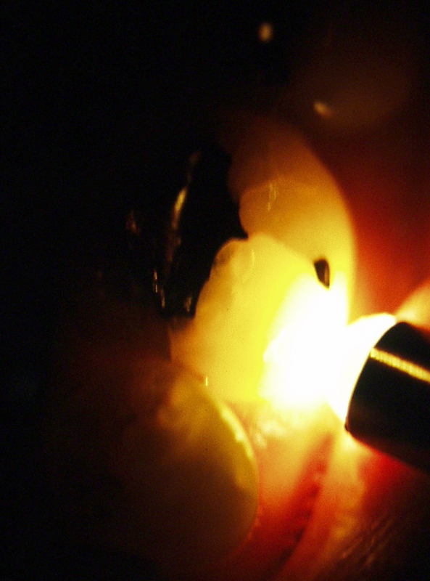

Slide 61
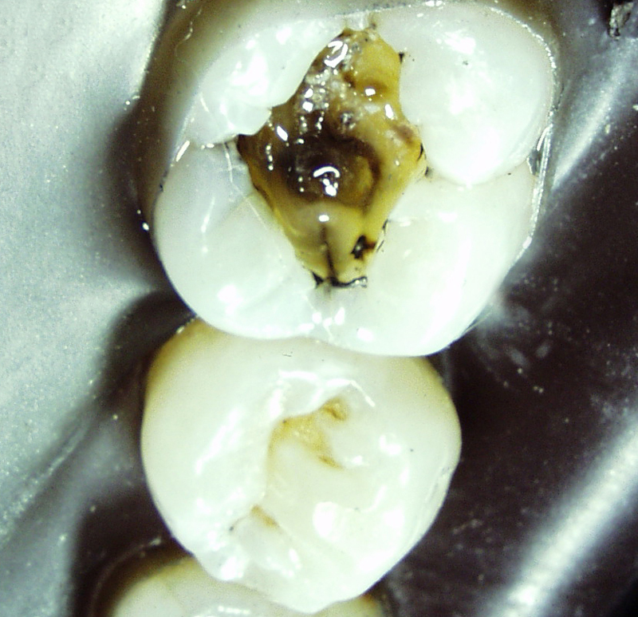

Slide 62
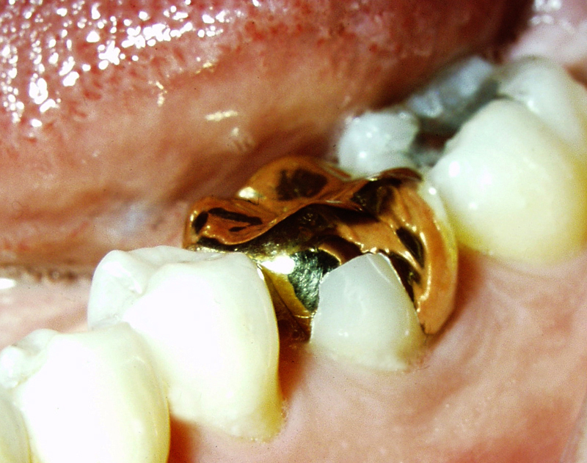

Slide 63
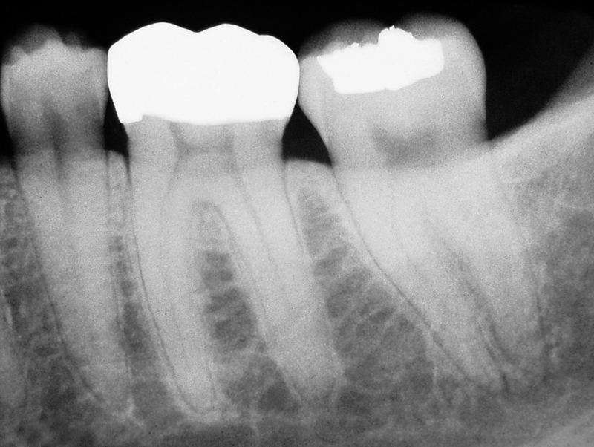

Slide 64
Maheu-Robert, LF, Andrian, E, Greiner, D. Overview of complications secondary to tongue and lip piercings. J Can Dent Assoc. 2007;73:327-31
Identified the risks and complications associated with tongue and lip piercings range from:
  abnormal tooth wear
  cracked tooth syndrome
  gingival recession
  systemic infections.

Slide 65
De Moor, RJ et al. Dental and oral complications of lip and tongue piercings. Br Dent J. 2005;22;199:506-9.
Present a clinical survey the prevalence of both tongue and lip piercing complications in oral health in a group of 50 patients.
  Post-procedural complications included edema, haemorrhage and infection.
  The most common dental problem found was chipping of the teeth, especially in association with tongue piercing.
  Gingival recession was seen as a result of lip piercing with studs.

Slide 66
Levin, L, et al. Oral and dental complications of intra-oral piercing. Dent Traumatol. 2005;21:341-3
Assessed the prevalence of oral piercing among young adults and revealed the types and rate of complications following oral piecing in 400 consecutive patients, who randomly arrived at a military dental office.
Intra-oral examination included special attention to piercing-related complications, such as tooth fractures, gingivitis, bleeding, infections, gingival recessions, etc.
A total of 389 patients, 54% males, and 46% females agreed to participate.
Of the participants 20.% reported having at least one type of oral piercing; lingual piercing was the most common.
  Swelling and bleeding after piercing were reported by 41 males (51.9%) and 36 females (45.7%) participants.
  57.8% were unaware of the dangers of intra-oral piercing.
  Clinical examination revealed 15 fractured teeth (13.9%) with piercing.
  Gingival recessions were observed in 26.6%, mostly in the mandibular incisor area.

Slide 67
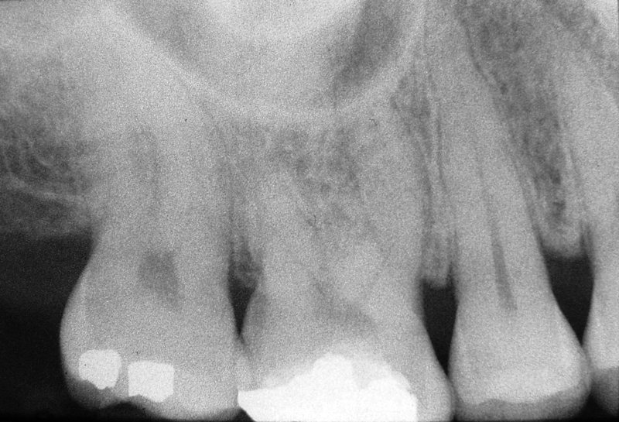

Slide 68
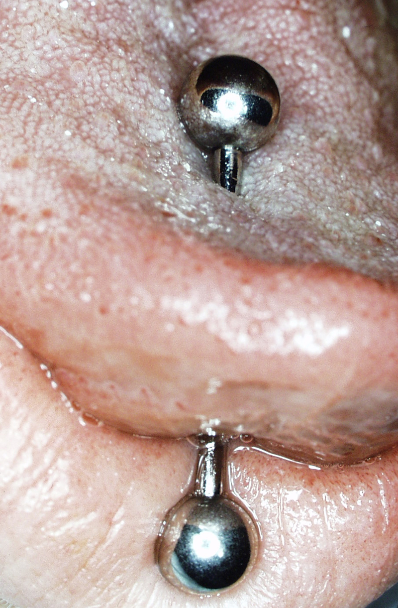

Slide 69
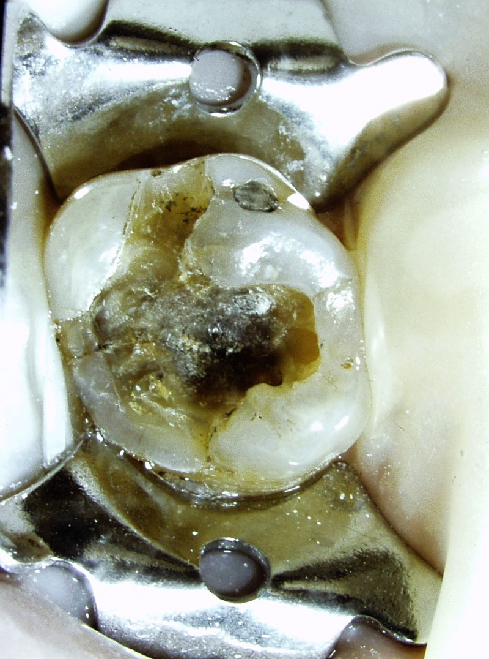

Slide 70


Slide 71



Slide 72




Slide 73

#15
Pulp Necrosis

Slide 74




Slide 75


Mesial Surface

Slide 76


Distal Surface

Slide 77
Cracked Teeth
  probing defects occur to the depth of the crack when it extends into the root structure
  radiographic examination may reveal horizontal, vertical or furcal defects

Slide 78


Slide 79


Slide 80

Mesial Surface

Slide 81

Distal Surface

Slide 82

Distal Surface

Slide 83
Polson AM. Periodontal destruction associated with vertical root fracture. Journal of Periodontology. 1977;48:27-32
  Demonstrated a relationship between vertical root fracture and
    Periodontal pocket formation
    Alveolar bone loss

Slide 84

August 2007

Slide 85

December 2007

Slide 86


Slide 87


Slide 88


Slide 89
Split Teeth
  evolves from the cracked tooth
  extends to a tooth surface in all areas
  the tooth segments are entirely separate and the fracture is easier to identify
  it is important to identify the extent and severity of the fracture before developing a treatment plan

Slide 90


Slide 91


Slide 92


Slide 93


Slide 94
Vertical Root Fracture

Slide 95
Etiology
  Volumetric expansion of posts
  Lateral condensation of gutta percha
  Cementation of posts
  Stress from occlusal forces
  Removal of tooth structure

Slide 96
Contributing Factors
  Embrittlement
      Loss of moisture
      Use of chelating agents
      Loss of internal architecture
  Overpreparation
      Endodontic treatment
      Post space preparation

Slide 97
Moisture Content
Helfer, et. al., Oral Surg 1972;34;661
  Evaluated the water content of pulpless teeth in dogs.
  The data demonstrated calcified tissues of pulpless teeth contained 9% less free moisture.
  No changes were noted in bound water

Slide 98
Moisture Content
Papa J. Cain C. Messer HH. Moisture content of vital vs endodontically treated teeth. Endodontics & Dental Traumatology. 1994;10:91-3
Compared the moisture content of vital and endodontically treated teeth in matched pairs of contralateral human.
  It was found that vital dentin had a moisture content of 12.35% while dentin from endodontically treated teeth had a moisture content of 12.10%. These results indicated that there was no significant difference in the moisture content between endodontically treated teeth and vital teeth.

Slide 99
Huang TJ. Schilder H. Nathanson D. Effects of moisture content and endodontic treatment on some mechanical properties of human dentin. Journal of Endodontics. 1992;18:209-15
Moisture Content
Compared the mechanical properties of human dentin from treated pulpless teeth and dentin from normal vital teeth. Compression, indirect tensile, and impact tests were conducted to measure the mechanical properties of those specimens.

Slide 100
Huang TJ. Schilder H. Nathanson D. Effects of moisture content and endodontic treatment on some mechanical properties of human dentin. Journal of Endodontics. 1992;18:209-15
  The measurements of impact-breaking energies of desiccated dentin were not found to be significantly decreased.
  The compressive and tensile strengths of dentin from treated pulpless teeth were not appear significantly different from those of normal dentin.
  The results do not support the theory that dehydration after endodontic treatment weakens the dentin structure in terms of compressive and tensile strengths.

Slide 101
Sedgley CM. Messer HH.: Are endodontically treated teeth more brittle? Journal of Endodontics. 1992;18:332-5
Moisture Content
Compared biomechanical properties (punch shear strength, toughness, hardness, and load to fracture) of 23 endodontically treated teeth (mean time since endodontic treatment 10 years) and their contralateral vital pairs.
  Results revealed no significant differences in punch shear strength, toughness, and load to fracture between the two groups.

Slide 102
Sedgley CM. Messer HH.: Journal of Endodontics. 1992;18:332-5
  Vital dentin was 3.5% harder than dentin from contralateral endodontically treated teeth.
  The similarity between the biomechanical properties of endodontically treated teeth and their contralateral vital pairs indicates that teeth do not become more brittle following endodontic treatment.
  Other factors may be more critical to failure of endodontically treated teeth.

Slide 103
Reeh ES. Messer HH. Douglas WH: Reduction in tooth stiffness as a result of endodontic and restorative procedures. Journal of Endodontics. 1989;15:512-6
  Compare the contributions of endodontic access procedures and restorative procedures on the loss of strength by using nondestructive occlusal loading on extracted intact, maxillary, second bicuspids.
  Results indicate that endodontic procedures have only a small effect on the tooth, reducing the relative stiffness by 5%. This was less than that of an occlusal cavity preparation (20%). The largest losses in stiffness were related to the loss of marginal ridge integrity.
  MOD cavity preparation resulted in an average of a 63% loss in relative cuspal stiffness.

Slide 104
Vertical Root Fracture
Diagnostic Aids:
  A good dental history
  Transillumination
  Exploration‑gingival retraction
  Periodontal probing
  Radiographic examination

Slide 105
Radiographic Examination
Rud and Omnell, Scand Journal of Dental Research, 1970;78:397
  Found that the fracture lines were evident radiographically only if the central beam was directed within four degrees of the fracture line

Slide 106
Diagnosis
Meister, et al., Diagnosis and possible causes of vertical root fractures. Oral Surg 49:243, 1980
Thirty-two cases
  Probable osseous defect 94%
  Diffuse widening of the PDL 75%
  Mild or dull discomfort 66%
  Periodontal abscess 28%
  Periapical pathosis 22%

Slide 107
Etiology
Meister, et al., Oral Surg 49:243, 1980
  84% were attributed to excessive force during lateral condensation of gutta percha.
  Fractures generally extend in a buccal-lingual direction.

Slide 108


Slide 109


Slide 110


Slide 111



Slide 112


Slide 114


Slide 115




Slide 116


Slide 117


Slide 118




Slide 119


Slide 120



Slide 121


Slide 122


Slide 123


Slide 124


Slide 125


Slide 126




Slide 127


Slide 128


Slide 129


Slide 130


Slide 131


Slide 132


Slide 133


Slide 134


Slide 135
Harvey et. al.,
Journal of Endodontics 7:151, 1981
Evaluated condensation forces in flared and unflared endodontic preparations using a photoelastic model
  Found stress was directly proportional to the force applied
  In unflared models, stress was concentrated at the tip of the spreader
  The flared models allowed the spreader to penetrate without binding and eliminated the concentration of stress permitting a more even distribution of force
  Condensation forces ranged from 1 to 3 kg

Slide 136
Pitts et. al., Journal of Endodontics 1983;9:544
Evaluated condensation forces in maxillary central incisors, maxillary canines, and mandibular canines
  Results indicated the minimum force required to fracture a central incisor with condensation pressure was 7.2 Kg.
  The authors noted 16% of the samples fractured at 10 Kg or less.
  Seventy-five percent of the specimens fractured in a facial-lingual direction

Slide 137
Pitts et al., Journal of Endodontics 1983;9:544
  A significant linear correlation exists between the fracture load and the load rate. As the load rate increased the force necessary to fracture the root decreased.

Slide 138
Holcomb, et. al. Journal of Endodontics 1987;13:277
Evaluated spreader loads required to cause vertical root fracture during lateral condensation of mandibular incisors
  A spreader load of 1.5 kg (3.2 lbs.) produced a fracture
  Thirteen percent of the specimens fractured at a load of 3.5 kg (7.7 lbs.) or less. There was a significant linear correlation between fracture load and root width, canal width, canal taper, ratio of canal width to total root width, and number of accessory cones placed.

Slide 139
Holcomb, et. al. Journal of Endodontics 1987;13:277
  All specimens fractured in a facial-lingual dimension.
  In 87% of the specimens fractures were found to extend tangentially from the canal when viewed in cross section. The fractures were often observed at the interface of the transparent and opaque dentin.

Slide 140
Dang and Walton, Journal of Endodontics 1989;15:294
Evaluated root distortion created during lateral condensation of gutta percha in single rooted teeth with either a D-11 spreader or a B-finger spreader
  The incidence of fractures created during obturation was low regardless of the spreader type.
  Distortion of the root was significantly greater with the more tapered D-11.
  Only the D-11 spreader produced vertical root fractures.

Slide 141
Walton, Journal of Endodontics 1984;10:48
  Found the fractures were usually complete
  Irritants identified were
    Bacteria
    Necrotic Tissue
    Debris
  The PDL reaction was one of inflammation

Slide 142
Wilcox LR. Roskelley C. Sutton T. The relationship of root canal enlargement to finger-spreader induced vertical root fracture. Journal of Endodontics 1997; 23:533-4
Evaluated the effect of lateral condensation forces on the development of vertical root fracture (VRF) in endodontically treated maxillary anterior teeth. The teeth were prepared with the step-back method so that the canal width was 20% of the total root width. Obturation was accomplished using a fine finger spreader and a static force of 3.3 kg for 15 seconds. The teeth were examined by transillumination for VRF.

Slide 143
Wilcox LR. Roskelley C. Sutton T. The relationship of root canal enlargement to finger-spreader induced vertical root fracture. Journal of Endodontics 1997; 23:533-4
Teeth not exhibiting VRF were tested further after gutta percha removal and canal enlargement of 30%, 40%, and 50%.
  No VRF occurred at 20% or 30%;
  5 teeth fractured at 40% and 7 at 50%.
  These teeth had root surface craze lines that developed during testing. Craze lines had also developed in all 17 of the remaining unfractured samples.
  No VRF occurred after testing unless craze lines were previously present.

Slide 144
Abuzeid ST. Et.al., Egyptian Dental Journal 1995;14:1367-72
Forty freshly single rooted teeth were prepared by modified step-back technique with K-flex files to size 35 at the apex. The Roots were divided into two groups:
  Group I, dentin and cementum thickness from 1.5-2.0 mm, and Group II, dentin and cementum thickness 1 mm.
  The results showed that Group I with 1.5-2.0 mm dentin thickness required greater force to fracture in all experimental groups, than that of Group II with 1 mm dentin thickness.
The amount of remaining dentin thickness significantly affected the resistance to fracture of the prepared roots.

Slide 145
Repair of Vertical Root Fractures
Michanowicz et al., Journal of the American Dental Association, 1971
  Found no evidence of repair in vertical root fractures.

Slide 146
Biologic Width
Ingber, Ross, and Coslet, Alpha Omegan 1977:70:62
  0.97 mm of junctional epithelium
  1.07 mm of connective tissue attachment
  1.0 mm for the margin

Slide 147
Root Resection
Erpenstein H. A 3-year study of hemisectioned molars. Journal of Clinical Periodontology 1983;10:1-10
  Over a period of 1-7 (average 2.9) years, 34 hemisectioned molars were examined clinically and radiographically. Mainly mandibular molars were treated (27). Root resections were carried out on only 7 maxillary molars, 22 of the treated teeth were used as distal abutments for small fixed bridges. The remaining treated teeth were crowned.
  Of the 34 treated molars, 7 were considered failures, 6 for endodontic reasons (apical periodontitis) and only 1 for periodontal reasons.

Slide 148
Root Resection
Langer, et al., Journal of Periodontology 1981;52:719
  Evaluated 100 cases of root resections at ten years. There were 38 failures.
    84% of the failures occurred after five years.
    47% of the failures were attributed to fracture of the remaining root or roots

Slide 149
Root Resection
Buhler, Journal of Periodontology 1988;59:805
  Evaluated 28 cases of root resections at ten years. There was a 32% failure rate.
      There was one root fracture
      Two failures were periodontal
      Two failures were attributed to endodontic-periodontic lesions
      Three failures were attributed to endodontics
      One failure was related to loss of retention

Slide 150
Root Resection
Basten CH. Ammons WF Jr. Persson R. Long-term evaluation of root-resected molars: a retrospective study. International Journal of Periodontics & Restorative Dentistry 1996;16:206-19
  Thirty-two consecutively treated patients were included in this study of 49 root-resected molars that were under regular recall of 3 to 6 months for a mean of 11.5 years (2 to 23 years).
  Treatment modalities for all patients were similar. Endodontic treatment was performed prior to resection

Slide 151
Basten CH. Ammons WF Jr. Persson R. Long-term evaluation of root-resected molars: a retrospective study. International Journal of Periodontics &
Restorative Dentistry 1996;16:206-19
  No threaded posts were used. Provisional restorations were in place prior to periodontal therapy (pocket reduction with or without osseous surgery). Most patients were treated with complete-mouth reconstruction.
  Ninety-two percent of all resected molars survived an average of 12 years. Teeth failed because of recurrent caries or for endodontic and strategic reasons.
  If proper treatment is rendered periodontally involved molars can be maintained for a long period of time and serve successfully as abutments in complete-mouth restorations.

Slide 152
Yang SF. et.al., Vertical root fracture in nonendodontically treated teeth. Journal of Endodontics 1995;21:337-9
This study describes 11 Chinese patients with 12 molars that developed vertical root fractures without endodontic or post procedures. Fractured teeth showed a consistent pattern.
  The majority were severely attrited mandibular molars in males.
  All had clinically intact crowns with no or minimal restorations.

Slide 153
Yeh CJ. Fatigue root fracture: a spontaneous root fracture in non-endodontically treated teeth.
British Dental Journal. 1997;182:261-6
46 cases of root fracture occurring in 51 non-endodontically treated teeth were studied.
  All of the patients had chewing habits which induced a unique root fracture. The results of this study suggest an additional cause of root fracture that has not been described previously. The term 'fatigue root fracture' describes a fracture that results from an excessive, repetitive, heavy masticatory stress applied to a tooth.
  The majority (80%) of cases of this kind of fracture are vertical and occur mainly (96%) in persons over the age of 40. In addition, all the teeth affected were posterior teeth, and the majority (51%) were mandibular first molars.

Slide 154


Slide 155


Slide 156


Slide 157


Slide 158


Slide 159


Slide 160



Slide 161



Slide 162


Slide 163


Slide 164



Slide 165
Nicopoulou-Karayianni K. Bragger U. Lang NP. Patterns of periodontal destruction associated with incomplete root fractures. Dento-Maxillo-Facial Radiology 1997;26:321-6
Evaluated the differential radiographic diagnostics of teeth with incomplete root fracture without displacement of the fractured fragments to a vertical periodontal defect, a periodontal-endodontic lesion and an endodontic-periapical lesion.
  Teeth with root fractures demonstrated smaller mean probing pocket depths than those with either periodontal or periodontal-endodontic lesions. Radiographic bone loss was significantly greater in teeth with periodontal and periodontal-endodontic lesions when compared with those with fractures.

Slide 166
Nicopoulou-Karayianni K. Bragger U. Lang NP. Patterns of periodontal destruction associated with incomplete root fractures. Dento-Maxillo-Facial Radiology 1997;26:321-6
Eighty-six percent of the teeth with fractures had a complete root canal filling. Posts were present in twenty-three of the fractured teeth and in thirteen percent of those with an endodontic periapical lesion. Ninety-one percent of the teeth with vertical fractures were crowned or fixed-bridge abutments. Only five percent of the fractured teeth had no evidence of periapical bone changes. Incomplete root fractures mainly involve teeth which have undergone successful endodontic treatment. An isolated pocket on one aspect of a suspected tooth is reliably diagnostic for a root fracture.

Slide 167
Selden HS. Repair of incomplete vertical root fractures in endodontically treated teeth--in vivo trials.
Journal of Endodontics 1996;22:426-9
Evaluated the healing of incomplete vertical root fractures following repair. The two-stage surgical procedure incorporated ultrasonic fracture cleaning, bonding of the fracture repair with silver glass-ionomer cement, placement of a bone graft material, and application of guided-tissue regeneration.
  Of the six roots in the study, five failed within 2 to 11 months. One root continued to be symptom-free, without periodontal pocket formation for 1 year, but then failed because of extension of the incomplete root fracture to the lingual of the root.

Slide 168
Joseph J. Ramachandran G. Fracture resistance of dowel channel preparations with various dentin thickness. Federation of Operative Dentistry 1990;1:32-5
  This study found that more than 1 mm thickness of labial dentin wall of post channel is required to prevent root fracture under horizontally directed force and an addition of 2 mm collar in the core around the root enhanced the resistance to root fracture.
  It was also found that adequate post diameter should be present to prevent dowel failure due to bending under force.

Slide 169
Morfis AS. Vertical root fractures. Oral Surgery, Oral Medicine, Oral Pathology 1990;69:631-5
This study reviewed 303 patients with 460 single or multirooted endodontically treated teeth restored with or without post and full cast crown coverage after treatment. The teeth were functioning for at least 3 years, without having received any other type treatment.
  3.69% of the teeth had had vertical root fracture. Computer analysis revealed a significant correlation between vertical root fracture and the technique of instrumentation and obturation of the canal, the length of the post, and the existence of the post.

Slide 170
Obermayr G. Walton RE. Leary JM. Krell KV. Vertical root fracture and relative deformation during obturation and post cementation. Journal of Prosthetic Dentistry. 1991;66:181-7
Compared the amount of strain to the root that occurs during obturation and post cementation and the incidence of incomplete and complete vertical root fractures occurring during the aforementioned procedures.
  Data showed significantly more relative deformation with placement of a post and loading than with obturation alone. The accumulation of strain from both procedures did not significantly increase incidence of vertical root fractures.
  The results indicate that stresses from cementation of posts is more likely to cause relative deformation of roots.

Slide 171
Morando G. Leupold RJ. Meiers JC. Measurement of hydrostatic pressures during simulated post cementation. Journal of Prosthetic Dentistry. 1995;74:586-90
Cast post and cores were fabricated and cemented with three different luting agents: resinous cement, glass ionomer cement, and zinc phosphate cement. Mean hydrostatic pressures (psi) recorded during post cementation were recorded
    Zinc phosphate cement 22.67
    Resinous cement 19.77
    Glass ionomer cement 17.66
Zinc phosphate cement created substantially greater hydrostatic pressures than either the resinous or glass ionomer cements.

Slide 172
Barkhordar RA. Radke R. Abbasi J. Effect of metal collars on resistance of endodontically treated teeth to root fracture. Journal of Prosthetic Dentistry 1989;61:676-8
Fractures of restored pulpless teeth without reinforcement are a familiar dilemma to the dentist. This study examined the effect of a metal collar with approximate 3 degrees of taper on the resistance of endodontically treated roots to fracture.
  Teeth without copings failed at a load of 49.6 kg whereas teeth with metal collars failed at a load of 65.29 kg.

Slide 174
Tan L, Chen NN, Poon CY, Wong HB. SuTrvival of root filled cracked teeth in a tertiary institution. Int Endod J. 2006;39:886
Assessed the survival rate of fifty root filled cracked teeth over a 2-year period in a tertiary institute (National Dental Centre in Singapore)
Pre-treatment data collected were number, extent and location of crack, presence of periodontal pocketing, patients' age and gender, location of cracked teeth, type of teeth and presence of terminal cracked tooth.
Cracked teeth which were the terminal teeth in the dental arch teeth with pre-root filling periodontal pocketing and teeth with multiple cracks were more likely to be extracted.

Slide 175
Nagasiri R, Chitmongkolsuk S. Long-term survival of endodontically treated molars without crown coverage: a retrospective cohort study. J Prosthet Dent. 2005;93:164-70
This study evaluated the survival rate for endodontically treated molars without crown coverage in of 220 endodontically treated permanent molars. Tooth loss due to endodontic and periodontal problems were excluded.
Variables assessed were patient age, gender, location (maxilla or mandible), the existence of an opposing dentition and adjacent teeth, remaining tooth structure, and types of restorative material.
Overall survival rates of endodontically treated molars without crowns at 1, 2, and 5 years were 96%, 88%, and 36%, respectively. With greater amounts of coronal tooth structure remaining, the survival probability increased. Molar teeth with maximum tooth structure remaining after endodontic treatment had a survival rate of 78% at 5 years. Restorations with direct composite had a better survival rate than conventional amalgam and reinforced zinc oxide and eugenol with polymethacrylate restorations.

Slide 176
Roh BD and Lee YE. Analysis of 154 cases of teeth with cracks. Dent Traumatol.
2006;22:118-23
This study is to analyzed tooth cracks in terms of the classification of cavity and restorative material, the nature of opposing tooth, the location in the arch, the age and gender, and the clinical signs and symptoms, and treatment result at one year.
Cracked teeth were observed most frequently in the teeth with no restorations (60.4%) and with class I restorations (29.2%).
The most prevalent age was in those over 40 years of age (31.2% in their 40s, 26.6% in their 50s) and the prevalence was similar in men (53.9%) and women (46.1%).
Cracked teeth were found most frequently in the maxillary molars (33.8% in first molar, 23.4% in second molar) than in the mandibular molars (20.1% in first molar, 16.2% in second molar). 96.1% of the cracked teeth responded to the bite test, and 81.1% of the cracked teeth were observed in the mesiodistal direction.

Slide 177
Ratcliff S, Becker IM, Quinn L. Type and incidence of cracks in posterior teeth. J Prosthet Den. 2001;86:168-72
This study characterized the type and incidence of cracks in posterior teeth and identified possible etiologic factors in a observational cross-sectional survey of 51 patients from a private practice examined during an 18-month period.
Variables such as the presence of a Class I or II restoration and the presence of excursive interferences were shown to significantly increase the chances of a crack being present. Combinations of variables, such as interferences and a restoration, also increased the chance of a crack being present.
Age played a role in the presence of stained or symptomatic cracks, which suggests that cracks have chronicity. Although many questions remain regarding prevention, it is evident that protecting teeth from excursive interferences and parafunction may thwart premature breakdown.

Slide 178
Chadwick, BL, Groves, G, Dransfield, K. Orofacial piercings: perceptions of dental practitioners and piercing parlours. Prim Dent Care 2005;12:83-8
Identified the advice given by 19 piercing parlours prior to orofacial piercing and determined how many dental practitioners see complications from orofacial piercings.
Ninety-nine per cent south-east Wales had treated patients with orofacial piercings, over three-quarters had seen a patient for a complication caused by the piercing, and over half had treated a patient for a complication of piercing. Almost all practitioners wanted more information on orofacial piercing and its sequelae.
Tongue and lip piercings were most frequently seen and the most commonly occurring complication was fractured or cracked teeth.
All 19 piercing parlours in south-east Wales warned clients about pain following piercing and 18 mentioned swelling; only four discussed possible damage to teeth and none discussed the risk of airway obstruction

Slide 179
Kahler B, Moule A, Stenzel D. Bacterial contamination of cracks in symptomatic vital teeth. Aust Endod J 2000;26:115-8
Studied teeth exhibiting symptoms consistent with the presence of dentinal cracks.
All the cracked cusps exhibited complete fracture of the dentine to the level of the dentino-enamel junction. Numerous bacteria of many morphological forms were present on the dentinal surfaces, of all fractured cusps, in all teeth. Cocci, bacilli and filamentous forms were consistently found.
All symptomatic cracks in teeth appear to extend right through the dentine to the dentino-enamel junction, and appear to be extensively contaminated by bacteria.

Slide 180
Geurtsen W, García-Godoy F. Bonded restorations for the prevention and treatment of the cracked-tooth syndrome. Am J Dent 1999;12:266-70
Besides full cuspal coverage by partial or full crowns, bonded restorations have been proposed for internal splinting of teeth.
Although contradictory data have been published, there is evidence that bonded amalgam or resin-based composite restorations (RBC) do not increase fracture resistance of teeth with wide occlusal-proximal cavities to values similar to sound, unrestored controls.
Indirectly fabricated RBC inlays and various ceramic inlays, however, increased fracture strength to levels as high as those of sound caries-free teeth.
Therefore, it is recommended that weakened teeth with wide cavities be strengthened by full cuspal coverage with cast or ceramic restorations, by bonded ceramic inlays, or by indirectly-fabricated bonded RBC composite inlays.

Slide 181
Davis R, Overton JD. Efficacy of bonded and nonbonded amalgam in the treatment of teeth with incomplete fractures. J Am Dent Assoc 2000;131:469-78
Compared the efficacy of adhesive-retained vs. pin-retained complex amalgam restorations in the treatment of 40 molars with incomplete fractures by evaluating relief of chewing pain and cold sensitivity at two weeks, three months and one year.
Twenty teeth received bonded amalgam restorations and twenty teeth received amalgapins or threaded pins to retain the amalgam. Teeth were evaluated for postoperative chewing sensitivity.
Chewing pain was completely eliminated in all but one tooth. A Student's t-test found no significant difference in preoperative cold sensitivity between the bonded and nonbonded groups. A paired t-test comparison indicated that the teeth in the bonded group were significantly less sensitive to cold after three months and 12 months than they were at the time of the baseline measurements (P < .0001). A paired t-test indicated no significant difference between preoperative and postoperative cold sensitivity scores for teeth in the nonbonded group (P > .05).
CLINICAL IMPLICATIONS: Incomplete tooth fracture in molars can be successfully treated by covering fractured cusps with amalgam restorations.

Slide 182
Bader JD, Shugars, DA, Roberson, TM. Using crowns to prevent tooth fracture. Community Dent Oral Epidemiol 1996;24:47-51
The Authors describe two studies about dentists' use of crowns to prevent tooth fracture. North Carolina general dentists indicated that 44% of the crowns they placed were for the principal reason of fracture prevention. However, when groups of dentists examined the same patients, there was little agreement about which teeth should be crowned due to risk of fracture.

Slide 183
Bader JD, Shugars, DA, Martin JA. Risk indicators for posterior tooth fracture. J Am Dent Assoc 2005 ;136:18
The authors evaluated 39 potential risk indicators identified in previous uncontrolled studies for an association with fracture in 200 patients with fractures and 252 patients without fractures.
The presence of a fracture line and an increase in the proportion of the volume of the natural tooth crown occupied by the restoration substantially increased the odds of fracture (P < .001).
Neither clenching, grinding and biting hard objects nor occlusal characteristics such as guidance, cusp anatomy and general wear patterns were strong predictors of fracture risk.

Slide 184
Abbott, P. Assessing restored teeth with pulp and periapical diseases for the presence of cracks, caries and marginal breakdown. Aust Dent J 2004;49:33-9
Studied whether clinical examinations and periapical radiographs provide sufficient information to assess the cause of pulp and periapical diseases, the status of teeth when restored and their further treatment needs in 245 restored teeth. Teeth were examined before and after the restorations were removed and the findings were compared.
Pre-operative examination revealed 19.2 per cent of the teeth had caries, 23.3 per cent had cracks and 39.2 per cent had marginal breakdown.
After restoration removal, 86.1 per cent had caries, 60 per centhad cracks, and 99.6 per centhad marginal breakdown. Ninety-three per cent had more than one of these factors.
Periapical radiographs were unreliable indicators of their presence. There was only a 56% chance of finding caries, cracks or marginal breakdown prior to restoration removal.
CONCLUSIONS: All restorations should be removed prior to endodontic treatment in order to remove the common factors that may have caused the pulp and periapical disease, and to assess the tooth's prognosis and future treatment needs.

Slide 185
Eakle, WS, Maxwell EH, Braley BV. Fractures of posterior teeth in adults. J Am Dent Assoc 1986 ;112:215-8
Examined patients with 206 complete or incomplete fractures of posterior teeth. The patients ranged in age from 14 to 76 years, with 66.5% younger than 40 years.
The number of fractures occurring in each arch was almost equal.
The mandibular first molar was the most frequently fractured posterior tooth. The lingual cusps of mandibular molars fractured more often than did the buccal cusps of mandibular molars by a ratio of 2 to 1.
In maxillary molars, buccal and lingual cusps fractured with almost equal frequency, but, in maxillary premolars, the lingual cusps fractured slightly more often than buccal cusps.
Data gathered on the widths of the isthmuses of restorations in 109 teeth showed that fewer fractures occurred in teeth with more conservative restorations, with widths of isthmuses a quarter of the inter-cusp distance, and intact marginal ridges.

Slide 186
Gibbs CH, et al. Maximum clenching force of patients with moderate loss of posterior tooth support: a pilot study. J Prosthet Dent 2002;88:498-502
The purpose of this study was to test the hypothesis that moderate loss of posterior tooth support will have a significant effect on maximum clenching force. The maximum clenching force of 44 adults, ages 28 to 76, with posterior tooth loss was compared with the maximum clenching force of a control group of 20 healthy full dentition adults, ages 18 to 55 using of a bilateral strain-gauged transducer.
For the 44 subjects with posterior tooth loss, the mean clenching force was 104 lbs, with a range of 22 to 232 lbs. compared with a mean of 162 lbs with a range of 55 to 280 lbs for the full-dentition subjects.
Clenching force was not well correlated with age.

Slide 187
Erhardson S, Sheikholeslam A, Forsberg CM, Lockowandt P. Vertical forces developed by the jaw elevator muscles during unilateral maximal clenching and their distribution on teeth and condyles. Swed Dent J 1993;17:23-34
The activity of the jaw elevator muscles (EMG) was recorded during maximal clenching in intercuspal position and unilaterally on 1st and 2nd molars, premolars, canines and central incisors in ten subjects with complete dentitions, normal occlusal relationships, and without signs and symptoms of craniomandibular disorders.
The results suggest that the magnitude of the muscle force is strongly associated with the localization of the biting point. Thus the greatest muscle force is produced during clenching in the intercuspal position (100%). At unilateral clenching 75% of this intercuspal position force is reached during rubber pad clenching on 2nd molars, 85% during rubber pad clenching on 1st molars and 45% during clenching on incisors. The calculations of the mathematical model showed then that highest bite force should be produced on 2nd molars and lowest on incisors (20%).

Slide 188
Hommez GM, Coppens CR, De Moor RJ. Periapical health related to the quality of coronal restorations and root fillings. Int Endod J 2002;35:680-9
Evaluated the impact of the quality of coronal restorations the quality of root fillings on periapical health in 745 root-filled teeth, randomly selected from patients attending the Ghent University Dental School.
Thirty-three percent of the teeth had apical periodontitis as diagnosed radiographically.
Teeth with good and poor coronal clinical restorations had apical periodontitis in 31.1 and 36.8%, respectively
The quality of the coronal restorations evaluated radiographically had a statistically significant influence on the periapical condition with apical periodontitis in 23.8% in acceptable and 49.1% for unacceptable restorations. Marginal decay did not influence the periapical status.
Teeth restored with a base under the coronal filling had significantly less apical periodontitis (25.9%) when compared to teeth without a base (41.3%)
Teeth with composite-restored teeth exhibited apical periodontitis in 40.5% of cases while amalgam-restored teeth had apical periodontitis in 28.4% of cases
Root-canal posts had no influence on periapical health.
The length and homogeneity of the root-canal fillings had a significant influence on the presence of apical periodontitis, as well as the quality of the coronal restoration scored radiographically

Slide 189
Van Nieuwenhuysen JP, D'Hoore W, Carvalho J, Qvist V. Long-term evaluation of extensive restorations in permanent teeth. J Dent 2003;31:395-405
This prospective, longitudinal study assessed the outcome of extensive posterior restorations and identified risk factors for failure of the restorations. The sample consisted of 722 amalgam restorations, 115 composite resin restorations and 89 crowns placed in 428 adults by one dentist from 1982 to 1999 in Belgium.
At the closure of the study 48% of the restorations were well functioning, 24% were lost to lack of follow-up, and 28% had failed.
The most frequent reasons for failure were fracture of restoration (8%), secondary caries (6%) and fracture of cusp (5%).
Failures were more often found in premolar teeth (34%) than in molars (27%) (P=0.05) and occurred in 28% of the amalgam restorations, 30% of the resin restorations and 24% of the crowns (P=0.55).
Kaplan-Meier median survival times were 12.8 years for amalgam restorations, 7.8 years for resin restorations, and more than 14.6 years for crowns, considering all retreatment as failures (P=0.002).
Within the limits of the study the data support the view that extensive amalgam restorations but not composite resin restorations can be used as an appropriate alternative to crowns, with due consideration to the longevity of the restorations.

Slide 190
Cohen S, Blanco L, Berman L. Vertical root fractures: clinical and radiographic diagnosis. J Am Dent Assoc. 2003 Apr;134(4):434-41
During a five-year period, the authors examined 36 patients who had VRFs.
Results revealed vertical root fractures occurred in two vital and 34 nonvital endodontically treated teeth.
Thirty-one of these 34 VRFs were caused by poorly designed dowels (too long, too wide or both) or inappropriate selection of the tooth as a bridge abutment; two VRFs were caused by a restoration that exerted lateral pressure on the axial walls of the preparation; and one VRF was caused by overzealous endodontic forces. The VRFs in the two vital teeth were in men who had a history of bruxism or clenching.

Slide 191
Kieser JA, Thomson WM, Koopu P,Quick AN. Oral piercing and oral trauma in a New Zealand sample. Dent Traumatol. 2005 Oct;21(5):254-7
This study investigated the periodontal and dental trauma resultant from tongue and lip piercings in 43 adult dental patients.
Of the 43 individuals who participated (93.0% females; mean age 21 years; age range 14-34 years) 76.7% had a tongue piercing, 34.9% had a lip piercing, and 11.6% had both.
Postpiercing complications were reported by 34.9%. Most of those with a labial piercing (80.0%) had 1+ labial site with gingival recession (GR), and almost one-third of those with a tongue piercing had at least one lingual site with GR. Age was a significant predictor of the prevalence of lingual recession, with the odds of having lingual recession increasing by 1.17 for every year older than 14. Age was the only significant predictor of the number of lingual sites with recession, but was not a predictor of the prevalence of labial recession or the number of affected sites.
There were no significant associations between piercings and abnormal toothwear or trauma. These findings suggest that oral piercings are associated with localized gingival recession, and that the providers of such procedures should ensure that, as part of the informed consent process, prospective patients are informed of the likelihood that their periodontal health may be compromised.

Slide 192
Campbell A, Moore A, Williams E, Stephens J, Tatakis, DN. Tongue piercing: impact of time and barbell stem length on lingual gingival recession and tooth chipping. J Periodontol 2002;73:289-97
The purpose of this study was to evaluate the effect of time (years of wear) and tongue barbell size (stem length) on gingival recession and tooth chipping in fifty-two adults (mean age 22). Subjects were grouped according to years of wear and barbell stem length.
No subject with a tongue piercing less than2 years exhibited lingual recession or tooth chipping. Lingual recession was found on mandibular central incisors in 50% of subjects wearing long barbells for 2 or more years.
Tooth chipping was found on molars and premolars in 47% of subjects with a tongue piercing for 4+ years.

Slide 193
Hammad M, Qualtrough A, Silikas N. Effect of new obturating materials on vertical root fracture resistance of endodontically treated teeth. J Endod 2007;33:732-6
Compared vertical forces at fracture of teeth obturated with different materials. Single-rooted teeth were divided into five groups shaped using ProTaper rotary files.
  The first group was a negative control.
  The second group was obturated with gutta percha and a zinc oxide sealer.
  The third group was obturated with EndoRez points and EndoRez sealer
  The fourth group was obturated with Resilon and RealSeal sealer.
  The fifth group was obturated with Guttaflow .
Roots were loaded with a spreader in a universal testing machine until fracture.
It was found that forces required for fracture were significantly higher in the Resilon and EndoRez groups.

Slide 194
Ebrahim AK, Wadachi R, Suda, HAccuracy of three different electronic apex locators in detecting simulated horizontal and vertical root fractures. Aust Endod J 2006;32:64-9
Evaluate the accuracy of three electronic apex locators: Root ZX, Foramatron D10 and Apex NRG, in the detection of simulated horizontal and vertical root fractures in 90 extracted intact, straight, single-rooted teeth.
In Groups A, B and C, an incomplete horizontal fracture 0.25 mm wide was simulated by preparing coronal, middle or apical portion of the root until half of the canal was exposed in the horizontal plane respectively.
In Groups D, E and F, an incomplete vertical root fracture 0.25 mm wide was simulated in the coronal, middle or apical portion of the root a longitudinal plane.
The teeth were embedded in 1% agar and the canals were irrigated with saline solution during electronic measurement. Detection of the simulated root fractures was established with a size 10 K-file.
In Groups A, B and C, there were no statistically significant differences between the three EALs. However, statistically significant differences were found among the EALs in Groups D, E and F.
The three EALs tested were accurate and acceptable clinical tools in the detection of horizontal root fractures. However, the three EALs were unreliable in detecting the position of vertical root fractures.

Slide 195
Tamse A, Kaffe I, Lustig J, Ganor Y, Fuss Z. Radiographic features of vertically fractured endodontically treated mesial roots of mandibular molars. Oral Surg Oral Med Oral Pathol Oral Radiol Endod 2006;101:797-802.
Evaluate the most frequent radiographic appearance of bony lesions around endodontically treated vertically fractured mesial roots of 49 mandibular molars.
The "halo" (36.7%) and "periodontal" (28.6%) type radiolucencies were the most typical appearances of periradicular areas around the mesial roots of mandibular molars with vertical root fractures. By itself, bifurcation radiolucency was statistically insignificant (6.1%), however in conjunction with other areas of radiolucency, it was significant (63.3%).
Defined but not corticated (57.2%) or diffuse (32.6%) borders were typical for vertically fractured mesial roots.
Amalgam dowel in the coronal part (1-2 mm) of the root was found in 67.3% of the vertically fractured roots

Slide 196
Lustig JP, Tamse A, Fuss Z. Pattern of bone resorption in vertically fractured, endodontically treated teeth. Oral Surg Oral Med Oral Pathol Oral Radiol Endod 2000;90:224-7
Evaluated the clinical pattern of alveolar bone resorption associated with vertically fractured, endodontically treated teeth in correlation to clinical symptoms in 66 maxillary premolars, 13 mandibular premolars, and 31 mesial roots of mandibular molars with vertical root fractures. Type and duration of symptoms were recorded and correlated to the pattern of bone resorption.
A V-shaped pattern osseous defect (dehiscence) was typical (91%) to the buccal plate rather than a U-shaped shallow, rounded, slow grade resorption in the palatal or lingual plate. Fenestration of the buccal plate was observed in 10 patients (9%).
A positive correlation between type of symptoms and amount of buccal bone resorption was found. The resorptive defect was always facing the fracture line.

Slide 197
Tamse A, Fuss Z, Lustig J, Kaplavi J. An evaluation of endodontically treated vertically fractured teeth. J Endo 1999:25:506-8.
Ninety-two vertically fractured endodontically treated teeth were evaluated clinically and radiographically.
The maxillary second premolars (27.2%) and mesial roots of the mandibular molars (24%) were the most fractured teeth.
In 67.4% of the teeth, a solitary buccal pocket was present;
In 34.8% a sinus tract appeared closer to the gingival margin than to the apical area.
A lateral radiolucency or a combination of lateral and periapical radiolucency was found in more than half of the cases.
General practitioners correctly diagnosed vertical root fracture in only one-third of the cases.

Slide 198
Lam PP, Palamara JE, Messer HH. Fracture strength of tooth roots following canal preparation by hand and rotary instrumentation. J Endo 2005;31:529-32
Studied fracture loads in tooth roots after canal preparation using different techniques. Mesiobuccal roots of 39 extracted mandibular molars were used.
Three groups each of 13 roots were prepared by stainless steel hand files (K-files), and two rotary nickel-titanium techniques (Lightspeed and Greater Taper files). After obturation, a vertical load was applied by means of a spreader inserted into the canal until fracture occurred.
The mean fracture load was 10.2 +/- 4.4 kg for K-files, 15.7 +/- 9.1 kg for Lightspeed and 13.2 +/- 6.1 kg for Greater Taper files, but differences were not statistically significant (p > 0.05).
Most fracture lines were incomplete fractures on the buccal surface, followed by proximal and compound fractures. Greater apical enlargement (Lightspeed) or increased canal taper (Greater Taper files) did not increase fracture susceptibility of tooth roots.

Slide 199
Tan PL, Aquilino SA, Gratton DG, Stanford CM, Tan SC, Johnson WT, Dawson D. In vitro fracture resistance of endodontically treated central incisors with varying ferrule heights and configurations. J Prosthet Dent 2005;93:331-6
Investigated the resistance to static loading of endodontically treated teeth with uniform and nonuniform ferrule configurations in fifty extracted intact maxillary human central incisorsassigned to five groups.
Crown, no root canal treatment (RCT), restored with a crown
Root canal treatment, crown, no dowel/core, restored with a crown
2.0 mm ferrule, cast dowel/core and crown
nonuniform ferrule (2 mm buccal and lingual, 0.5 mm proximal), cast dowel/core and crown
no ferrule, cast dowel/core and crown
Testing was conducted with a universal testing machine with the application of a static load, and the load (N) at failure was recorded.
Results indicated the lack of a ferrule produced a significantly lower mean fracture strength relative to all other groups.
The presence of a nonuniform ferrule resulted in a significant decrease in mean fracture strength when compared with the uniform 2-mm vertical ferrule, the group without RCT, and the RCT-treated tooth with a crown alone
The predominant mode of failure was an oblique fracture extending from the lingual margin to the facial surface just below the insertion of the tooth into the acrylic resin. Central incisors restored with cast dowel/core and crowns with a 2-mm uniform ferrule were more fracture resistant compared to central incisors with nonuniform (0.5 to 2 mm) ferrule heights. Both the ferrule groups were more fracture resistant than the group that lacked a ferrule.

Slide 200
Teixeira FB, Teixeira EC, Thompson JY, Trope M. Fracture resistance of roots endodontically treated with a new resin filling material. J Am Dent Assoc. 2004 May;135(5):646-52
Evaluated the fracture resistance of endodontically treated teeth filled with either gutta-percha or a new resin-based obturation material.
Eighty single-canal extracted teeth were randomly assignedto five groups:
lateral and vertical condensation with gutta-percha,
lateral and vertical condensation with the new resin-based obturation material,
a control group with no filling material.
The groups with the resin based obturation material displayed higher mean fracture loads compared to the gutta-percha groups, however, the differences were not significant.
The groups with the resin based obturation material had higher mean fracture loads than gutta-percha groups independent of the filling technique used.

Slide 201
Wu MK, van der Sluis LW, Wesselink PR. Comparison of mandibular premolars and canines with respect to their resistance to vertical root fracture. J Dent. 2004 May;32(4):265-8
Compare the force required to vertically fracture uninstrumented and instrumented mandibular premolars and canines. The root canals of three of these groups (one from each category) were conventionally enlarged using same-sized instruments, while the other three groups were uninstrumented. The force required to cause vertical root fracture was measured using an Instron tester.
No significant difference in resistance to vertical root fracture was found between the round and oval canal premolars with (p = 0.9) or without (p = 0.6) instrumentation.
The average force required to fracture the uninstrumented premolars and canines was 698 and 566 N, respectively.
The average force required to fracture the instrumented premolars and canines was 490 and 554 N, respectively.
The force required to fracture the instrumented premolars and canines was 30% and 2% lower, respectively, than that required to fracture their uninstrumented counterparts.

Slide 202
Cohen S, Blanco L, Berman L. Vertical root fractures: clinical and radiographic diagnosis. J Am Dent Assoc. 2003 134:434-41
During a five-year period, the authors examined 36 patients who had vertical root fractures .
The study revealed vertical root fractures in 36 teeth, two of which were vital and 34 of which were endodontically treated. The 34 vertical root fractures resulted from excessive operative procedures performed in the root canal after endodontic treatment.
Thirty-one of the 34 vertical root fractures were caused by poorly designed dowels (too long, too wide or both) or inappropriate selection of the tooth as a bridge abutment two
Two vertical root fractures were caused by a restoration that exerted lateral pressure on the axial walls of the preparation
One Vertical root fracture was caused by overzealous endodontic forces
The Vertical root fractures in the two vital teeth were in men who had a history of bruxism or clenching.

Slide 203
Lertchirakarn V, Timyam A, Messer HH. Effects of root canal sealers on vertical root fracture resistance of endodontically treated teeth. J Endo 2002;28:217-9
Compare vertical forces at fracture of endodontically treated mandibular incisors obturated with different types of root canal sealer. Four groups of 10 teeth each were tested:
Group 1 served as positive and negative controls (five teeth each)
Groups 2, 3, and 4 were obturated by lateral condensation with gutta-percha and AH Plus, Tubliseal, or Ketac-Endo
All teeth were loaded vertically using a plugger tip inserted into the canal space until fracture occurred
Force at fracture of roots obturated with Ketac-Endo was significantly higher than those obturated with AH Plus and Tubliseal. Most fracture lines were in a buccolingual direction.

Slide 204
Llena-Puy, MC et al. Vertical root fracture in endodontically treated teeth: a review of 25 cases. Oral Surg Oral Med Oral Pathol Oral Radiol Endod 2001;92:553-5.
Examine the clinical conditions under which 25 endodontically treated teeth underwent vertical root fracture and to relate this condition to the time elapsed from endodontic treatment to fracture.
The mean time to vertical root fracture was 54 months; this was not significantly influenced by the presence or absence of prior restoration or by the presence or absence of a crown fitting.
The use of a prefabricated, cylindrical, cemented intraradicular retainer increased the time between endodontics and vertical root fracture.
Teeth restored with conventional amalgam took significantly longer to undergo vertical root fracture than those restored with composite or bonded amalgam, however, amalgam restored teeth suffered more coronal fractures before vertical root fracture than did teeth in the other 2 groups.

Slide 205
Chan CP, Lin CP, Tseng SC, Jeng JH. Vertical root fracture in endodontically versus nonendodontically treated teeth: a survey of 315 cases in Chinese patients. Oral Surg Oral Med Oral Pathol Oral Radiol Endod 1999;87:504-7
Compare endodontically versus nonendodontically treated teeth with respect to clinical features, including patient age and gender and tooth types of vertical root fractures in 315 consecutive cases of vertical root fracture.
Most patients (87%) had 1 fractured tooth; the others had 2 or 3 fractured teeth. Of all vertical root fractures, 40% occurred in nonendodontically treated teeth. In comparison with those in endodontically treated teeth, vertical root fractures in nonendodontically treated teeth tended to occur in patients with a higher mean age (55 years vs. 51 years) and were more frequent in male patients (78% vs. 58%).
Vertical root fractures occurred in nonendodontically treated teeth more often in molars (84% vs. 53%), less often in premolars (16% vs. 33%), and seldom in anteriors (1 tooth vs. 27 teeth).

Slide 206
Youssefzadeh S, Gahleitner A, Dorffner R, Bernhart T, Kainberger FM. Dental vertical root fractures: value of CT in detection. Radiology 1999;210:545-9
Determine the value of computed tomography (CT) in the diagnosis of vertical root fractures relative to the value of conventional dental radiography in thirty-seven patients with 42 teeth in which vertical root fracture was clinically suspected. Two radiologists evaluated the images independently and by consensus for a fracture line.
Twenty-eight of the 42 teeth were proved intraoperatively to be fractured. The sensitivity and specificity averaged for the two reviewers in the assessment of vertical fractures with dental radiography were 23% and 70%, respectively, and with CT 100% and 100%.
Consensus reading showed sensitivities of 25% for dental radiography and 75% for CT.
Eight (reviewer A) or nine (reviewer B) false-negative CT findings were encountered in cases in which metallic artifacts obscured parts of the root and in cases in which the root was very small in diameter. Interobserver agreement was 95% for dental radiography and 93% for CT.

Slide 207
Sirimai S, Riis DN, Morgano SM. An in vitro study of the fracture resistance and the incidence of vertical root fracture of pulpless teeth restored with six post-and-coresystems. J Prosthet Dent 1999;81:262-9
Compared the resistance to vertical root fracture of extracted teeth treated with post-core systems that were modified with polyethylene woven fibers (Ribbond) with those treated with conventional post-and-core systems in 60 maxillary central incisors.
The coronal portion of each tooth was amputated, and 6 post-and-core systems were studied. Loads were applied at an angle of 130 degrees and measured with a universal testing machine.
Cast posts and cores resulted in significantly higher failure thresholds than all others, except for prefabricated, comparably sized, parallel-sided posts with composite cores. All failures in the group with cast posts involved fracture of the teeth, whereas 70% of the teeth with comparably sized parallel-sided posts and composite cores failed as a result of tooth fractures and 30% experienced core fractures. The woven fiber post-core system was significantly lower in strength than all others, and exhibited significantly fewer vertical root fractures.
Polyethylene woven fiber and composite resin without a prefabricated post resulted in significantly fewer vertical root fractures, but mean failure load was the lowest. Smaller diameter prefabricated posts combined with the polyethylene woven fiber and composite cores improved resistance to failure. Traditional cast posts and cores were the strongest of the 6 post-core systems.

Slide 208
Chan CP, Tseng SC, Lin CP, Huang CC, Tsai TP, Chen CC. Vertical root fracture in nonendodontically treated teeth--a clinical report of 64 cases in Chinese patients. J Endo 1998;24:678-81
Vertical root fractures in teeth without endodontic treatment are uncommon. A clinical study was done on 64 cases of VRFs in 61 Chinese patients to define better the clinical characteristics, diagnostic signs, and possible causes.
Results showed that fractures occurred most often in first molars of patients between 40 and 69 yr of age, and the incidence was two times higher in males than in females. Flat roots with smaller mesiodistal diameters were more prone to fracture. The majority (79%) of patients had intact dentition with less than four teeth missing.
Fractured teeth were frequently attrited with no restorations. Vertical root fractures may result from excessive or repetitive masticatory force due to damaging chewing habits exerted on flat roots of smaller mesiodistal diameter. Nonendodontic VRFs seem to occur more frequently than earlier believed and may represent an underdiagnosed clinical entity deserving of our attention.

Slide 209
Joyce AP, Loushine RJ, West LA, Runyan DA, Cameron SM. Photoelastic comparison of stress induced by using stainless-steel versus nickel-titanium spreaders in vitro. J Endo 1998;24:714-5
Fabricated twenty photoelastic acrylic model to exhibit the stress produced during obturation of curved canals (32degrees) using the lateral condensation technique. The canals were fitted with a gutta-percha point, and either a stainless-steel or nickel-titanium finger spreader was inserted. An Instron 4502 universal testing machine applied a vertical force of 20 Newtons to the spreader. Quarter wave and polarizing filters were used with backlighting to generate the fringe patterns in the models.
Photographs of the resulting stress lines showed that the stainless-steel spreaders created three areas of concentrated stress. The nickel-titanium spreaders induced stress patterns spread out along the surface of the canals, thus reducing the concentration of stress and the potential for vertical root fracture.

Slide 210
Lertchirakarn V, Palamara JE, Messer HH. Load and strain during lateral condensation and vertical root fracture. J Endo 1999;25:99-104
Measured vertical loads and root surface strains in extracted teeth during lateral condensation using finger and hand spreaders
Six groups each of 10 teeth were tested: maxillary central incisor, premolar and molar; and mandibular incisor, premolar and molar. Root strains were measured using strain gauges mounted on the apical and middle third of the buccal root surface.
The maximum loads and strains generated by finger spreaders were significantly lower than those generated using a hand spreader (D11T). These loads and strains were also significantly lower than the values at fracture.
Most fracture lines were in a buccolingual direction, but maxillary premolars with two separate roots and the mesiobuccal root of maxillary molars showed more variation in fracture site. The results suggest that lateral condensation alone should not be a direct cause of vertical root fracture. The use of finger spreaders, however, is associated with lower risk.

Slide 211
Yang, SF et al. Vertical root fracture in nonendodontically treated teeth. J Endo 1995;21:337-9.
Described 11 Chinese patients with 12 molars that developed vertical root fractures without endodontic or post procedures. These showed characteristics of a true vertical root fracture as confirmed after extraction. Fractured teeth showed a consistent pattern. The majority were severely attrited mandibular molars in males. All had clinically intact crowns with no or minimal restorations.

Slide 212
Telli C, Gülkan P, Günel H. A critical reevaluation of stresses generated during vertical and lateral condensation of gutta-percha in the root canal. Endod Dent Traumatol 1994;10:1-10.
The finite element method was used to calculate the stresses in a maxillary canine tooth produced during lateral and vertical condensation. Description of the biological domain to be analyzed, and conversion of the manual operations of the endodontist to realistic load representation are intricate problems which must be overcome before stresses are recovered and plotted. The stresses in dentin are in general of comparable magnitudes during lateral or vertical condensation, but these magnitudes generally remain much below those presented in a previous study. From these calculations it appears that root fractures reported by some investigators may be explained in terms of stress concentrations and local irregularities of the samples tested.

Slide 213
Testori T, Badino M, Castagnola M. Vertical root fractures in endodontically treated teeth: a clinical survey of 36 cases. J Endo 1993;19:87-91
A clinical study was done on 36 original cases of vertical root fractures along with the data gathered from 32 cases published previously in the literature.
Vertical root fractures most frequently occur in posterior teeth in patients between 45 and 60 yr of age.
The average elapsed time between the endodontic treatment and the subsequent diagnosis of vertical fracture was found to be approximately 10 yr.
The evidence and symptoms most often found are mild pain in the area of the fractured tooth often accompanied by swelling and sinus tract, along with a deep pocket in just one area of the attachment surrounding the tooth.
The sign most often revealed by X-ray is a radiolucent periradicular band.

Slide 214
Sornkul E, Stannard JG. Strength of roots before and after endodontic treatment and restoration. J Endo 1992;18:440-3
The resistance to fracture of mandibular premolar roots before and after endodontic and restorative procedures was tested. Seven treatment groups were evaluated. A Universal testing machine was used to apply vertical and lateral (45-degree) forces.
Overall, the untreated roots showed the highest resistance to fracture. Factors of importance to prevent fracture were found to be (a) the amount of remaining tooth structure; (b) strength of post and core; and (c) bonding between core material and dentin. These factors suggest that a composite core following the use of EDTA to remove the smear layer may be a successful treatment when sufficient tooth structure remains.

Slide 215
Milot P, Stein RS. Root fracture in endodontically treated teeth related to post selection and crown design. J Prosthet Dent1992;68:428-35
Standardized plastic analogues simulating an endodontically treated maxillary central incisor root were used to investigate the resistance to root fracture in endodontically treated teeth.
Three different post and core systems were used:
  (1) cast post and core
  (2) Para-Post Plus post
  (3) Flexi-Post post.
The core build-up material selected in this study was Ketac Silver material, after which a crown preparation was made on each analogue. Two types of preparations were used: a wide chamfer margin (butt-joint) and a wide chamfer margin with a 1.0 mm circumferential bevel.
An overcasting was fabricated and was permanently cemented on each preparation. Assemblies were subjected to an increasing lingual oblique force until fracture occurred.
Beveled preparations with a concomitant final restoration provided a significant increased resistance to root fracture. Furthermore, vertical fracture occurred twice as often with nonbeveled preparations.

Slide 216
Murgel, CA and Walton RE. Vertical root fracture and dentin deformation in curved roots: the influence of spreader design. Endod Dent Traumatol 1990;6:273-8
The effect of lateral condensation using different tapered spreaders was evaluated in curved mesiobuccal roots of maxillary molars following step-back preparation. Strain gauges applied to the root surfaces measured dentin deformation during controlled lateral condensation with either fine finger or D11 spreaders.
After obturation, roots were cross sectioned and analyzed under the stereomicroscope to detect the presence and pattern of fractures. The results showed no statistical difference between spreader designs as to mean distortion and the incidence of fractures; however several specimens in the D11 group showed high root distortion measurements. When fractures occurred, there were no consistent patterns of fracture in either spreader group.

Slide 217
Tamse A, Fuss Z, Lustig J, Ganor Y, Kaffe I. Radiographic features of vertically fractured, endodontically treated maxillary premolars. Oral Surg Oral Med Oral Pathol Oral Radiol Endod 1999;88:348-52
Evaluate the most frequent radiographic appearance of bony lesions associated with vertically fractured roots of endodontically treated maxillary premolars.
The radiographic features of 102 endodontically treated teeth and their periradicular areas (51 with and 51 without vertically fractured roots) were compared.
The predominant appearance of the periradicular area in the teeth with vertically fractured roots was the "halo" lesion (57%); by contrast, in the non-vertically fractured roots group, a "periapical" radiolucent lesion was most frequently found (55%). Angular bone loss (14%) and periodontal radiolucency (14%) were also typical radiolucent lesions in the vertically fractured teeth.
The"Halo" lesion, perilateral radiolucency, and angular resorption of the crestal bone, combined with diffuse or defined but not corticated borders, indicated a high probability of vertical root fracture in maxillary premolars.

Slide 218
Lindauer PA, Campbell AD, Hicks ML, Pelleu GB. Vertical root fractures in curved roots under simulated clinical conditions. J Endo 1989;15:345-9
Determine the incidence of vertical root fractures in the mesial roots of 120 extracted human mandibular molars that were endodontically prepared by hand or ultrasonic instrumentation and obturated with laterally condensed gutta-percha and sealer using finger and hand spreaders.
Obturation was accomplished by laterally condensing gutta-percha and sealer with B-finger or D11T hand spreaders.
Teeth were obturated using forces in the range of 1 to 3 kg or 4.5 to 7.5 kg. Three teeth obturated with the D11T hand spreader using 7.0 to 7.3 kg of force demonstrated vertical root fractures.
The results suggest that in vitro the range of forces reported as most commonly used by endodontists to laterally condense gutta-percha (1.0 to 3.0 kg) and those of a higher magnitude up to 4.9 kg are safe and will not result in vertical root fractures of mesial roots of mandibular molars.

Slide 219
Morfis AS. Vertical root fractures. Oral Surg Oral Med Oral Pathol 1990;69:631-5
Clinically and radiographically reviewed 303 patients with 460 single or multirooted endodontically treated teeth.
3.69% of the teeth had had vertical root fracture. Computer analysis, simple correlation hypothesis, and distribution method with 1 degree of freedom revealed significant correlation between vertical root fracture and the technique of instrumentation and obturation of the canal, the length of the post, and the existence of the post.

