Slide 1

Periapical Healing
Hiran Perinpanayagam, DDS, MS, PhD
&
Eugene A. Pantera Jr., DDS, MS

Slide 2
Root Canal Treatment Objectives
The objective of RCT is to prevent &
treat periapical lesions of pulpal origin.
Normal Periapical Tissues:
  Prevent Apical Periodontitis
Pre-Existing Periapical Pathosis:
  Resolution of Inflammation & Healing
  Repair & Regeneration of Periradicular Tissues
What are the biological processes
involved in periapical healing?

Slide 3
Overview of the Presentation
Clinical Perspective
Presentation of Clinical Cases
Scientific Knowledge
Review the Scientific Literature
Review the Biological Processes
  Periapical Inflammation
  Resolution of Inflammation & Healing
Learning Objectives
Recognize the importance of periapical healing
Understand the biological processes involved
Identify factors which may influence healing

Slide 4
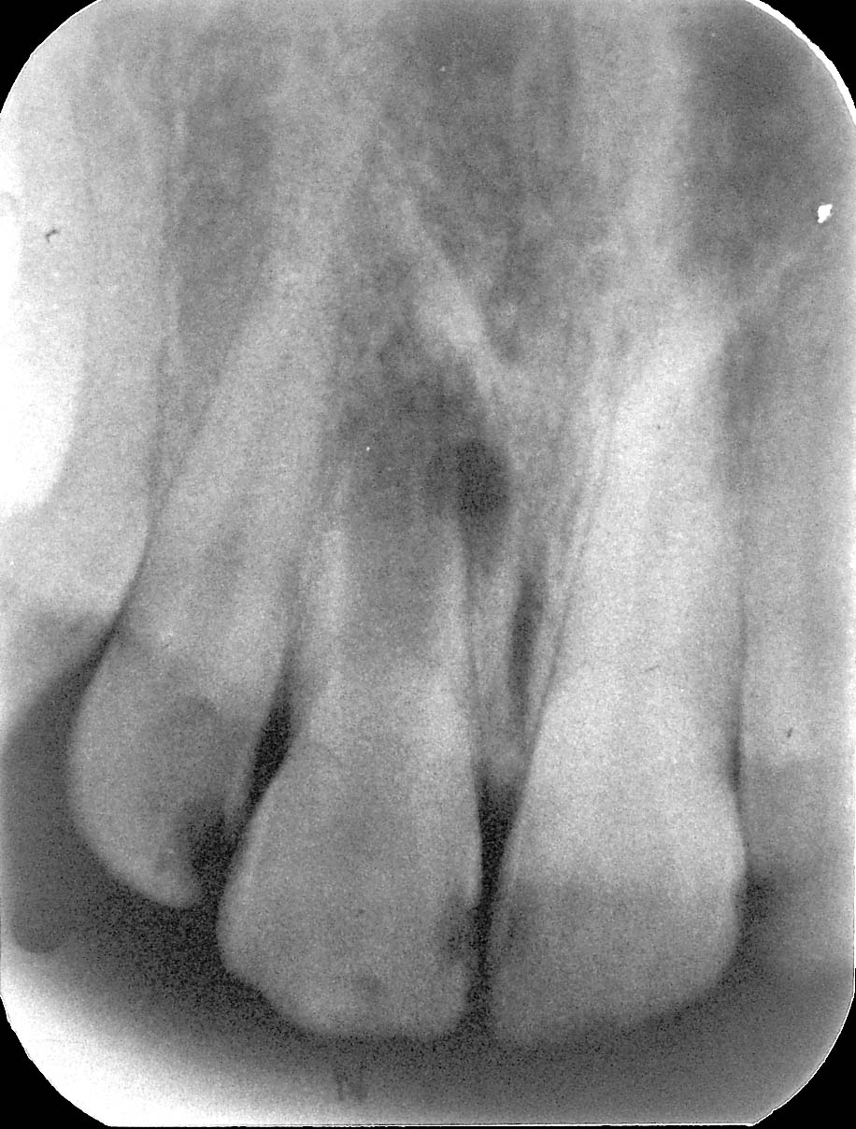
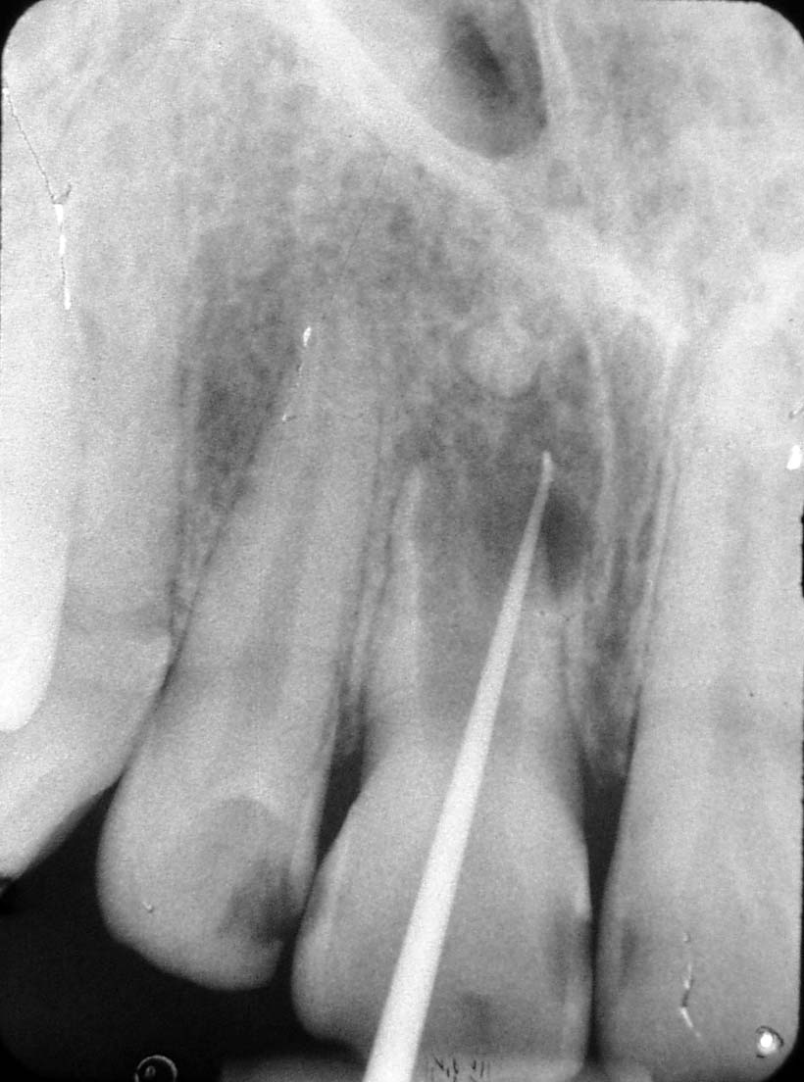
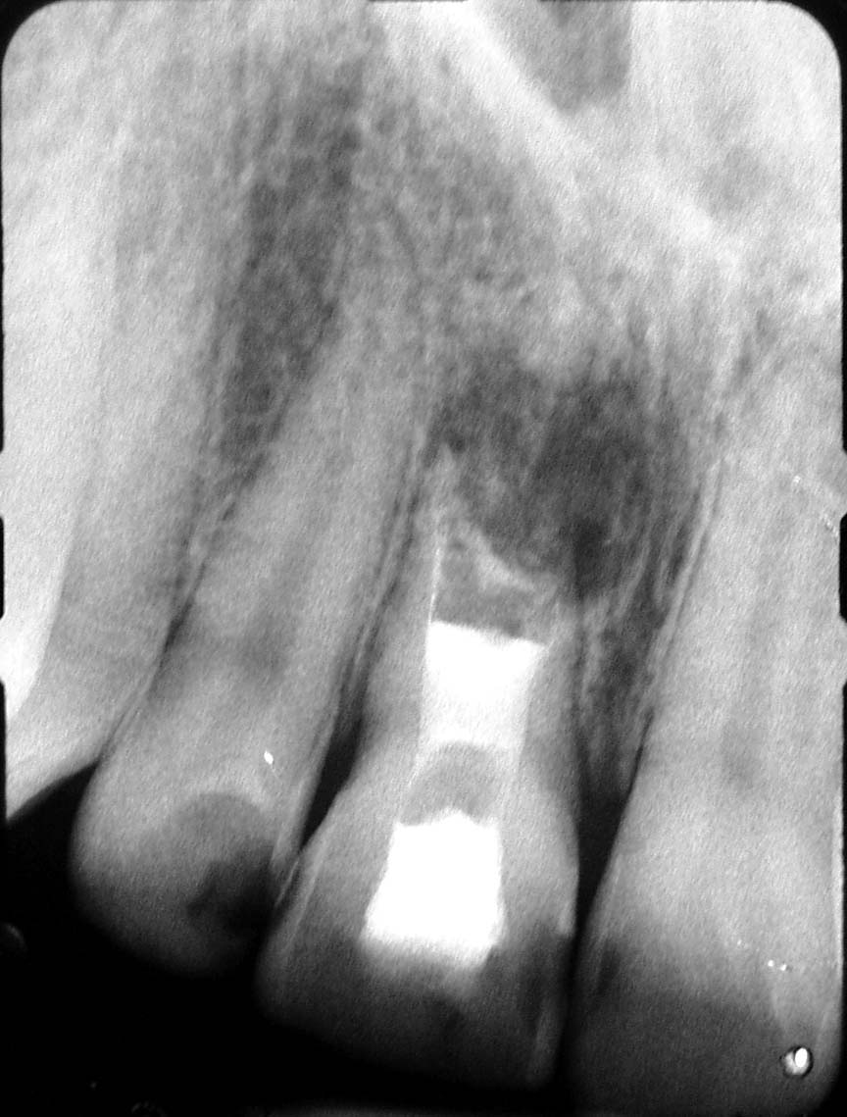
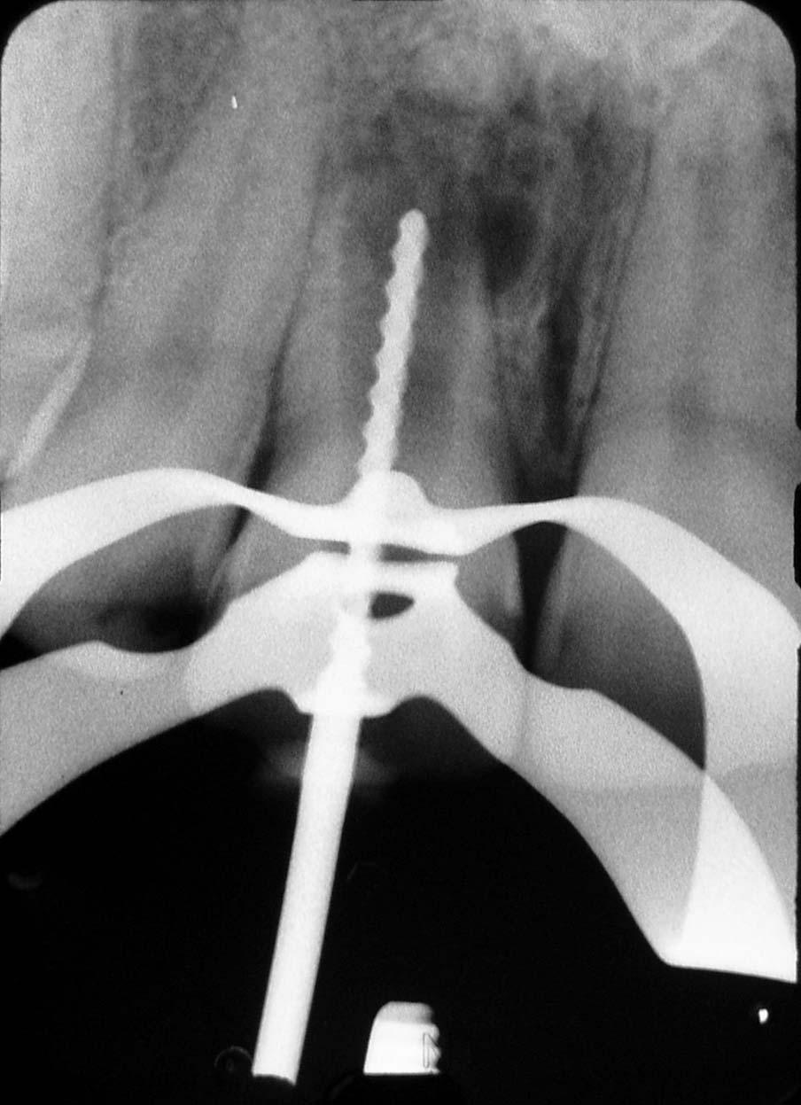
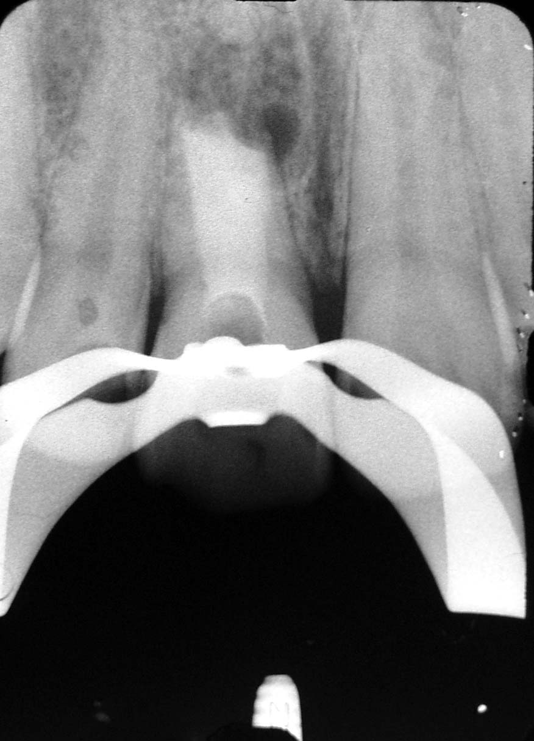
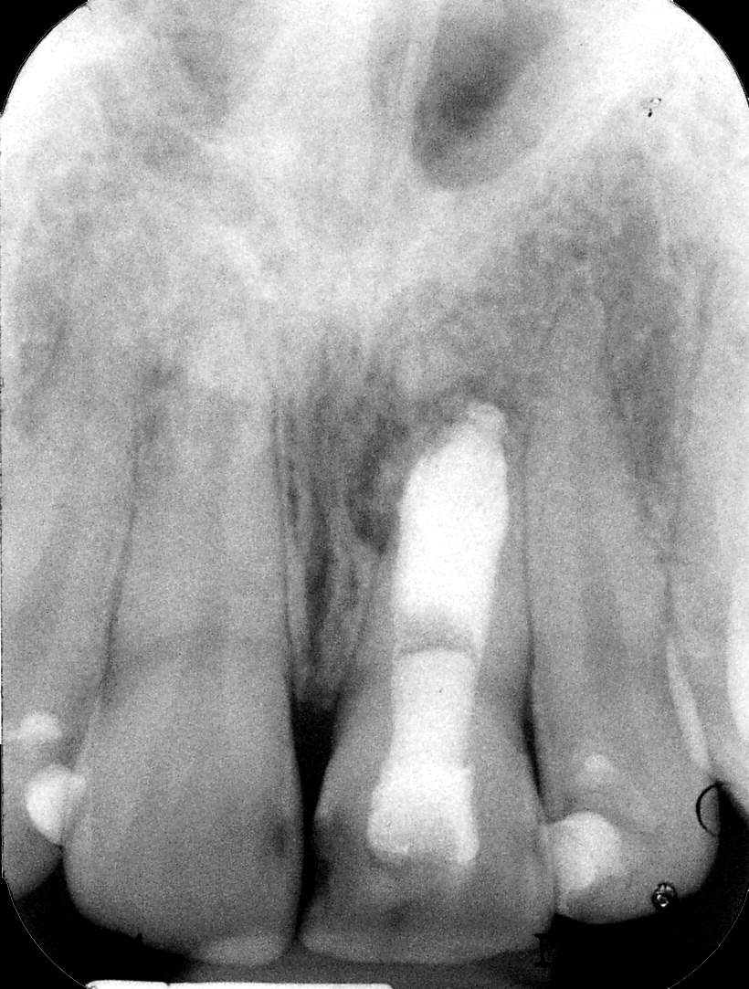
Avulsion 2yrs
1 yr
1 yr

Slide 5
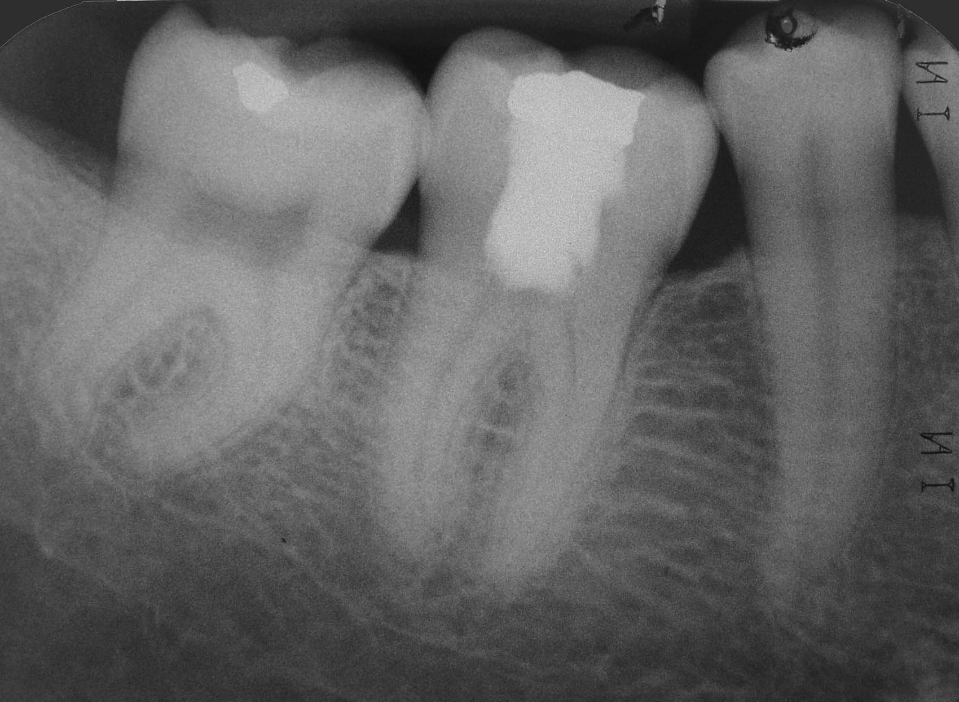
10 Years

Slide 6
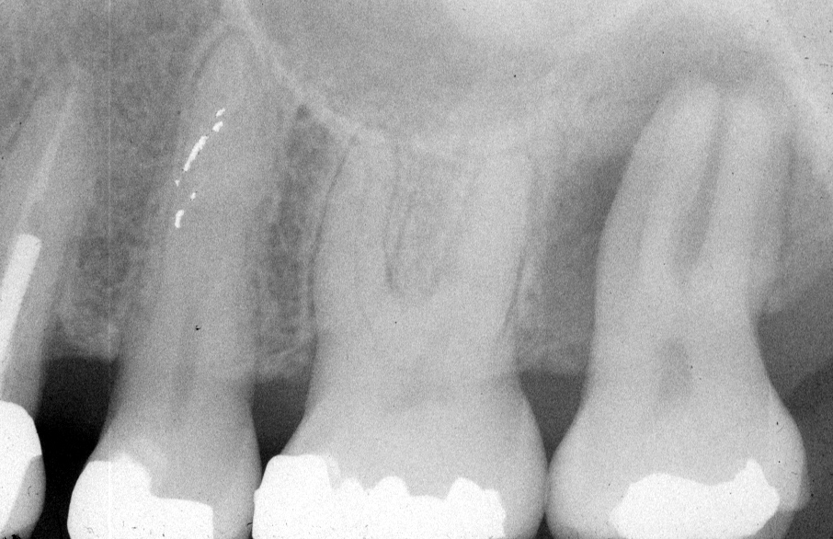

Slide 7
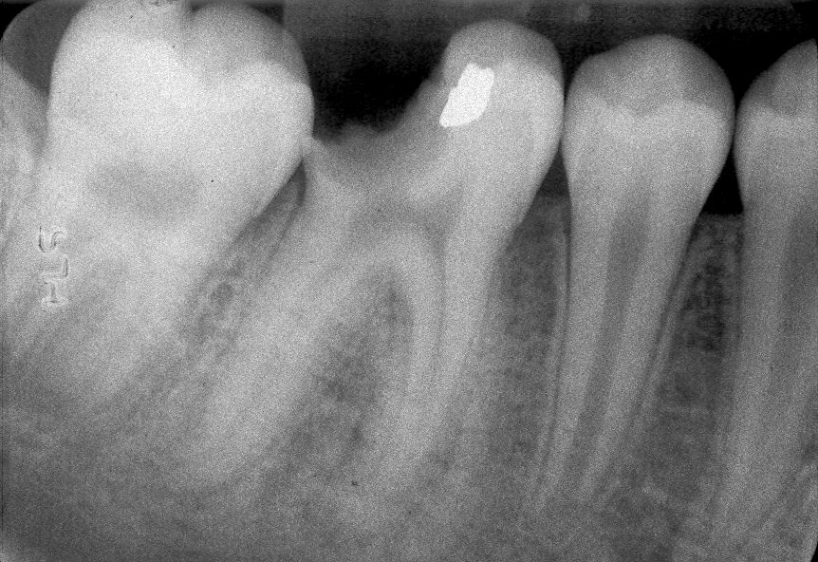
What causes
periapical inflammation?
Inflammation & necrosis of pulp leads to AP:
Dental Caries – carious pulp exposure
Traumatic Fractures – pulpal communication
Traumatic Avulsions – severance of vasculature
Restorative Dental Procedures – iatrogenic damage
Restorations & Microleakage – bacterial penetration
Notes:
Periapical lesion size in wild-type, anti- IL-6 antibody treated & IL-6 knockout mice. The periapical lesions were significantly larger in the anti- IL-6 antibody treated & the IL-6 knockout mice.

Slide 8
Etiology of Apical Periodontitis
Kakehashi et al., 1965
Surgically Exposed Rat Molar Pulps:
Conventional: Pulp Necrosis & PARL
Germ-Free: Vital Pulps & Repair Ø AP
Microbial infection causes AP.
Möller et al., 1981
Aseptically Devitalized Monkey Pulps:
Infected Necrotic Pulps: AP in all
Sterile Necrotic Pulps: Ø AP
Microbes are essential for AP.

Slide 9
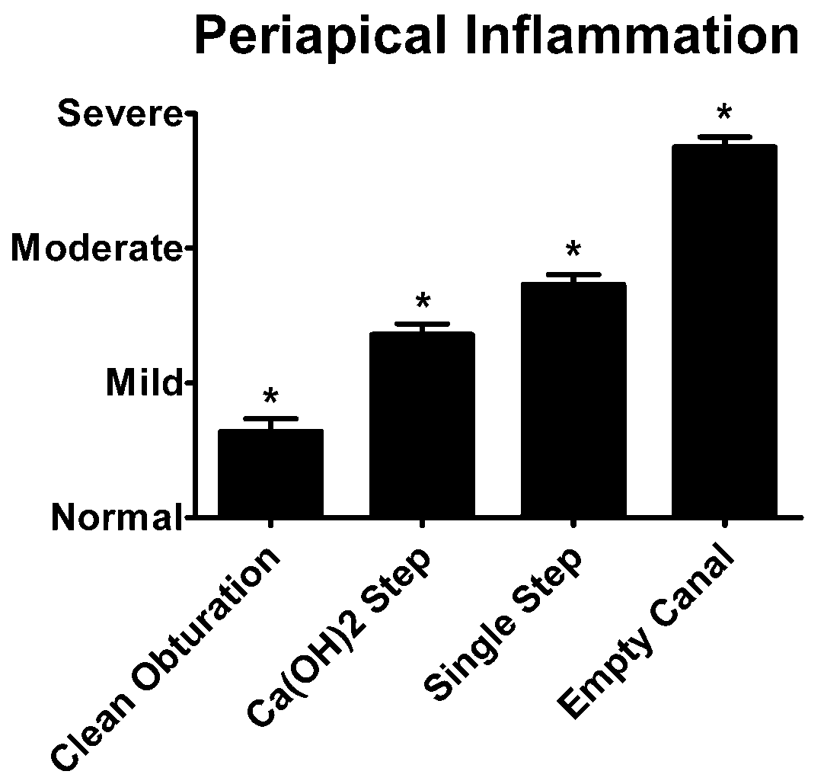
Uninfected & Disinfected Root Canals had less PA Inflammation
Dog root canals open 6wk
  PARL, (+) cultures, RCT
Clean Obturation (-) control
  Uninfected, 1-step filling
Ca(OH)2 Step
  Infected, Ca(OH)2 & filled
Single Step
  Infected & 1-step filling
Empty Canal (+) control
  Infected & left empty
Sacrificed @ 6mo histology
Katebzadeh, Hupp & Trope, JOE 2004

Slide 10
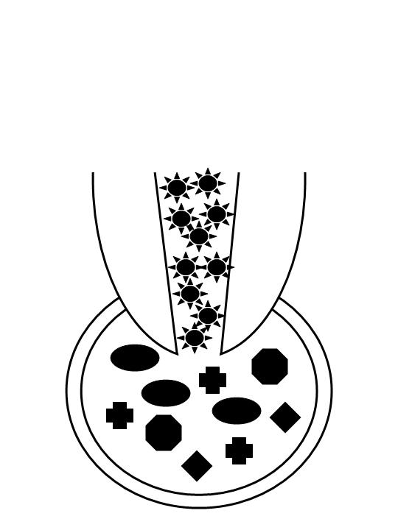
Apical Periodontitis
Host defenses respond to the threat of root canal microbes.
Neutrophils (PMN’s)
  phagocytize bacteria
Macrophages
  ingest bacteria & debris
  process & present antigen
  inflammatory mediators
T-Lymphocytes (T_{s}, T_{h1,2})
  inflammatory mediators
B-Lymphocytes
  Plasma cell antibodies
Modified from Nair 1997

Slide 11
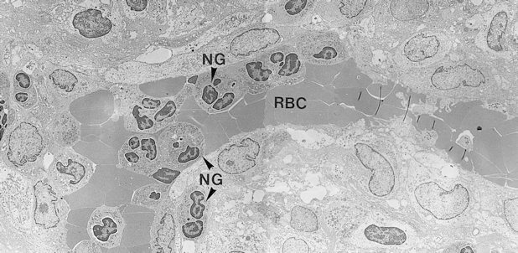
Neutrophils in Non-Specific Inflammatory Response
Front line of defense in acute inflammation
Neutrophils extravasate from blood vessels
Chemotax towards microbial irritants
Phagocytize opsonized bacteria
Lysosomal enzymes digest bacteria & host tissues
Nair, Pathways of the Pulp 2002

Slide 12
Enhancement of Neutrophils in Periapical Inflammation
PGG Glucan
  β-glucan polymer
  Saccharomyces cerevisiae cell wall
  Betafectin®, Alpha-Beta Technology Inc.
  Biological response modifier
  Immunomodulator
  Increases neutrophil number & activity
  Doesn’t induce pro-inflammatory cytokines
Stashenko et al, Journal of Dental Research 1995

Slide 13
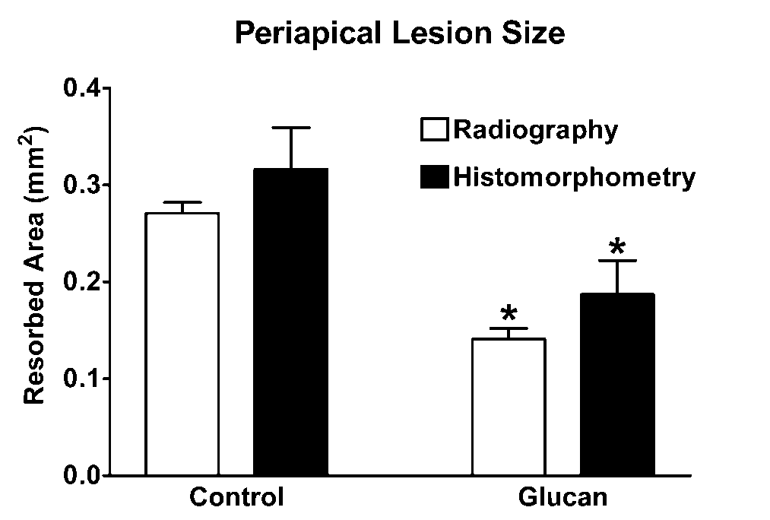
Enhanced Neutrophils Protected Pulp & Periapical Tissues
Exposed Pulps in PGG Glucan-Treated Rats:
More circulating neutrophils & monocytes
More phagocytosis of bacteria
Less pulp necrosis & periapical bone resorption
Stashenko et al, Journal of Dental Research 1995

Slide 14
Recovery from Surgery & Protection from Infection
Archives of Surgery 1999:
Dellinger et al., “Effect of PGG-glucan on the rate of serious postoperative infection or death observed after high-risk gastrointestinal operations.”
  Multicenter, prospective, randomized, double-blind, placebo-controlled trial in 39 US Medical Centers (N=1249)
  Reduced serious post-op infection & death in high-risk non-colorectal operations (39%)
Medscape General Medicine 2003:
Kournikakis et al., “Anthrax-protective effects of yeast beta 1,3 glucans.”
  Anthrax challenge in Glucan-treated & control mice
  Decreased bacterial load & increased mice survival

Slide 15
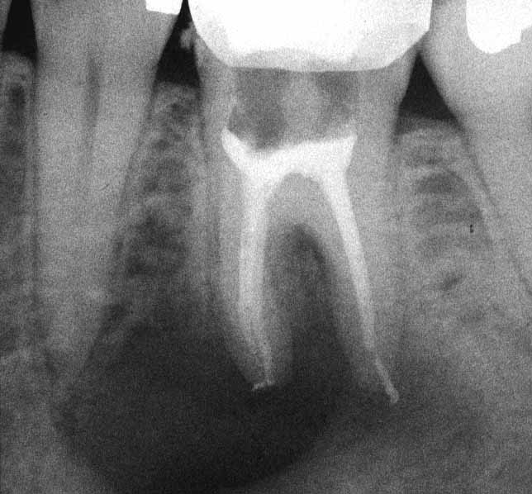
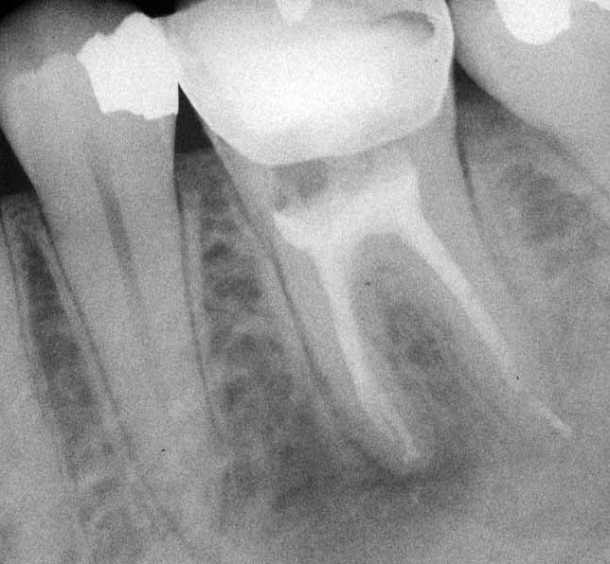
1 Year

Slide 16
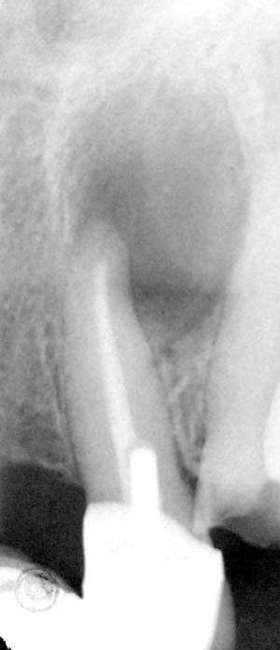
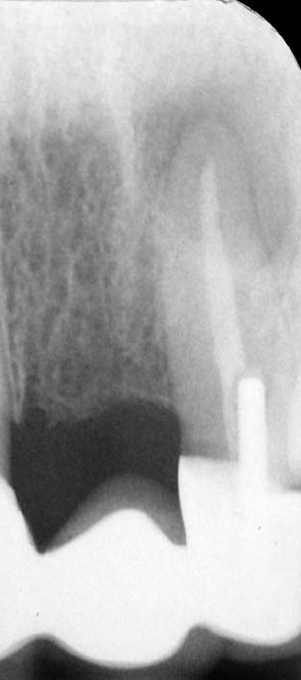
2 YEARS

Slide 17
Mediators of Periapical Inflammation & Bone Resorption
Cytokines - Regulatory Polypeptides
  intercellular mediators with pleiotropic effects
  inflammation & immune response
  cell growth & differentiation
  tissue repair & remodeling
Pro-inflammatory (IL-1, TNF, IL-6)
  stimulate neutrophils & lymphocytes
  induce prostaglandins & bone resorption
Anti-inflammatory (IL-4, IL-10)
  reduce IL-1 & Th1-type cytokines
  reduce bone resorption

Slide 18
Bone Resorptive Cytokines in Human Periapical Granulomas
Periapical Tissue
  RCT failures (x10)
  Apical Surgery
  Harvested PA tissue
Bone Resorption Assay
  PA tissue extracts
  ⁴⁵Ca radiolabelled fetal rat long bone
  Inhibitory Antibodies
Prostaglandins, IL-1β & TNFβ account for most bone
resorbing activity in chronic human periapical lesions.
Wang & Stashenko, JOE 1993

Slide 19
Infection-Induced Periapical Inflammation in a Rat Model
PA Lesions Induced
  Exposed rat molars
  Open to oral cavity
  Harvested PA tissue
PA Bone Resorbtion
  PA tissue extracts
  ⁴⁵Ca radiolabelled fetal rat long bone
  Inhibitory Antibodies
Prostaglandins & IL-1α account for most bone
resorbing activity in induced rat periapical lesions.
Wang & Stashenko, Oral Microbiology & Immunology 1993

Slide 20
Summary
Pro-Inflammatory Cytokines
Interleukin-1
  IL-1β (chronic human granulomas)
  IL-1α (infection-induced rodent model)
Tumor Necrosis Factor
  mainly TNFβ (especially in human)
Prostaglandins
  Indomethacin inhibits bone resorption

Slide 21
Other Mediators of Periapical Inflammation & Bone Resorption
Arachidonic Acid Metabolites
  Membrane Phospholipids
Prostaglandins - Cyclooxygenase Pathway
  COX-1 in all tissues
  COX-2 is induced by LPS & cytokines
  PGE2 from PMN’s activate osteoclasts
  acute inflammation & rapid bone resorption
Leukotrienes - Lipoxygenase Pathway
  LTB4 promotes PMN adhesion to endothelial walls & chemotaxis

Slide 22
COX-2 Expression Increases in Developing Periapical Lesions
Exposed rat pulps & PA DNA probes
Lin et al., European Journal of Oral Sciences 2002

Slide 23
Inhibition of COX-2 Reduced Inflammation & Bone Resorption
Lin et al., European Journal of Oral Sciences 2002
Notes:
Periapical lesion size in wild-type, anti- IL-6 antibody treated & IL-6 knockout mice. The periapical lesions were significantly larger in the anti- IL-6 antibody treated & the IL-6 knockout mice.

Slide 24
Prostaglandin E2 in Human Periapical Lesions
Normal - Unerupted & Uninflamed 3rd Molars (x4)
Chronic - Chronic Apical Periodontitis Lesions (x6)
Acute - Acutely Inflamed (pain/swelling) Lesions (x6)
McNicholas et al., JOE 1991
Notes:
There was a progressive increase in radiographic size of the induced periapical lesions over 24 weeks.

Slide 25
Prostaglandin E2 in Human Periapical Exudate
Clinical cases (x77)
Carefully collected periapical exudates
Elevated PGE2
  PARL
  Acute Symptoms of Inflammation
Takayama et al., JOE 1996
Notes:
There was a progressive increase in radiographic size of the induced periapical lesions over 24 weeks.

Slide 26
Initiation of RCT Reduced PGE2 in Human Periapical Exudate
Clinical cases (x20)
Carefully collected periapical exudate
1st Visit
  Initiated RCT
2nd Visit (1-2wk)
  RCT Continued
Reduced PGE2
  RCT initiated
  Clinical improved
Shimauchi et al., JOE 1997
Notes:
There was a progressive increase in radiographic size of the induced periapical lesions over 24 weeks.

Slide 27
Summary
Prostaglandins
COX-2 & PGE2
  Increased periapical inflammation
  Increased periapical bone resorption
NSAIDS & COX-2 Inhibitors
  Reduce periapical inflammation
  Reduce periapical bone resorption

Slide 28
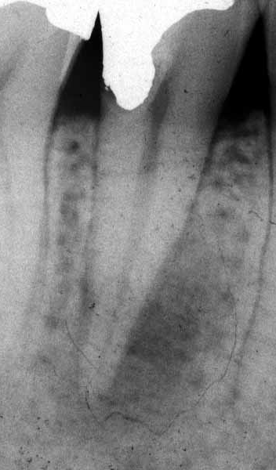
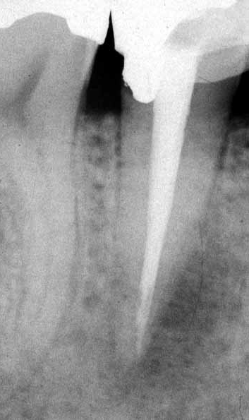
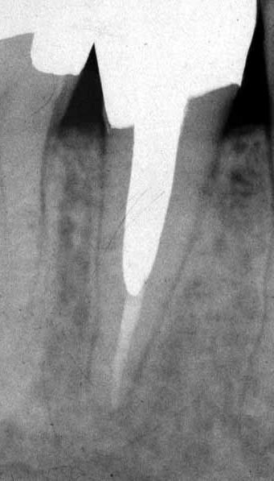
2 Years

Slide 29
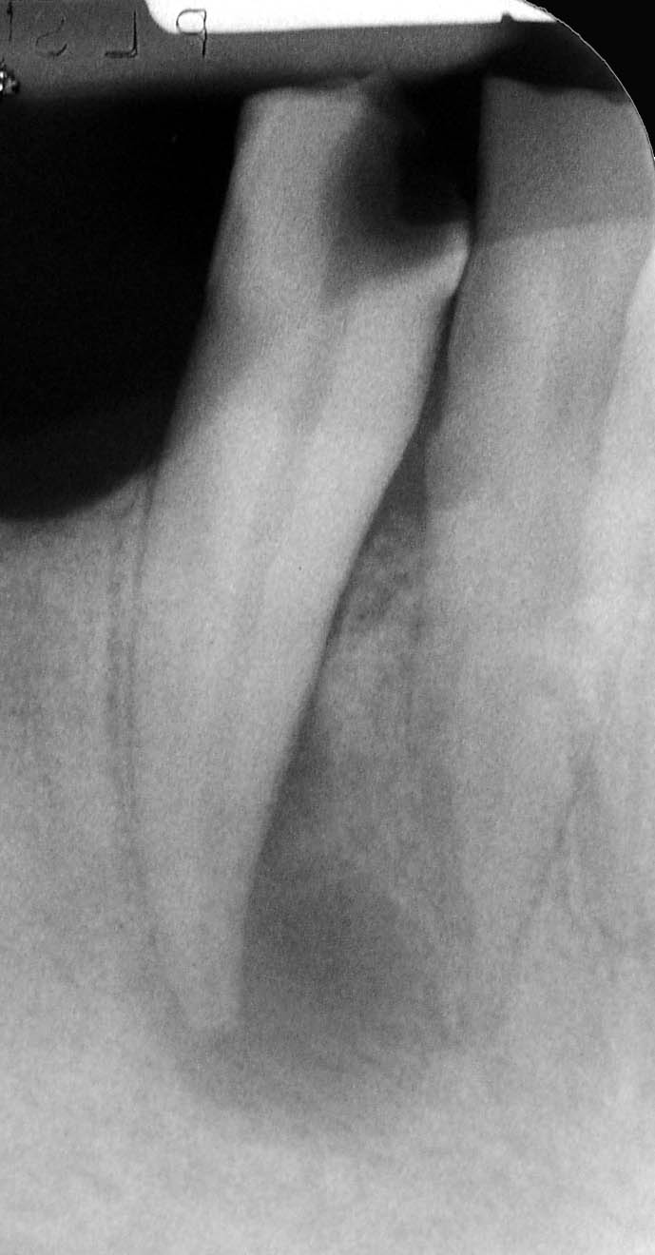
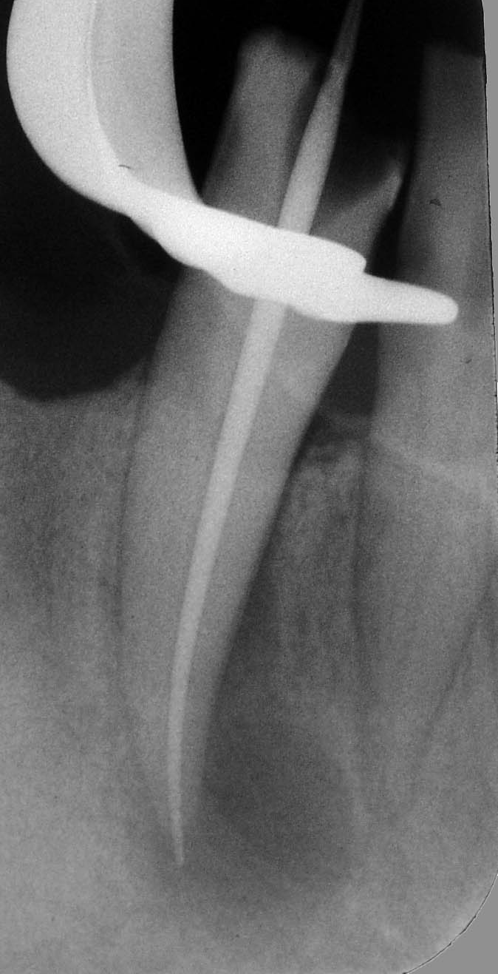
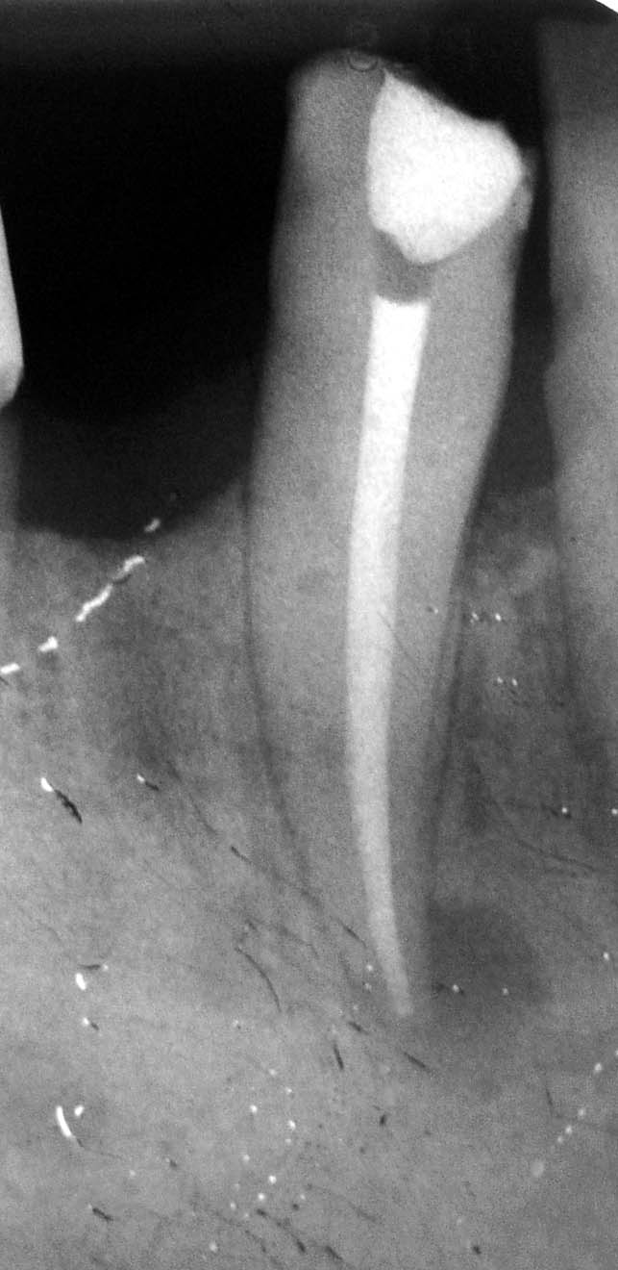
6 Months

Slide 30
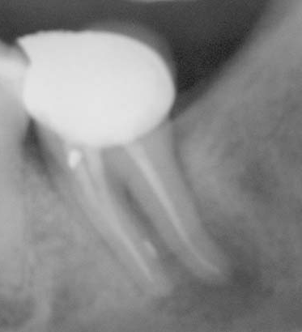
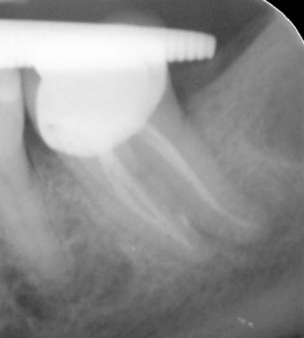
1 Year

Slide 31
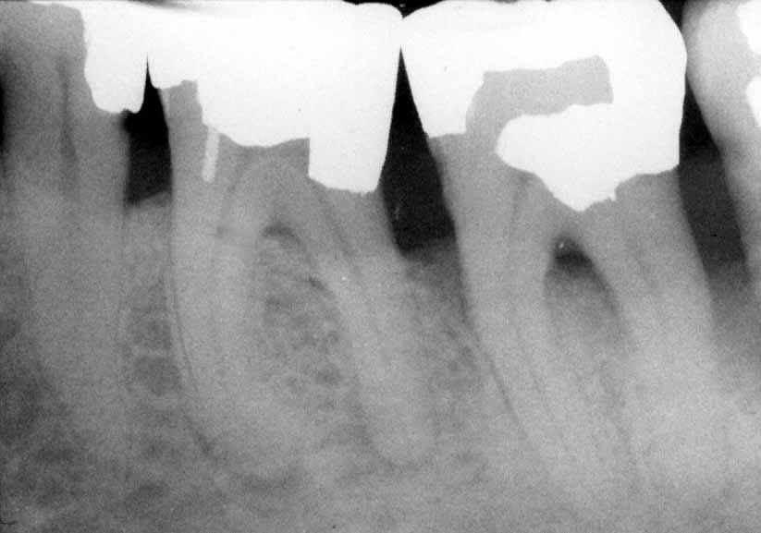

Slide 32
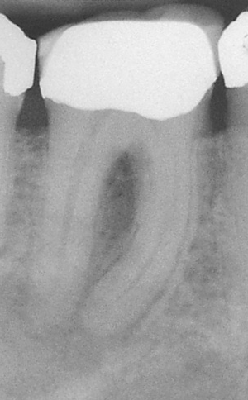
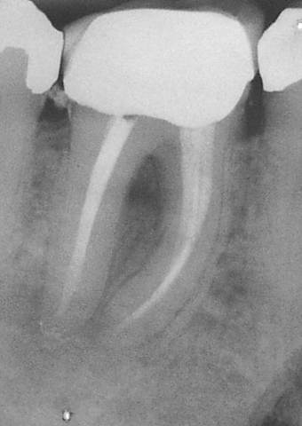
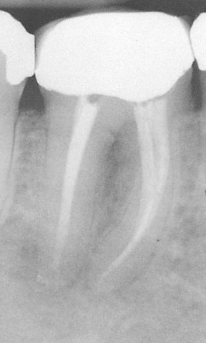
1 Year

Slide 33
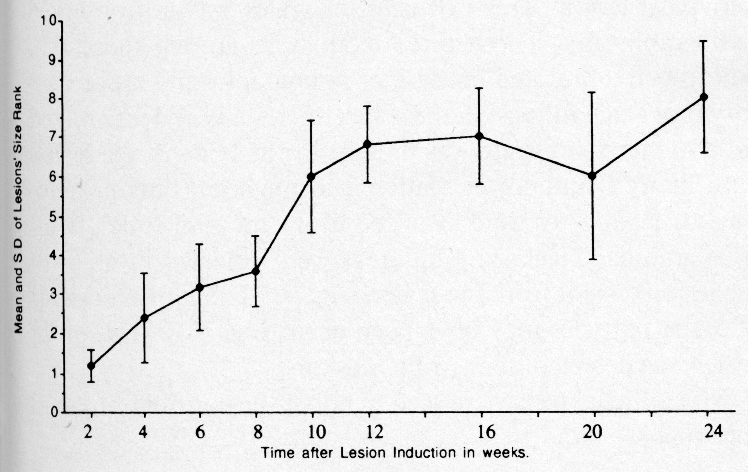
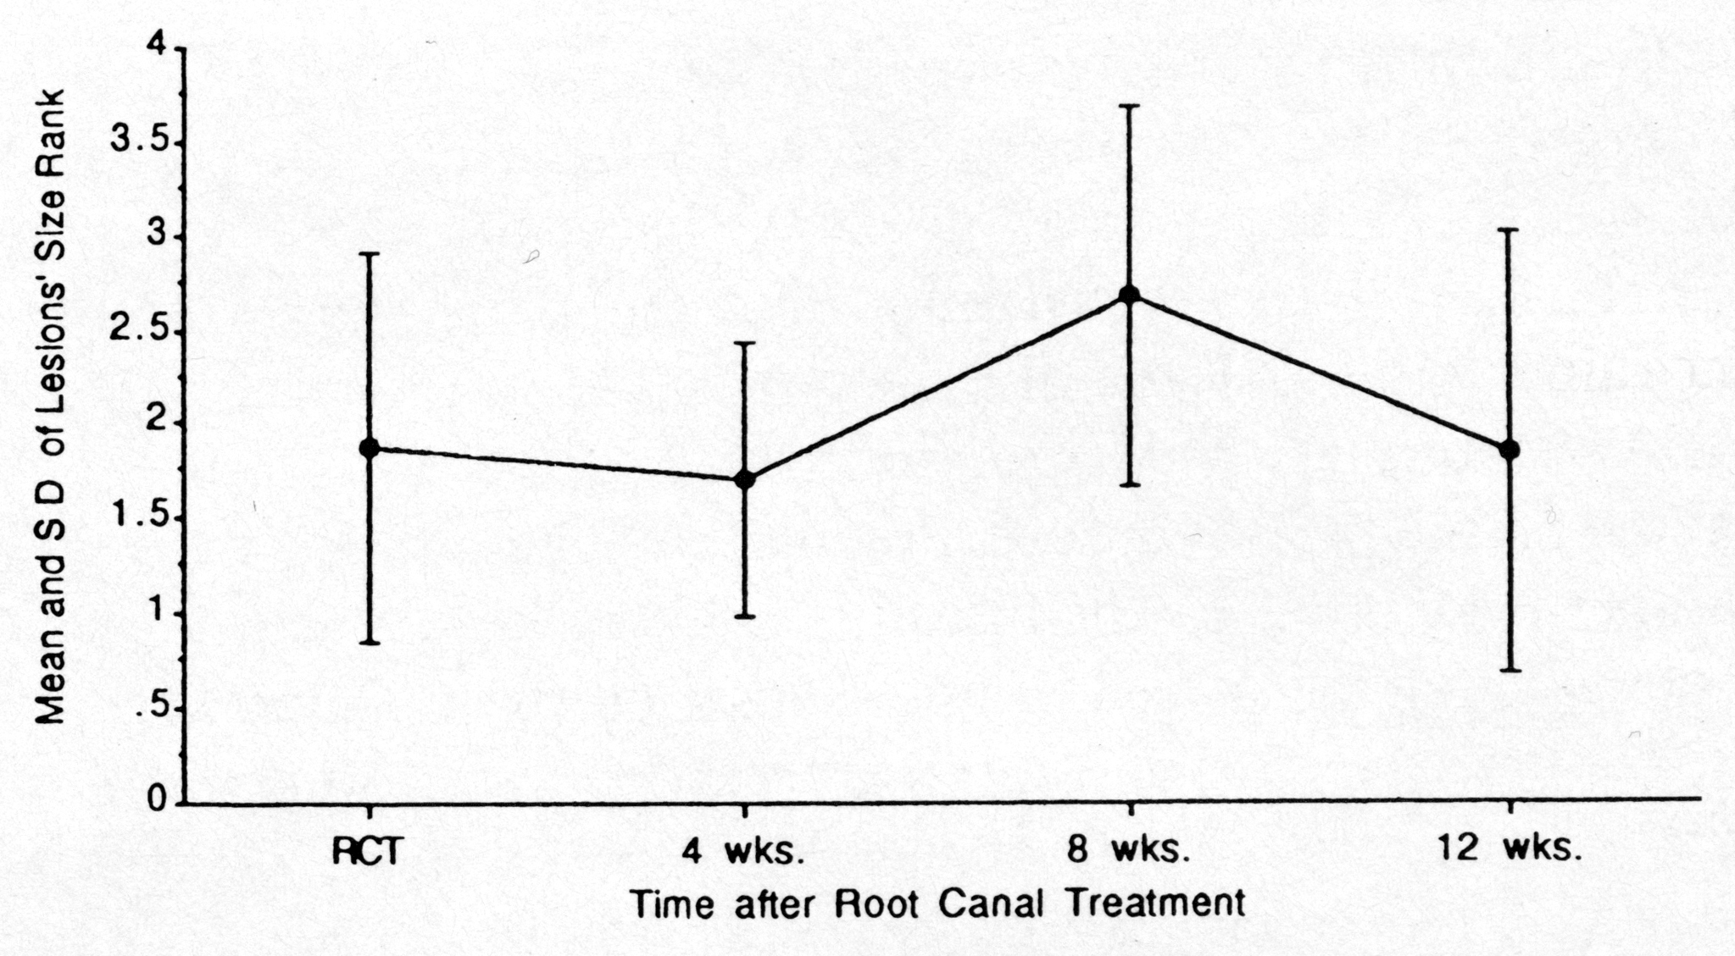
Root Canal Therapy & Periapical Healing in Ferret Canine Teeth
Infection-Induced Periapical Inflammation:
  Canine root canals exposed for 1wk & filled @ 13wk
Histological Evidence of Periapical Healing:
  Reduction in inflammatory cell infiltrate
  Many capillaries, fibroblasts & osteoblasts
  Collagen matrix & bone formation
Fouad et al, JOE 1993
Notes:
After RCT, there was no change in lesion size during the following 12 week period.

Slide 34
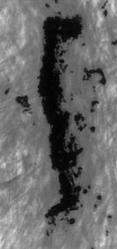
Periapical Granuloma Cells Develop into Osteoblasts & Bone
Chronic Periapical Lesions:
  RCT failures (x3 patients)
  Surgically harvested PA tissue
  Grew primary cell cultures
Periapical Tissue Cells:
  Expressed alkaline phosphatase
  Osteoblast transcription factors
  Osteoblast proteins
  Formed calcified mineral deposits
PA granulomas can generate osteoblasts & bone.
Maeda et al., Cell & Tissue Research 2003

Slide 35
Summary
RCT & Periapical Healing:
Stabilization in periapical lesion size
Reduction in inflammatory infiltrate
Increase in vascularity
Fibroblasts & collagen deposition
Osteoblasts & bone formation

Slide 36
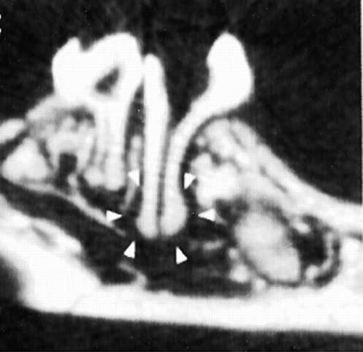
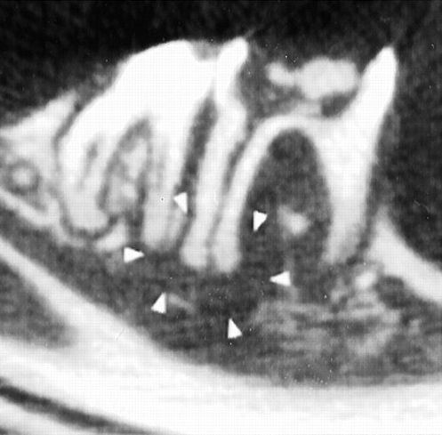
Anti-Inflammatory Cytokines in Periapical Lesions
Anti-Inflammatory
  IL-4 & IL-10
  Th2-type cytokines
  reduce IL-1
  reduce Th1 cytokines
  inhibit bone resorption
Exposed Mice Molars
  Wild Type Mice
  IL-4 (-/-) Knockouts
  IL-10 (-/-) Knockouts
IL-4 (-/-)
Knockout
IL-10 (-/-)
Knockout
Sasaki et al., J of Immunology 2000
Notes:
Micro-CT images of PA lesion formation in wild-type (A, C) & IL-6 knockout (B, D) mice. The intact molars (A, B) serve as controls. The periapical lesions were larger in the IL-6 knockouts (IL-6 deficient) mice.

Slide 37
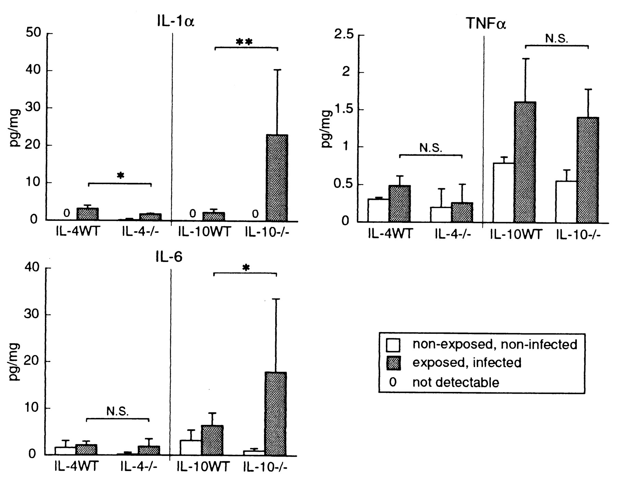
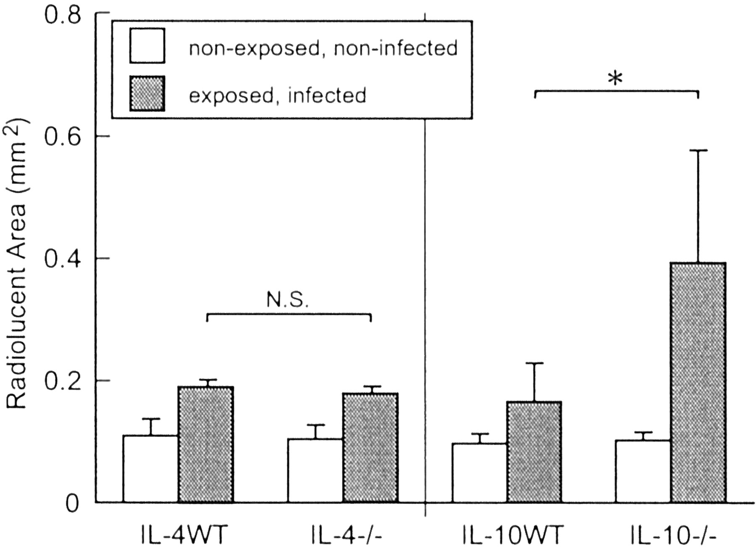
IL-10 Inhibits Inflammatory Mediators & Bone Resorption
IL-10 has important anti-inflammatory
effects in periapical lesions.
Sasaki et al., J of Immunology 2000
Notes:
Pulp exposure causes an increase in the pro-inflammatory cytokine IL-1 alpha, bone resorption & periapical lesion formation. IL-1 alpha levels were significantly higher with pulp exposures in anti- IL-6 antibody treated & IL-6 knockout mice, than in the wild-type.

Slide 38
Summary
Anti-Inflammatory Cytokines
Interleukins -4 & -10
IL-10 (mouse model)
  reduces pro-inflammatory IL-1
  reduces pro-inflammatory IL-6
  decreases bone resorption

Slide 39
IL-6 has Pleiotropic Effects
Interleukin-6
  induced by pro-inflammatory IL-1 & TNF
Pro-Inflammatory Effects
  stimulates osteoclast precursors
  promotes bone resorption
Anti-Inflammatory Effects
  down-regulates IL-1 levels
  increases IL-1 receptor antagonist

Slide 40
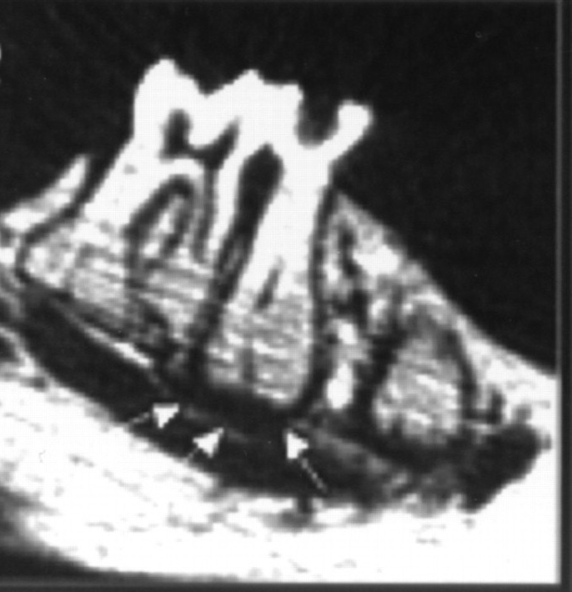
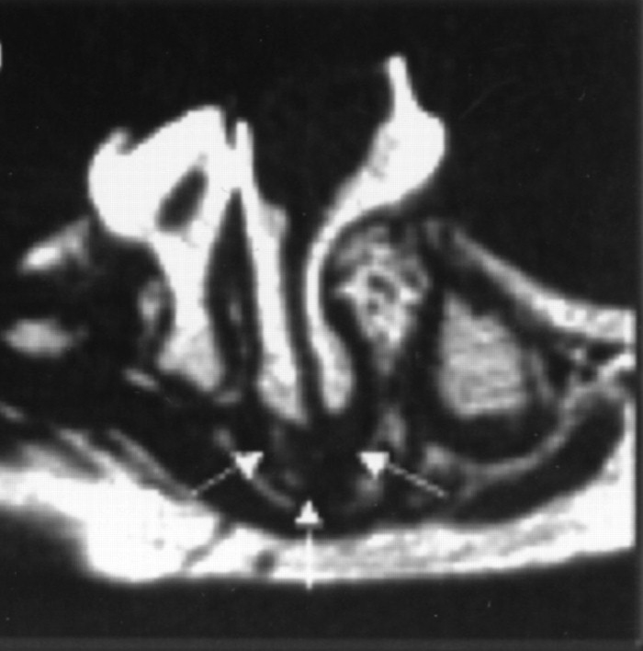
Pro- & Anti-Inflammatory Effects of IL-6 in Periapical Lesions
IL-6 (+/+)
Wild Type
Exposed Mice Molars:
Wild Type Mice
IL-6 (-/-) Knockouts
Anti-IL-6 Treatment
IL-6 (-/-)
Knockout
Balto et al., Infection & Immunity 2001
Notes:
Micro-CT images of PA lesion formation in wild-type (A, C) & IL-6 knockout (B, D) mice. The intact molars (A, B) serve as controls. The periapical lesions were larger in the IL-6 knockouts (IL-6 deficient) mice.

Slide 41
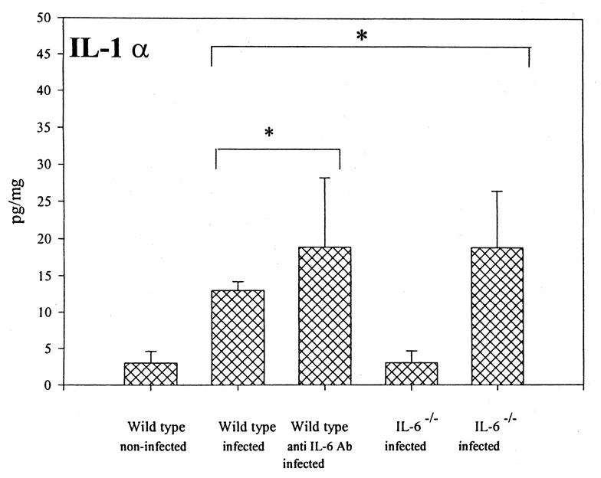
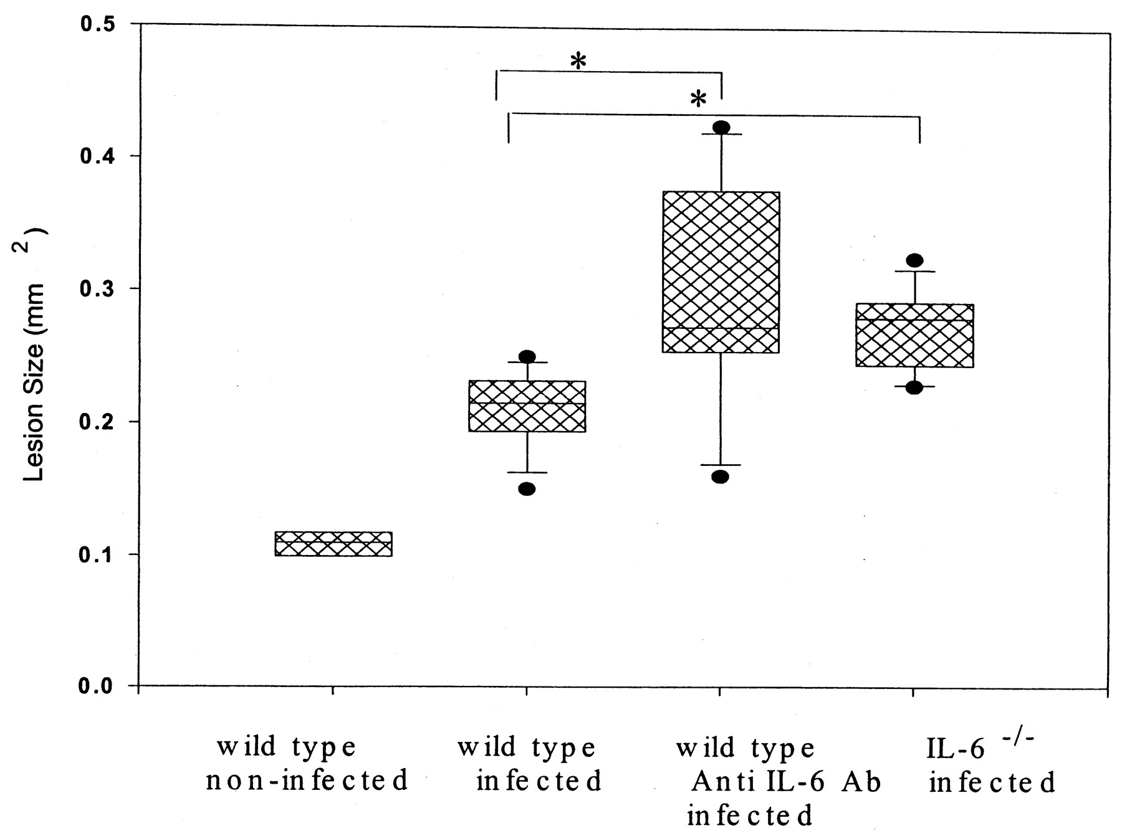
IL-6 Deficient Mice had more IL-1 & Periapical Bone Resorption
IL-6 has mostly anti-inflammatory
effects in periapical lesions.
Balto et al., Infection & Immunity 2001
Notes:
Pulp exposure causes an increase in the pro-inflammatory cytokine IL-1 alpha, bone resorption & periapical lesion formation. IL-1 alpha levels were significantly higher with pulp exposures in anti- IL-6 antibody treated & IL-6 knockout mice, than in the wild-type.

Slide 42
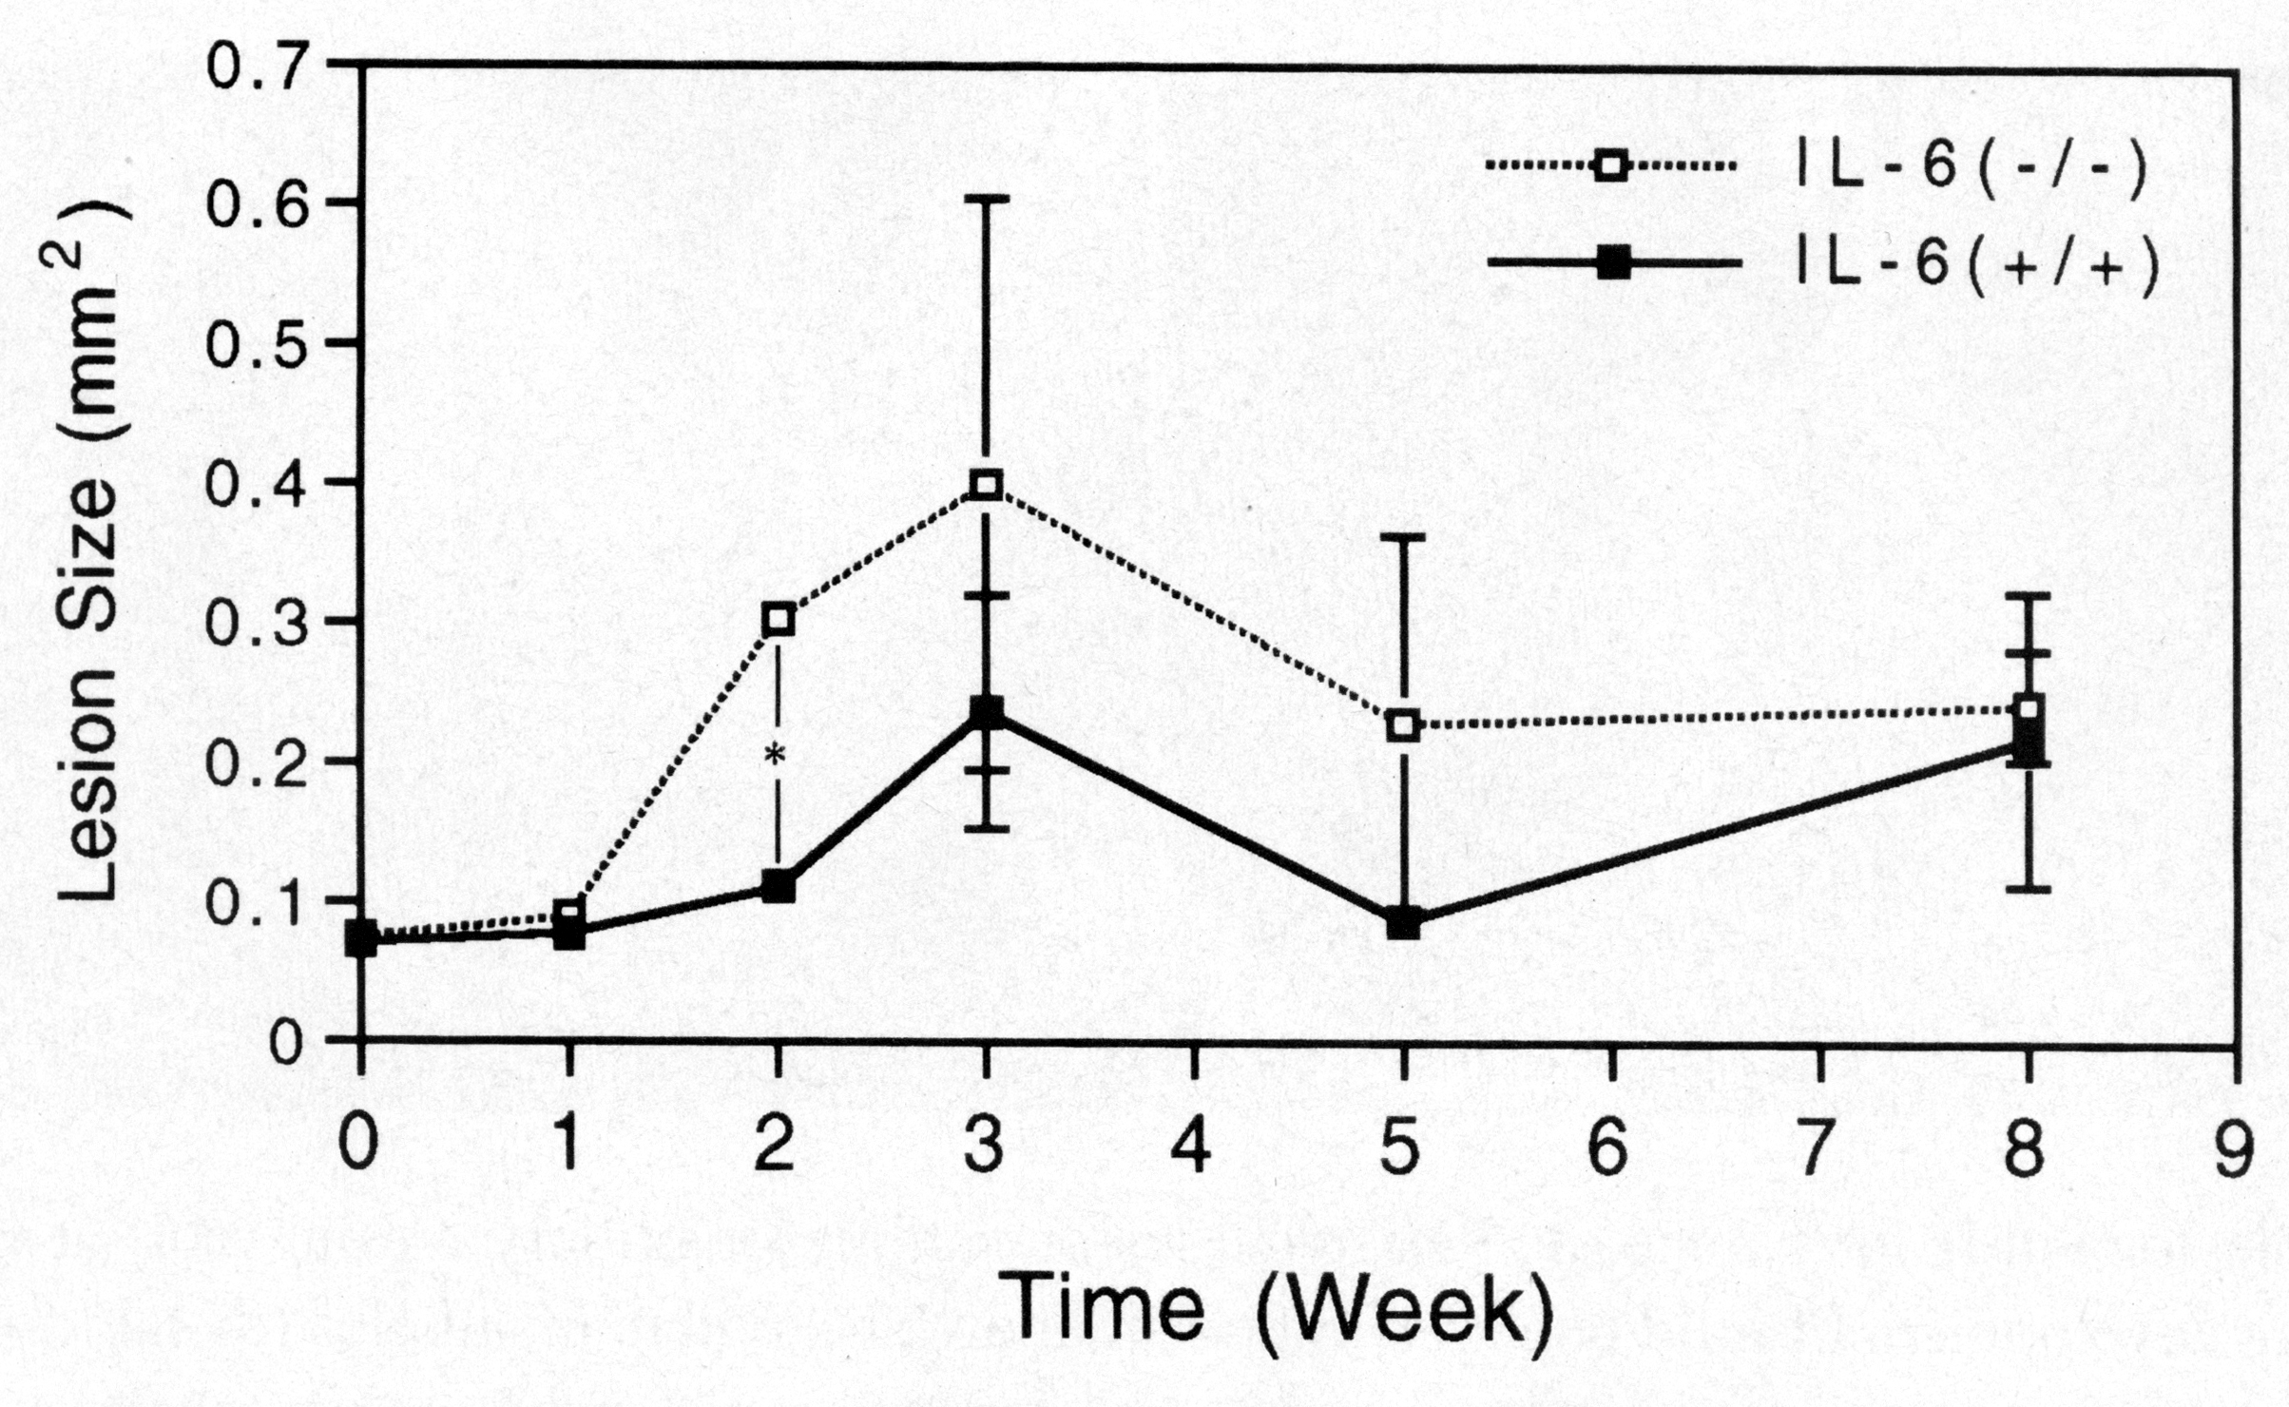
IL-6 Deficient Mice Rapidly Developed Larger PA Lesions
Huang et al., OOOOE 2001
Notes:
There was a progressive increase in radiographic size of the induced periapical lesions over 24 weeks.

Slide 43
Summary
Interleukin-6 (mouse model)
Down-regulates IL-1 levels
Reduces periapical bone resorption
Predominantly anti-inflammatory effects

Slide 44
Another Pleiotropic Cytokine in Periapical Lesions
Transforming Growth Factor β (TGFβ)
Pro-Inflammatory Effects
  Recruit & activate PMN’s, macrophages & T cells
  Induce bone resorptive IL-1, TNF & IL-6
Anti-Inflammatory Effects
  Fibroblast proliferation, matrix synthesis & healing
  Stimulate osteoblasts & inhibit osteoclasts
Lin et al., JOE 2000
TGFβ was expressed by macrophages in the active lesion, & by bone forming osteoblasts in the chronic phase.

Slide 45
Summary
Mediators in Periapical Healing:
Anti-Inflammatory Cytokines
  IL-10 & IL-6 (pleiotropic)
  Reduce pro-inflammatory mediators
  Reduce inflammation & bone resorption
Growth Factors (TGFβ)
  Pro- & anti-inflammatory effects

Slide 46
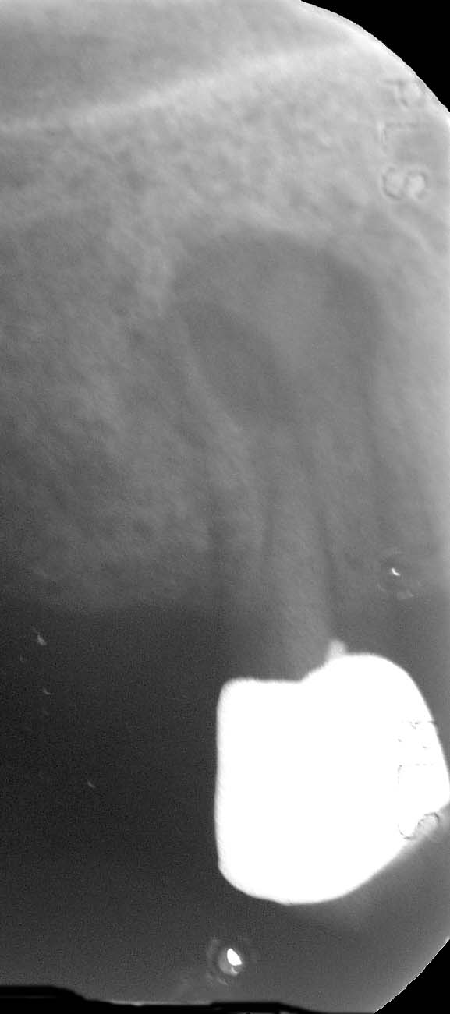
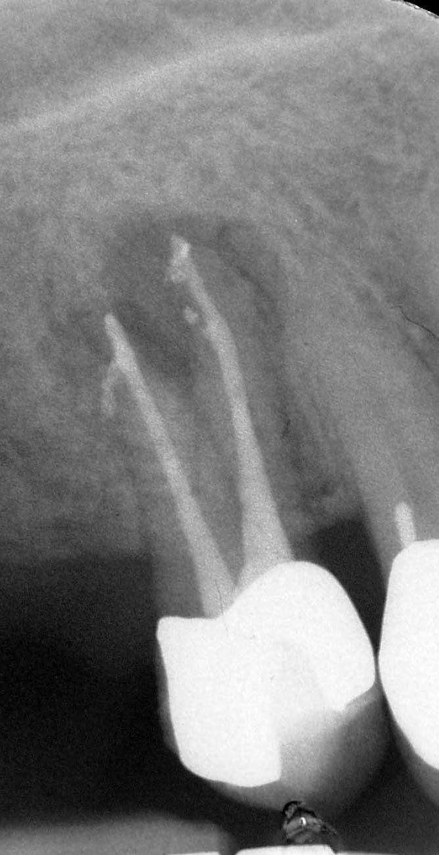
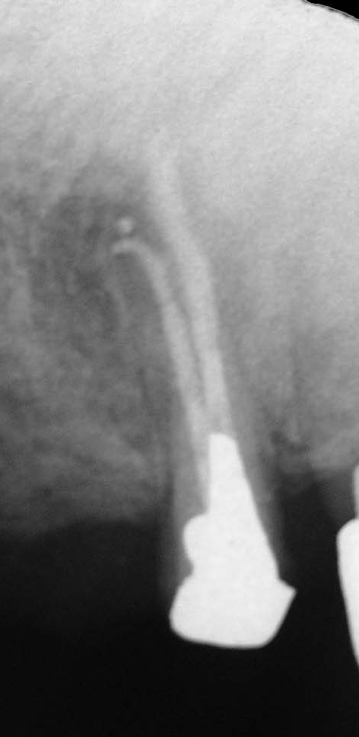
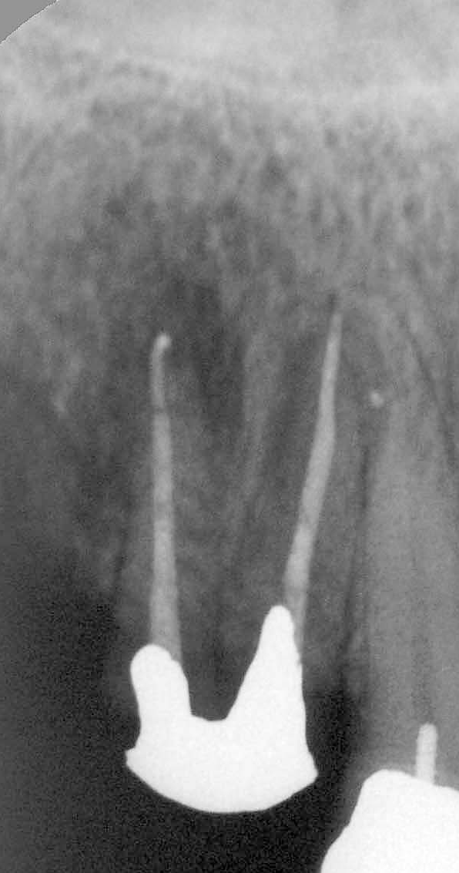

Slide 47
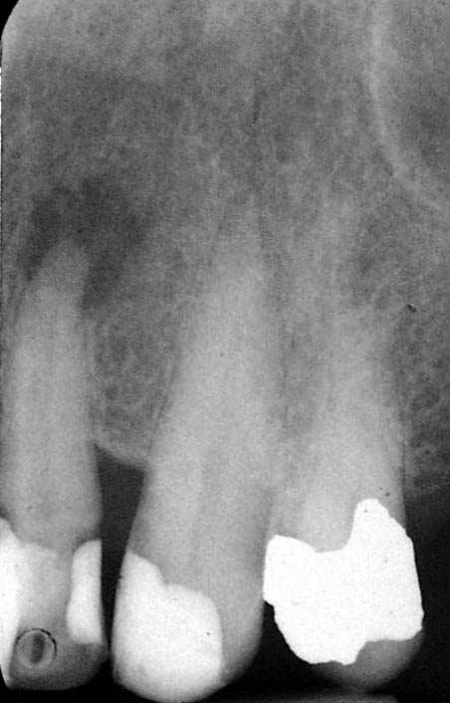
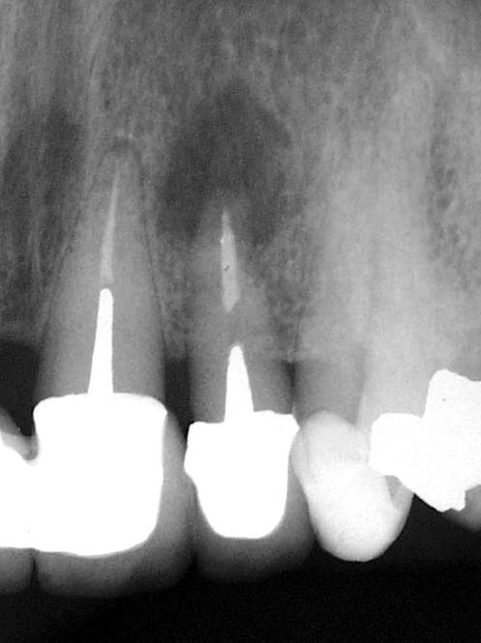

Slide 48
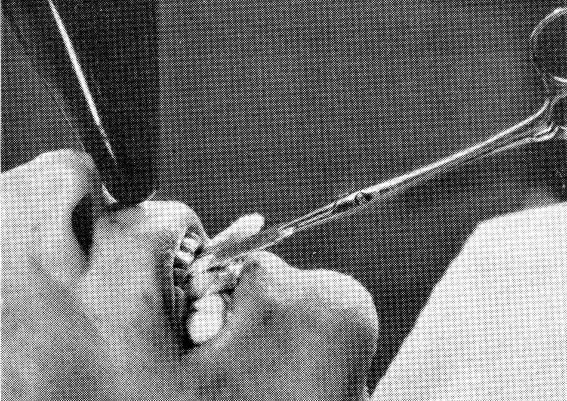
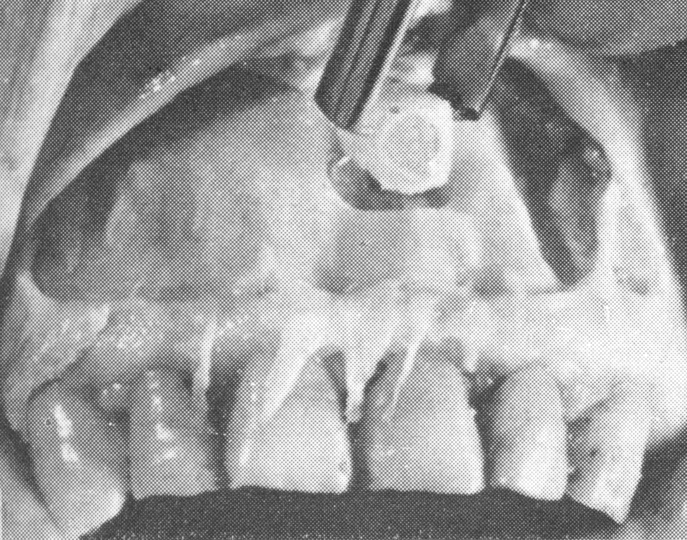
Histological Evidence of Healing in Root Filled Cadaver Teeth
Study Design:
142 Human Cadavers
320 Maxillary Incisors
119 Root Filled Teeth
201 Control Teeth
  107 PARL / altered PA
  94 normal PA
Brynolf, Odontologisk Revy 1967

Slide 49
‘A histological and roentgenological study of the periapical region of human upper incisors’
Root Filled Maxillary Incisors in Cadavers:
  7% Normal Periapical Histology
  20% Evidence of Periapical Healing
  73% Persistent Periapical Inflammation
Many root filled teeth may have persistent periapical inflammation.
Brynolf, Odontologisk Revy 1967

Slide 50
Recent Studies
Green et al., OOOOE 1997
29 Root Filled Cadaver Teeth
66% (19) Radiographically Normal
  74% (14) Histologically Normal
  26% (5) Histologically Inflamed
Barthel et al., JOE 2004
53 Root Filled Cadaver Teeth
53% (28) Radiographically Normal
  68% (19) Histologically Normal
  32% (9) Histologically Inflamed
Radiographically normal periradicular tissues
may have persistent periapical inflammation.

Slide 51
Question?
Can the systemic condition influence the healing process in human periapical tissues?

Slide 52
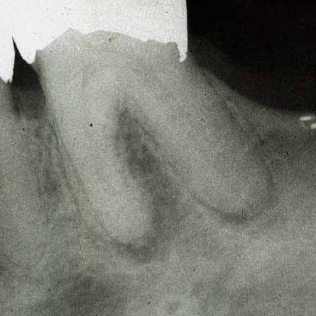

80 yrs
6 Months

Slide 53




Cohenca et al, JOE 12:2003
Notes:
Actinomycosis Of the Actinomyces species described, all but A. bovis, A. howellii , and A. hordeovulneris are prevalent in the human oral cavity. They are often isolated in significant levels from dental plaque and calculus, as well as from the tongue, tonsils, and other soft tissues. Opportunistic infections may arise following traumatic injury and the introduction of contaminated debris into the tissues. Actinomycosis is a chronic, granulomatous, soft tissue infection with foci of abscesses and suppuration through draining sinuses. It is most common in the cervicofacial region (Fig. 8-3) , draining intraorally or through the skin of the face or neck. Actinomycosis can also affect the lower respiratory tract via aspiration or inhalation of contaminated material from the mouth and may occasionally affect the abdomen following surgical or accidental trauma
Actinomycosis lesions often contain a mixed microbiota. By far, the most common species is A. israelii , but some lesions yield A. naeslundii, A. viscosus , or Arachnia propionica. Actinomyces bovis causes similar infections in cattle. Along with anaerobic streptococci, gram-negative bacteria have been isolated from mixed actinomycotic lesions; the most common are pigmented gram-negative anaerobic rods and Actinobacillus actinomycetemcomitans —this significant periodontal pathogen was named for its actinomycosis association! The relative contribution of the individual species to pathogenicity of mixed actinomycosis infections has not been clearly established, but their common colonization of teeth and periodontal pockets suggests an intraoral reservoir for infecting other tissues. It should not be surprising that trauma to the teeth or jaws and bite wounds are often the opportunistic events predisposing to actinomycosis. Treatment of actinomycosis is often difficult and protracted because the mixed flora massed in the center of the "sulfur granules" is relatively protected from host defenses. Surgical excision and drainage is usually required, as well as extended antibiotic therapy, usually with drugs in the penicillin family.
Periapical ActinomycosisActinomycosis is a chronic, granulomatous, infectious disease in man and animals that is caused by the genera Actinomyces and Propionibacterium.164 The causative agent of bovine actinomycosis, Actinomyces bovis, was the first species to be identified.99 The disease in cattle, known as "lumpy jaw" or "big head disease," is characterized by extensive bone rarefaction, swelling of the jaw suppuration, and fistulation. The causative agents were described as nonacid-fast, nonmotile, gram-positive organisms, revealing characteristic branching filaments that end in clubs or hyphae. Because of the morphologic appearance, these organisms were considered fungi and the taxonomy of Actinomyces remained controversial for more than a century. The intertwining, filamentous colonies are often called "sulphur granules," because of their appearance as yellow specks in exudate. On careful crushing, the tiny clumps of branching microorganisms with radiating filaments in pus give a "starburst appearance" that prompted Harz99 to coin the name Actinomyces, or "ray fungus." Four years later Actinomyces israelii was isolated from humans in pure culture. Then it was characterized and its pathogenicity in animals demonstrated.328 Many researchers, nevertheless, considered the human and bovine isolates as identical. However, A. bovis and A. israelii are now classified as two distinct bacterial species, and in natural infections the former is restricted to animals and the later to humans.Human actinomycosis is clinically divided into cervicofacial, thoracic, and abdominal forms. About 60% of the cases occur in the cervicofacial region, 20% in the abdomen, and 15% in the thorax.124,208 The most species isolated from humans is A. israelii,328 which is followed by Propionibacterium propionicum,41Actinomyces naeslundii,298Actinomyces viscosus,111 and Actinomyces odontolyticus16 (in descending order).Periapical actinomycosis (Fig. 12-16) is a cervicofacial form of actinomycosis. The endodontic infections are generally a sequel to caries. A. israelii is commensal of the oral cavity and can be isolated from tonsils, dental plaque, periodontal pockets, and carious lesions.283 Most of the publications on periapical actinomycosis are case reports and have been reviewed.*13 Although periapical actinomycosis is considered to be rare,194 it may not be so infrequent.116,178,232 The data on the frequency of periapical actinomycosis among apical periodontitis lesions is scarce. A microbiologic control study revealed actinomycotic involvement in 2 of the 79 endodontically treated cases.44 A histologic analysis showed the presence of characteristic actinomycotic colonies (see Fig. 12-16, A) in 2 of the 45 investigated lesions.194 Identification of the species involved (and cause of infection) can be established only through laboratory culturing of the organisms283 and by experimental induction of the lesion in susceptible animals.79 However, the strict growth requirements of A. israelii make isolation in pure culture difficult. Therefore a laboratory diagnosis is generally reached on the basis of histologic demonstration of typical colonies194 and by specific immunohistochemical staining of such colonies.94,283 The characteristic light microscopic feature of an actinomycotic colony is the presence of an intensely dark staining, gram- and PAS-positive core, with radiating peripheral filaments (see Fig. 12-16, A) that gives the typical "star burst" or "ray fungus" appearance.Ultrastructurally79,194 the center of the colony consists of a dense aggregation of branching filamentous organisms held together by an extracellular matrix (see Fig. 12-16, B). Several layers of PMN usually surround an actinomycotic colony.Because of the ability of certain actinomycotic organisms to establish extraradicularly (see Fig. 12-16) to perpetuate the inflammation at the periapex (even after proper root canal treatment), periapical actinomycosis is of special importance in endodontics.93,94,194,252,283 A. israelii and P. proprionicum are the most consistently isolated and characterized microorganisms from the periapical tissue of teeth that did not respond to proper conventional endodontic treatment.93,252 A. israelii has been specifically implicated in periapical actinomycosis.204,283 The biologic properties that enable these bacteria to establish in the periapical tissues are not fully understood, but they appear to involve the ability to build cohesive colonies (see Fig. 12-16) that enables them to escape the host defense system.79

Slide 54



Myonecrosis secondary to β-hemolytic streptococci
Necrotizing fasciitis
Notes:
myonecrosis 2nd to group A streptococci, beta hemolytic strep no pus flesh eating Streptococcus pyogenes
The most common infection due to β-hemolytic streptococci is streptococcal sore throat
Streptococcus pyogenes:Most streptococci that contain the group A antigen are S pyogenes. They are β-hemolytic. S pyogenes is the main human pathogen associated with local or systemic invasion and poststreptococcal immunologic disorders. S pyogenes typically produces large (1 cm in diameter) zones of β hemolysis around colonies greater than 0.5 mm in diameter. They are PYR-positive (hydrolysis of L-pyrrolidonyl-2-naphthylamide) and usually are susceptible to bacitracin.
This is infection of the subcutaneous tissues and fascia. There is extensive and very rapidly spreading necrosis of the skin and subcutaneous tissues. Bacteria other than group A streptococci can also cause necrotizing fasciitis. The group A streptococci that cause necrotizing fasciitis have sometimes been termed “flesh-eating bacteria.”
Necrotizing fasciitisNecrotizing fasciitis is a rapidly progressing infection involving the full thickness of the skin down to the fascial planes, causing extensive necrosis and tissue loss. The skin looks initially normal, but the infection spreads surreptitiously along the fascial planes, destroying the blood supply to the skin, which discolours and becomes necrotic within hours (hence the tabloid term ‘flesh-eating bacteria’). The patient is severely ill with toxaemia and shock, and may die within 24 hours. Formerly called ‘streptococcal gangrene’, it can be caused by a mixed flora comprising staphylococci, strict anaerobes and Enterobacteriaceae; the major offending organism is Streptococcus pyogenes. Management entails excision of skin, antibiotics and supportive therapy.
•Necrotizing fasciitis is the term given to rapidly progressing infection involving the full thickness of the skin including the fascial planes, causing extensive necrosis, tissue loss, toxaemia and shock
Hemolytic streptococci can be divided into serologic groups (A–H, K–U), and certain groups can be subdivided into types. Several antigenic substances are found:

Slide 55


RCT Outcomes in Diabetic & Non-Diabetic Patients
Dental School Database
5494 RCT
540 had 2-year Recall
73 had Diabetes
  More periodontal disease
  Same overall outcome
  Fewer PARL healed
Diabetics had less periapical healing.
Fouad & Burleson, JADA 2003

Slide 56
Question?
Are there local factors which influence the healing process in human periapical tissues?

Slide 57



Gottleib, 1935

Slide 58



1 Year
Courtesy Dr. M. Vatral

Slide 59



1 Year
Courtesy Dr. C. Pantera

Slide 60



1 Year
Courtesy Dr. C. Pantera

Slide 61



1 Year

Slide 62


1 Year
Courtesy Dr. C. Pantera

Slide 63


Case Report of a Radicular Cyst
#9 Necrotic Pulp + PARL
2-step RCT, Ca(OH)2 & (-) culture
Recalled over 44 months
  Asymptomatic
  Persistent PARL
Apical Surgery
  Sterile Root & Periapical Tissues
  Sterile Epithelial-lined Lumen
  Radicular Cyst
  Periapical Healing within 6 months
Nair et al., International Endodontic Journal 1993

Slide 64


Failed Root Canal Therapy
Post Removal & Non-Surgical Retreatment

Slide 65


Apical Surgery &
Lesion Resolution
Surgical Enucleation of Radicular Cyst

Slide 66
Recent Studies
Nair et al., European J of Oral Science 1998
Cholesterol crystals implanted in guinea pigs
  Foreign-body reaction
  Dense collection of macrophages & giant cells
  Couldn’t eliminate crystals over 8 months
Sjogren et al., J of Dental Research 2002
Mouse macrophages + cholesterol crystals
  Induced IL-1α, COX-2 & PGE2
  Stimulated bone resorption
Macrophage failure to phagocytize periapical
cholesterol crystals, stimulates bone resorption.

Slide 67
Periapical Healing
Down-Regulation
  Inflammatory cell infiltrate
  Pro-inflammatory cytokines (IL-1)
  Prostaglandins (PGE2)
Up-Regulation
  Anti-inflammatory cytokines (IL-10, IL-6)
  Growth factors (TGFβ)
  Fibroblastic & osteoblastic activity
Therapeutic Intervention
  Root canal disinfection
  Systemic conditions (diabetes)
  Local entities (cholesterol crystals)

Slide 68



Slide 69



Odontogenic Keratocyst with mild epithelial dysplasia
Notes:
This jaw cyst arises from remnants of the dental lamina and is defined by its histologic appearance. It frequently appears as a primordial cyst when a tooth (e.g., third molar) fails to develop. It is seen mostly in the second and third decades, more often in men. Often it is asymptomatic. Radiographically, it can be unilocular but is more often multilocular. The margins are radiopaque and scalloped and may demonstrate bony expansion. Internally some septa and a cloudy lumen (representing desquamated keratin) are seen. Histologically, the cystic epithelium is uniform, 8 to 10 cell layers thick, and parakeratinized. After excision, recurrence is up to 50% within 10 years.

Slide 70

Epithelium exhibiting characteristic loss of adhesion to underlying connective tissue.
Odontogenic Keratocyst with mild epithelial dysplasia
Notes:
This jaw cyst arises from remnants of the dental lamina and is defined by its histologic appearance. It frequently appears as a primordial cyst when a tooth (e.g., third molar) fails to develop. It is seen mostly in the second and third decades, more often in men. Often it is asymptomatic. Radiographically, it can be unilocular but is more often multilocular. The margins are radiopaque and scalloped and may demonstrate bony expansion. Internally some septa and a cloudy lumen (representing desquamated keratin) are seen. Histologically, the cystic epithelium is uniform, 8 to 10 cell layers thick, and parakeratinized. After excision, recurrence is up to 50% within 10 years.
Clinical Features. OKCs are relatively common jaw cysts (Box 10-4; Figure 10-24 and Figure 10-25 ). They occur at any age and have a peak incidence within the second and third decades. Lesions found in children are often reflective of multiple OKCs as a component of NBCCS. OKCs represent 5% to 15% of all odontogenic cysts. Approximately 5% of patients with OKCs have multiple cysts ( Figure 10-26 ), and another 5% have NBCCS ( Figure 10-27 ). OKCs are found in the mandible in approximately a 2-to-1 ratio. In the mandible the posterior portion of the body and the ramus region are most commonly affected, and in the maxilla the third molar area is most commonly affected ( Figure 10-28 and Figure 10-29 ). Radiographically, an OKC characteristically presents as a well-circumscribed radiolucency with smooth radiopaque margins. Multilocularity is often present and tends to be seen more commonly in larger lesions. Most lesions, however, are unilocular, with as many as 40% noted adjacent to the crown of an unerupted tooth (dentigerous cyst presentation). Approximately 30% of maxillary and 50% of mandibular lesions produce buccal expansion. Mandibular lingual enlargement is occasionally seen.
Treatment and Prognosis. Surgical excision with peripheral osseous curettage or ostectomy is the preferred method of management. This more aggressive approach for a cystic lesion is justified because of the high recurrence rate associated with OKCs. Some have also advocated the use of chemical cauterization of the cyst using Carnoy's solution (biologic fixative). In selected cases of large OKCs, marsupialization to permit cyst shrinkage, followed by enucleation, may be an attractive alternative.

Slide 71
Odontogenic Keratocyst: Pathogenetic Mechanisms High proliferation rate—Ki-67 staining Overexpression of antiapoptotic protein—Bcl-2 staining Overexpression of interface protein—MMPs 2 and 9, TGF, IL-1a, and IL-6 Mutations in PTCH tumor suppressor gene (protein receptor in hedgehog signaling pathway) Found in basal cell carcinomas and medulloblastomas of nevoid basal cell carcinoma syndrome Also mutated in syndromic odontogenic keratocysts MMP , Matrix metalloproteinases; TGF , transforming growth factor; IL , interleukin.

Slide 72

6 Months
Notes:
This jaw cyst arises from remnants of the dental lamina and is defined by its histologic appearance. It frequently appears as a primordial cyst when a tooth (e.g., third molar) fails to develop. It is seen mostly in the second and third decades, more often in men. Often it is asymptomatic. Radiographically, it can be unilocular but is more often multilocular. The margins are radiopaque and scalloped and may demonstrate bony expansion. Internally some septa and a cloudy lumen (representing desquamated keratin) are seen. Histologically, the cystic epithelium is uniform, 8 to 10 cell layers thick, and parakeratinized. After excision, recurrence is up to 50% within 10 years.
Clinical Features. OKCs are relatively common jaw cysts (Box 10-4; Figure 10-24 and Figure 10-25 ). They occur at any age and have a peak incidence within the second and third decades. Lesions found in children are often reflective of multiple OKCs as a component of NBCCS. OKCs represent 5% to 15% of all odontogenic cysts. Approximately 5% of patients with OKCs have multiple cysts ( Figure 10-26 ), and another 5% have NBCCS ( Figure 10-27 ). OKCs are found in the mandible in approximately a 2-to-1 ratio. In the mandible the posterior portion of the body and the ramus region are most commonly affected, and in the maxilla the third molar area is most commonly affected ( Figure 10-28 and Figure 10-29 ). Radiographically, an OKC characteristically presents as a well-circumscribed radiolucency with smooth radiopaque margins. Multilocularity is often present and tends to be seen more commonly in larger lesions. Most lesions, however, are unilocular, with as many as 40% noted adjacent to the crown of an unerupted tooth (dentigerous cyst presentation). Approximately 30% of maxillary and 50% of mandibular lesions produce buccal expansion. Mandibular lingual enlargement is occasionally seen.
Treatment and Prognosis. Surgical excision with peripheral osseous curettage or ostectomy is the preferred method of management. This more aggressive approach for a cystic lesion is justified because of the high recurrence rate associated with OKCs. Some have also advocated the use of chemical cauterization of the cyst using Carnoy's solution (biologic fixative). In selected cases of large OKCs, marsupialization to permit cyst shrinkage, followed by enucleation, may be an attractive alternative.

Slide 73


6 Months
Notes:
Pt had palatal and buccal swelling, sinus tract, had CT scan by ENT MD, was told probably needed hemi-maxilloectomy. He fell off a cliff a 3 years earlier, #7 necrotic, did non-surgical RCT, 6 mo recall.

Slide 74

Any Questions?
Niagara Falls, New York

