Slide 1
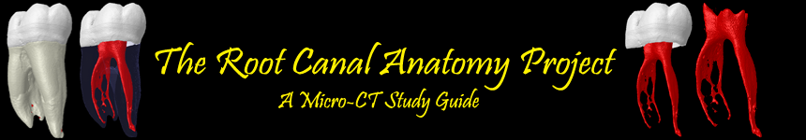



Marco A. Versiani, DDS, MS, PhD
Jesus D. Pécora, DDS, MS, PhD
Manoel D. Sousa-Neto, DDS, MS, PhD
The images and videos of The Root Canal Anatomy Project blog were developed at the Laboratory of Endodontics of Ribeirão Preto Dental School - University of São Paulo - and may be freely used for attributed noncommercial educational purposes by educators, scholars, student and clinicians. It means that all material used should include proper attribution and citation. In such cases, this information should be linked to the image in a manner compatible with such instructional objectives.
Contact: marcoversiani@yahoo.com
http://rootcanalanatomy.blogspot.com/

Slide 2
Mandibular Incisors

Slide 3
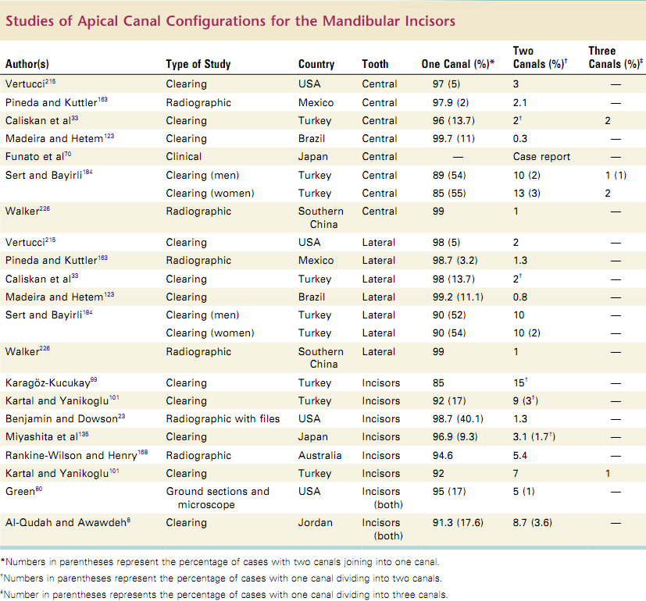
From Vertucci FJ, Haddix JE. Tooth morphology and access cavity preparation. In: Hargreaves KW, Cohen S. Cohen’s pathways of pulp. 10th ed. Mosby Elsevier, 2011. 1026 p.

Slide 4
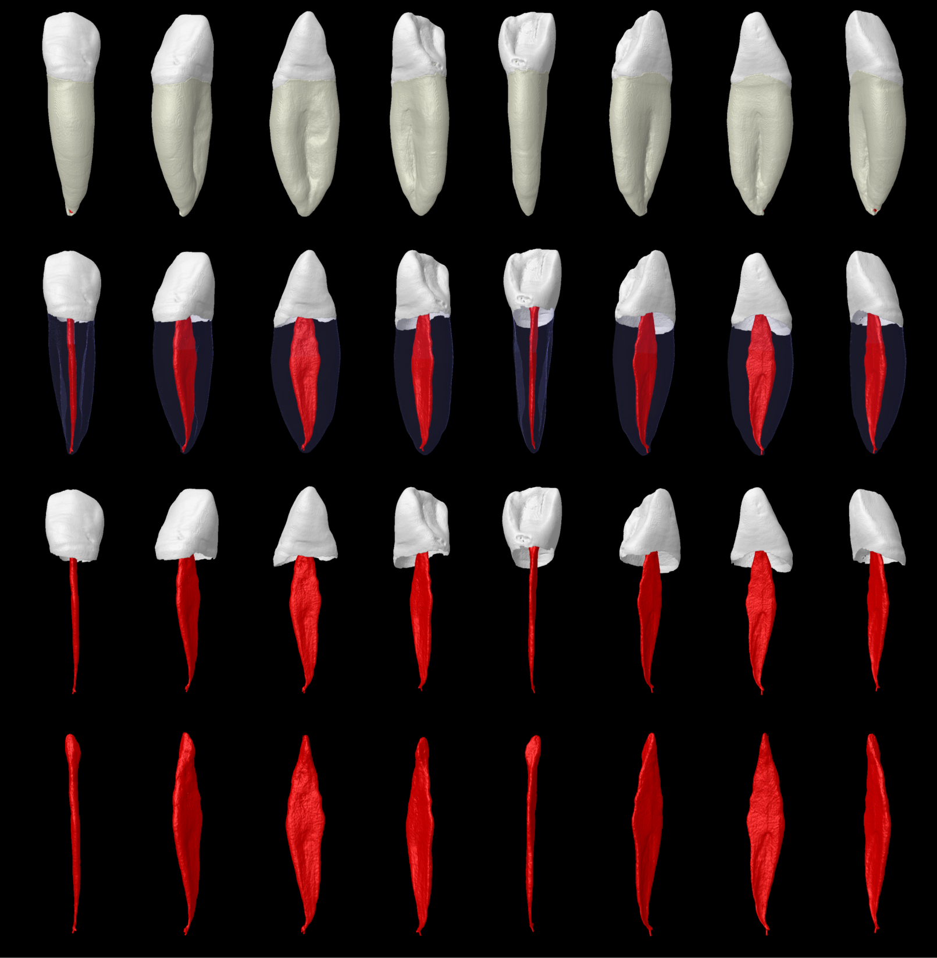

Slide 5
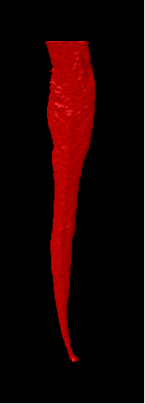
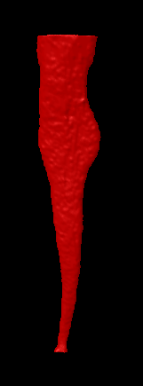
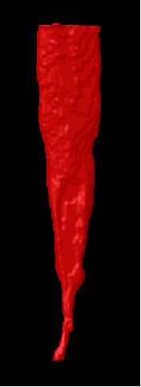
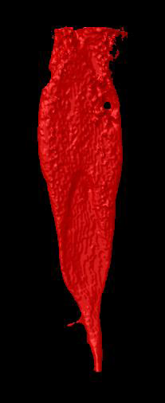
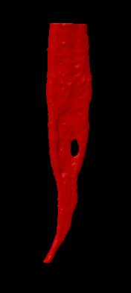
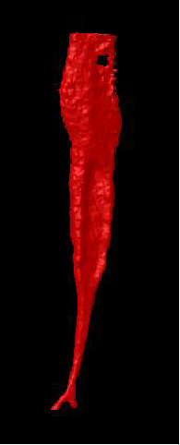
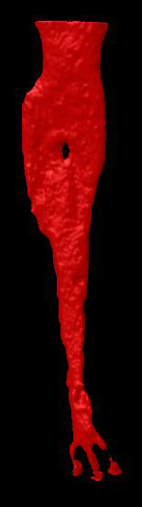
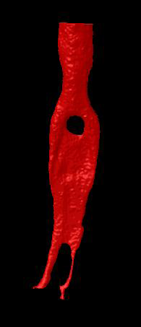
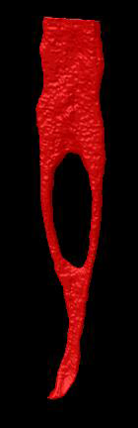
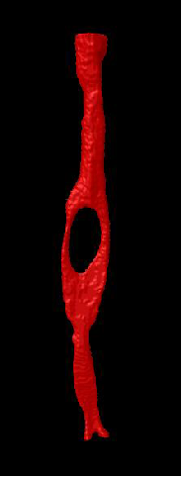
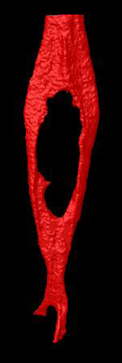
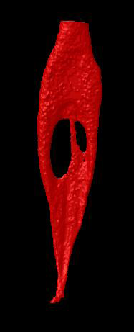
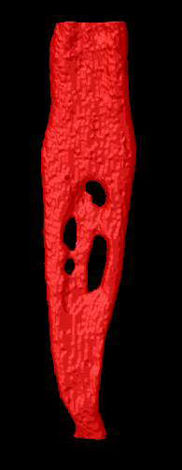
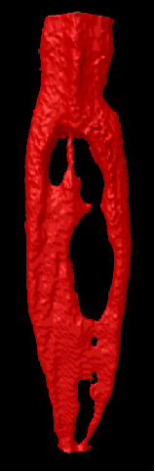

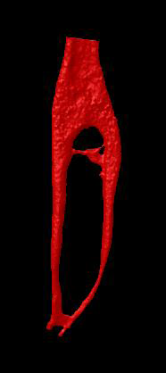
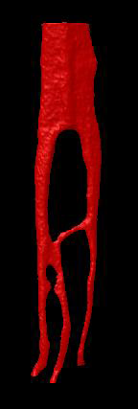
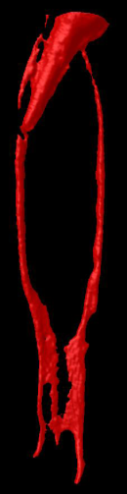
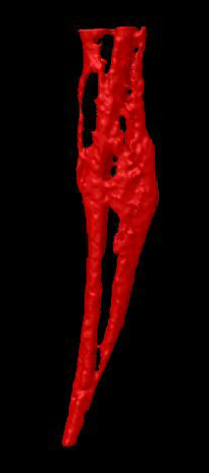
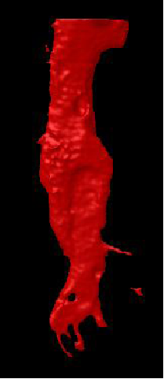
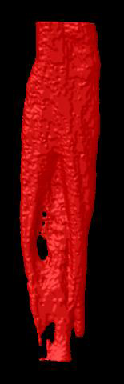

Slide 6
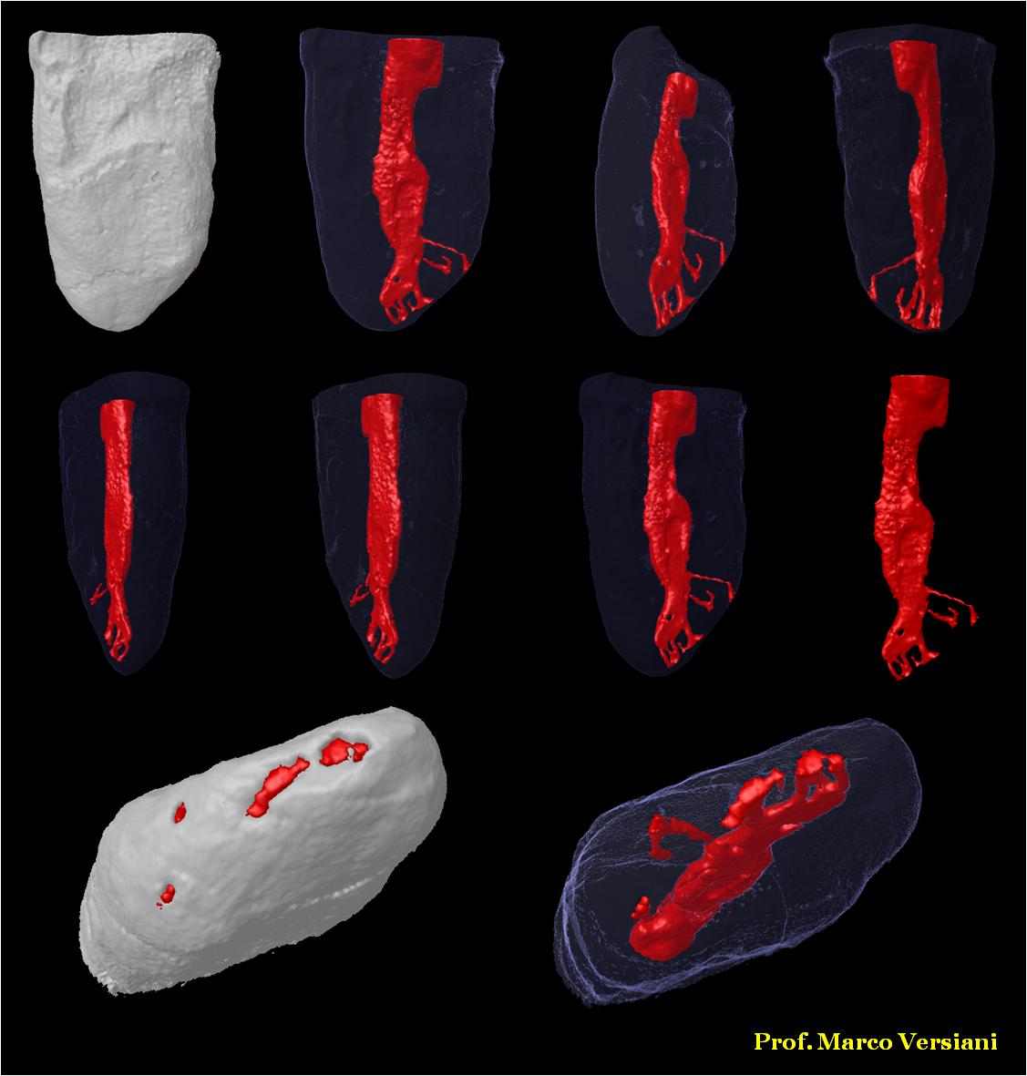

Slide 7
