Slide 1
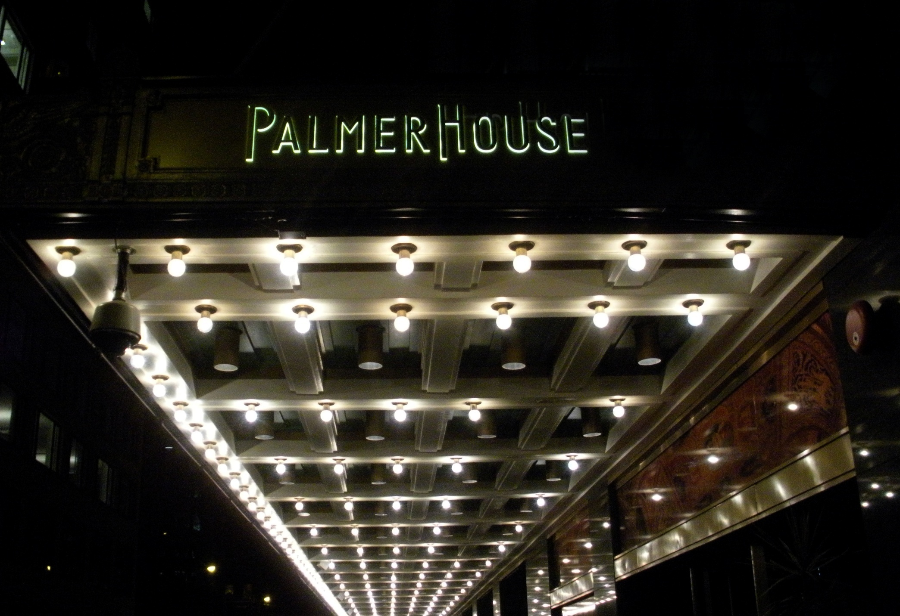

Slide 2
Case One
A twenty-four year old white female dental student presents for evaluation and treatment swelling in her maxillary left anterior area.
She notes that there has been gradual enlargement of the swelling over the past year to year and one-half.
She is asymptomatic.

Slide 3
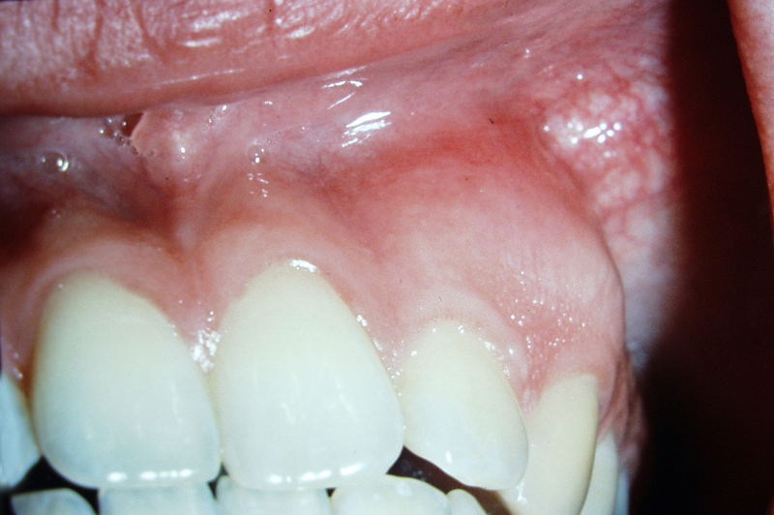
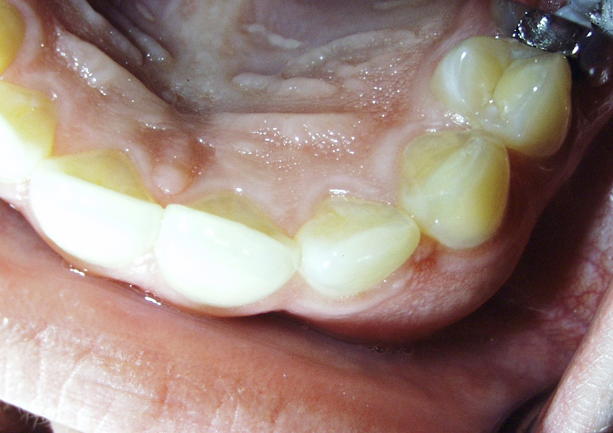

Slide 4
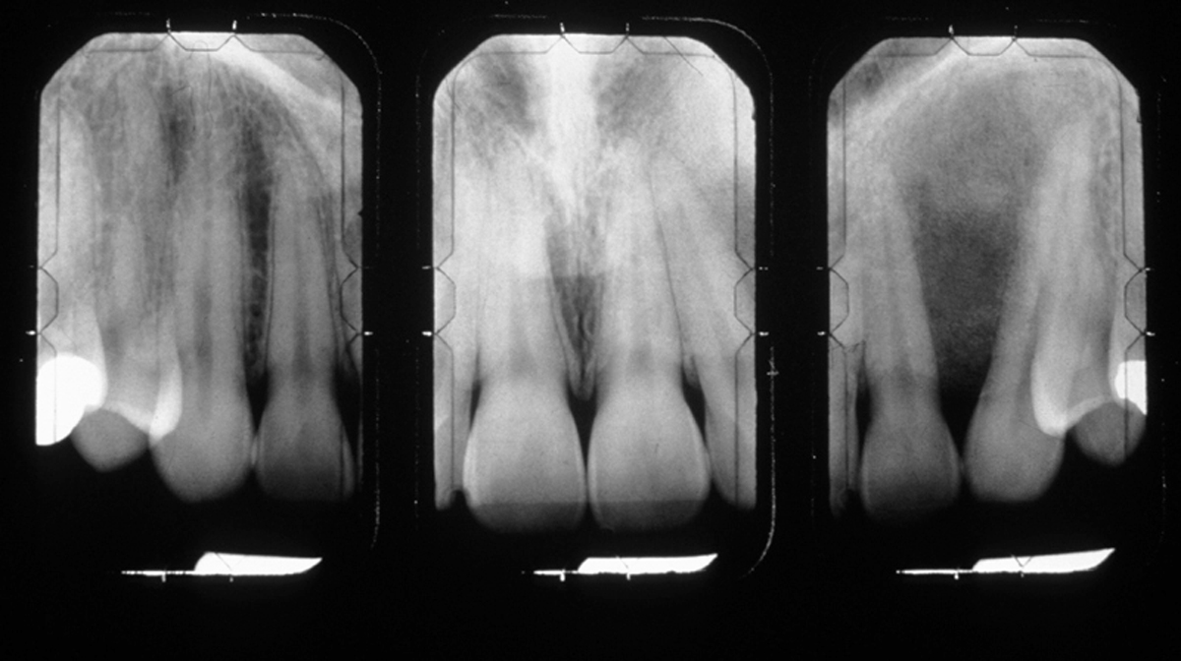

Slide 5
Differential Diagnosis

Slide 6
Fibro-Osseous Lesions
This is not a specific clinical diagnosis, but describes a process.
  Fibrous dysplasia
  Cemento-osseous dysplasia
    Focal cemento - osseous dysplasia
    Periapcal – cemento - osseous dysplasia
    Florid cemento - osseous dysplasia
  Ossifying Fibroma

Slide 7
A hamartoma is a benign focal malformation that resembles a neoplasm in the tissue of origin. It is not a malignant tumor, and it grows at the same rate as the surrounding tissues.
It is composed of tissue elements normally found at the site, but which are growing in a disorganized mass.

Slide 8
Fibrous Dysplasia
A hamartoma not of periodontal origin.
May be monostotic (80-85%) or polystotic, with the monostotic more common in the jaws of the skull.
Primarily a disease of children and young adults and ocurs in males and females equally.
The lesion is a painless and slow growing.
Has a ground glass appearance radiographically with the borders blending imperceptibly into adjacent bone

Slide 9
Focal Cemento-Osseous Dysplasia
Focal cemento-osseous dysplasia occurs predominately in females (90%) with a mean age of 38. There is a predilection for the third to sixth decades.
Radiographically, lesions are generally less than 1.5 cm and can be radiolucent to mixed. Lesions tend to be well defined and have a border that is irregular

Slide 10
Periapical Cemento-Osseous Dysplasia
Predominantly located in the anterior mandible with multiple foci being common.
Marked predilection for females 10:1 with being70% are black females
The diagnosis is made between the ages of 30-50, seldom under 20 tears of age
The teeth are asymptomatic and the pulp is vital
Radiographically the early lesion appears as a radiolucency similar to a granuloma or cyst. As the lesion matures, it is mixed. In the late stage, there is a circumscribed dense calcification surrounded by a narrow radiolucent rim.

Slide 11
Florid cemento-osseous dysplasia
Lesions appear as mulifocal areas in the posterior portions of the jaws. Many patients also have concurrent involvement of the anterior mandible. May be bilateral and symetrical.
Primarily black females with a predilection for middle age to elderly.
The course of maturation is similar to periapical cemento-osseous dysplasia
Dull pain and exposure of a yellowish avascular bone may occur.

Slide 12
Ossifying Fibroma
This may resemble focal cemento-osseous dysplasia, but it is a true neoplasm with significant growth potential.
The lesion occurs over a wide age range with the greatest number of cases in the third and fourth decades.
There is a female predilection with the mandibular premolar and molar sites being most common.
Larger tumors result in painless enlargement of the jaws.
Radiographically the lesions are well defined and unilocular. They may have a sclerotic border. The lesion may be radiolucent or radiopaque with a thin radiolucent periphery.

Slide 13
D MacDonald-Jankowski. Fibrous dysplasia: a systematic review. Dentomaxillofacial Radiology (2009) 38, 196–215
Evaluate the principal features of fibrous dysplasia by systematic review
106 reports and a total of 788 cases were included in the SR.
Fibrous dysplasia affected both genders equally, but was 50% more prevalent in the maxilla.
The mean age at first presentation was 24 years. The decade with the greatest frequency was the second, in which males accounted for 63%. The main symptom in 90% of all SR-included cases was swelling (including deformation of the jaws).
Not one SR-included case directly involved the ocular apparatus.
All cases displayed buccolingual expansion; all mandibular cases exhibited downward displacement of the lower border of the mandible and almost all maxillary cases involved the maxillary antrum.
Only 35% of reports included follow-up; 18% of cases recurred or were reactivated.

Slide 14
Dhiravarangkura, P, Cholitgul, W and Chai-u-Dom, Clinico-radiological study of fifty cases of fibrous dysplasia in the jaw bones. Oral Radiology 1994;10:15-22
Studied 50 patients with 54 lesions reported to have fibrous dysplasia at the faculty of Dentistry, Chulalongkorn University during 1971–1994.
The ratio of men to women was 26:24 and the ratio of mandible to maxilla was 28:26.
The most common age group was from 16 to 25 years. Calcification gradually increased with age: mottled in 14 (25.9%), orange peel in 3 (5.6%), and ground glass in 34 (63%).
The characteristics of this disease were painless swelling, a ground glass appearance and thinning or fade down of cortical bone particularly the loss of the lamina dura in 40 lesions (74%) and the inferior border of the mandible in 20 lesions (71.4%).
In the maxillary lesions, the maxillary sinus was partially involved in 7 (28.9%), and completely involved in 13 (50%). These maxillary lesions confined to only one site. In the mandibular lesions, there were 9 large lesions (32.1%), all of these crossed the symphysis. Mode of the expansions occurred in all directions in 31 lesions (57.4%), bucco-lingually in 13 (24.1%), and buccally in 7 (13%).

Slide 15
Cementoblastoma
Rare (less than 1% of all odontogenic tumors) neoplasm predominantly in children and young adults (50% under the age of twenty, 75% before thirty)
Primarily in the mandible (75%) – molar/premolar region (90%)
Radiographically appears as an opaque mass fused to the root and surrounded by a radiolucent rim. Usualy the root outline is obscured by the lesion.

Slide 16
Cementoossifying Fibroma
Usually occur as solitary periapical lesions with 70-80% in the mandible (molar and premolar region)
There is a predilection for females (usually under thirty years of age) and reach a size of 2-4 cm.
Expansion of the jaw is common

Slide 17
Odontoma
The most common odontogenic tumor representing 67% of all odontogenic tumors
Results from extra budding from the dental lamina
  Compound odontoma – tooth like structures – more common in the maxilla
  Complex odontoma – tooth like structures do not form – more common in the mandible (70% first and second molar region) - there is a well defined border - 68% occur in females
Same developmental process as a tooth. Early and intermediate stages are radiolucent and mixed.May block eruption of permanent teeth

Slide 18
Calcifying Odontogenic Cyst
A slow growing asymptomatic lesion consisting of cystic (86%) and neoplastic forms (14%) -90% of the central lesions are cystic
Sixty-five percent are found in the incisor canine region – in the mandible the molar-premolar region is more common
Unerupted teeth and root resorption is common
Radiolucencies may unilocular or multilocular and may contain radiopaque foci

Slide 19
Calcifying Epitheila Odontogenic Tumor
Pindborg tumor
Rare odontogenic tumor having a mixed appearance “driven snow” – 52% are associated with an unerupted tooth
Occurs in all age ranges with a mean age at diagnosis of forty.
Sixty-eight percent occur in the mandible with a predilection for the molar region
A painless slow growing lesion that produces expansion

Slide 20
Osteosarcoma
Osteosarcomas of the jaws occur in the third and fourth decades of life (the mean age is 33 years).
The maxilla and mandible are equally involved.
Pain and swelling are the most common symptoms.
An early radiographic sign is symetrical widening of the periodontal ligament space around a tooth or several teeth.
Paresthesia, loosening of teeth, nasal obstruction, and resorption of roots are often noted.
Radiographically the lesion can be a dense sclerosis to a mixed sclerotic/radiolucent area. Borders are ill-defined.
A sunburst appearance is noted in 25% of the lesions.

Slide 21
Chondrosarcoma
Chondrosarcoma is a rare oral tumor of adulthood with a peak prevalance of the sixth and seventh decades. Tumors arising before the age of 45 are uncommon.
The maxilla is the most common site.
A painless mass or swelling is the common presenting sign.
Radiographically there is a radiolucency with a poorly defined border (maybe multilocular). The radiolucent portion frequently has scattered radiopaque foci of calcified cartilage matrix.
Root resorption and symmetrical widening of the periodontal ligament may be present.

Slide 22
Ewing’s Sarcoma
Most studies indicate a neuroecto dermal origin and this lesion is the third most common osseous neoplasm.
The peak prevalence is the second decade of life (80% are younger than twenty).
Jaw involvement is uncommon (1-2%) and the disease primarily involves Caucasians.
Swelling with pain is a common presenting sign and symptom. The tumor may penetrate the cortex producing a soft tissue mass overlying the bone. Paresthesia and loosening of teeth are common findings.
Radiographically there is an irregular area of lytic bone destruction with ill-defined borders.

Slide 23
Metasatic Tumors of the Jaws
Metastatic carcinoma is the most common form of cancer involving bone.
Twothirds of breast cancers, one half of prostate cancers, and one-third of lung and kidney cancers spread to bone.
Eighty percent of oral metastasis is to the mandible.
Autopsy specimens of cancer patients indicated 16% had metastatic disease not evident on radiographs.
Paresthesia is a common symptom.
Often the oral lesion is the first indication of primary disease.
Radiographically the appearance is often “moth-eaten”

Slide 24
Focal Sclerosing Osteomyelitis
Focal Sclerosing Osteomyelitis is associated with teeth exhibiting pulp necrosis
Radiographically characterized by increased radiodensity around the root of the involved tooth. This may also occur adjacent to a widened PDl or apical inflammatory lesion.
Most often noted in the molar and premolar teeth of the mandible.

Slide 25
Paget’s Disease
Primarily affects older individuals (rarely in patients younger than forty).
Males are affected more than females, and Caucasians more than blacks.
Most lesions are polystotic.
Symptoms vary. Bone pain is often severe
Jaw involvement is approximately 17%. Maxillary disease is more common than mandibular lesions.
Radiographic appearance is “cotton-wool”. Teeth may exhibit hyperementosis

Slide 26
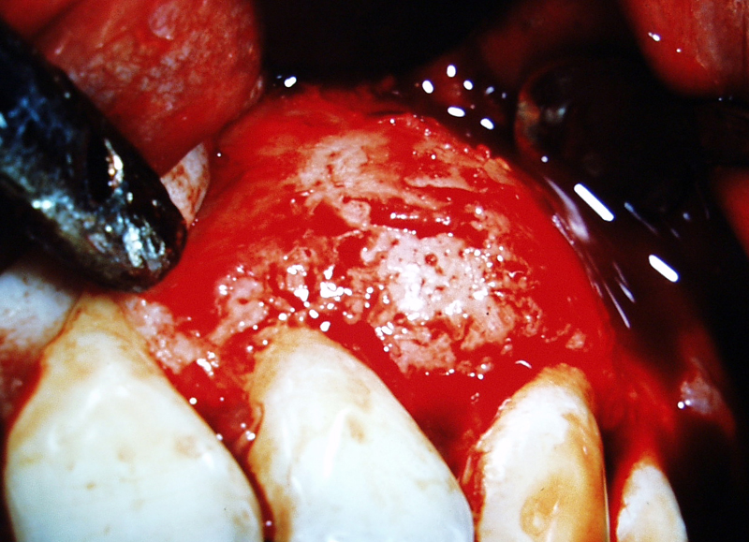
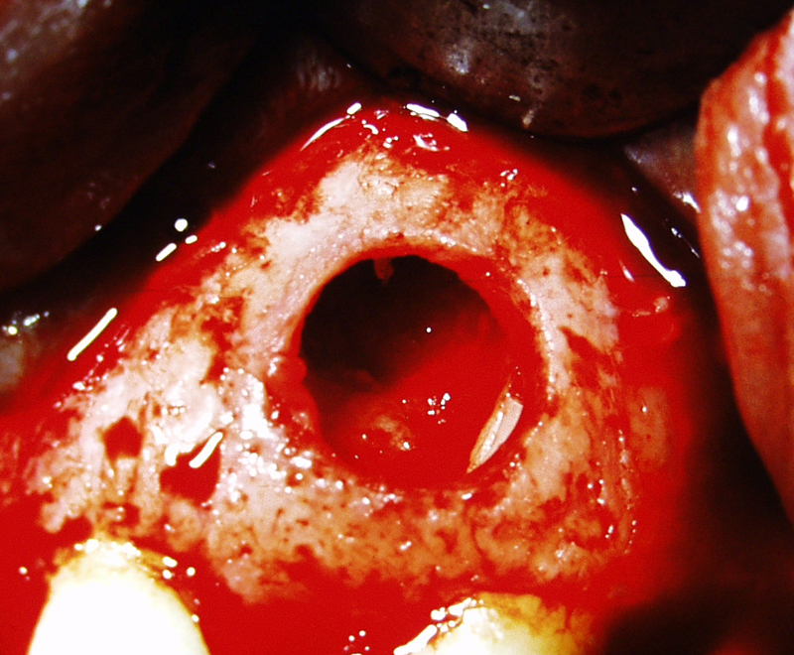

Slide 27
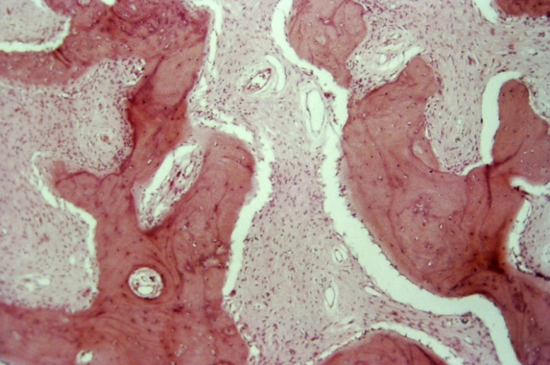
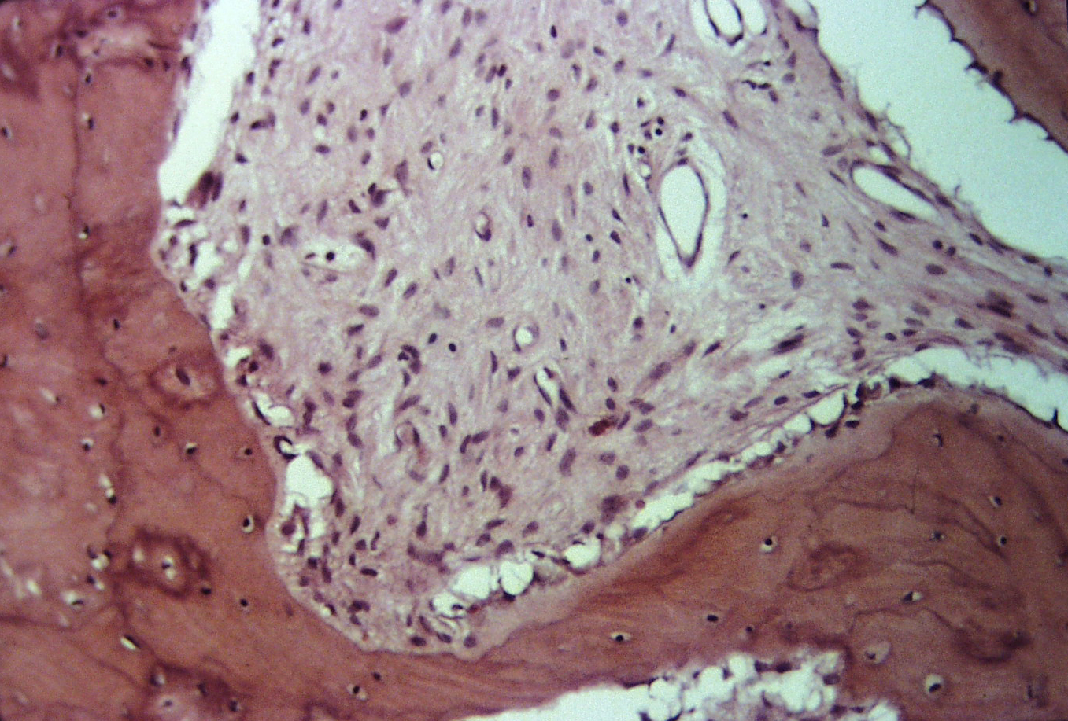

Slide 28
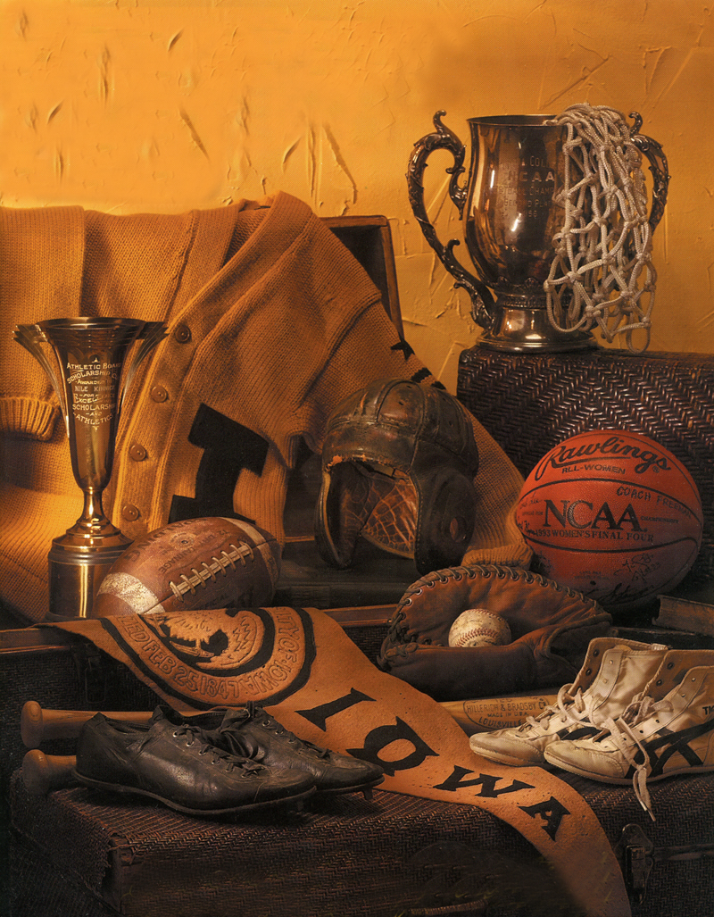

Slide 29
Case Two
A seventy-five year old male presents for evaluation of non-surgical root canal treatment performed by general dentist one year ago (2008).
His general dentist restored the tooth following NSRCT, but he relates his mandibular left first molar (#19) has remained symptomatic to biting pressure and often “aches”

Slide 30
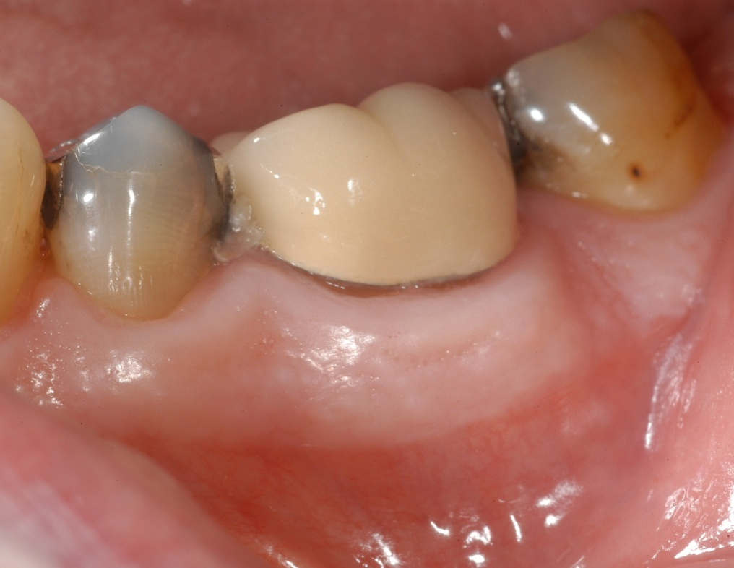
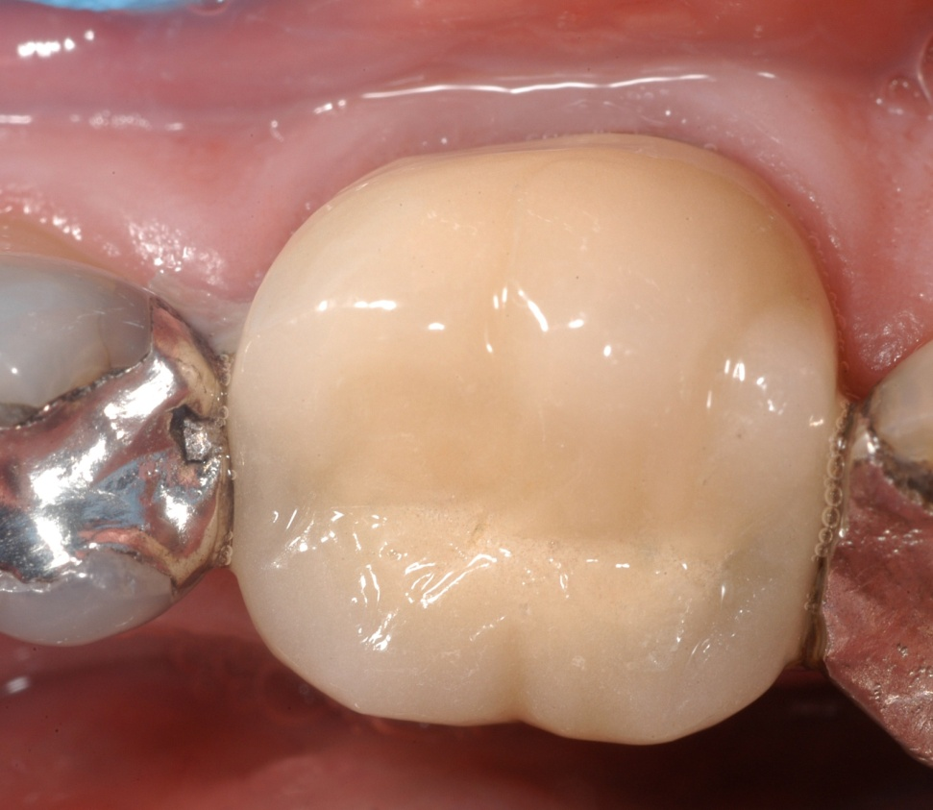

Slide 31
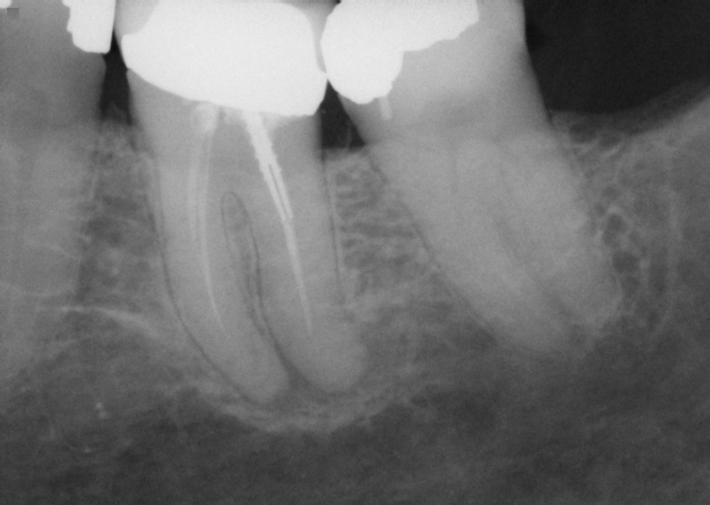
Preoperative Radiograph
11 September 2008

Slide 32
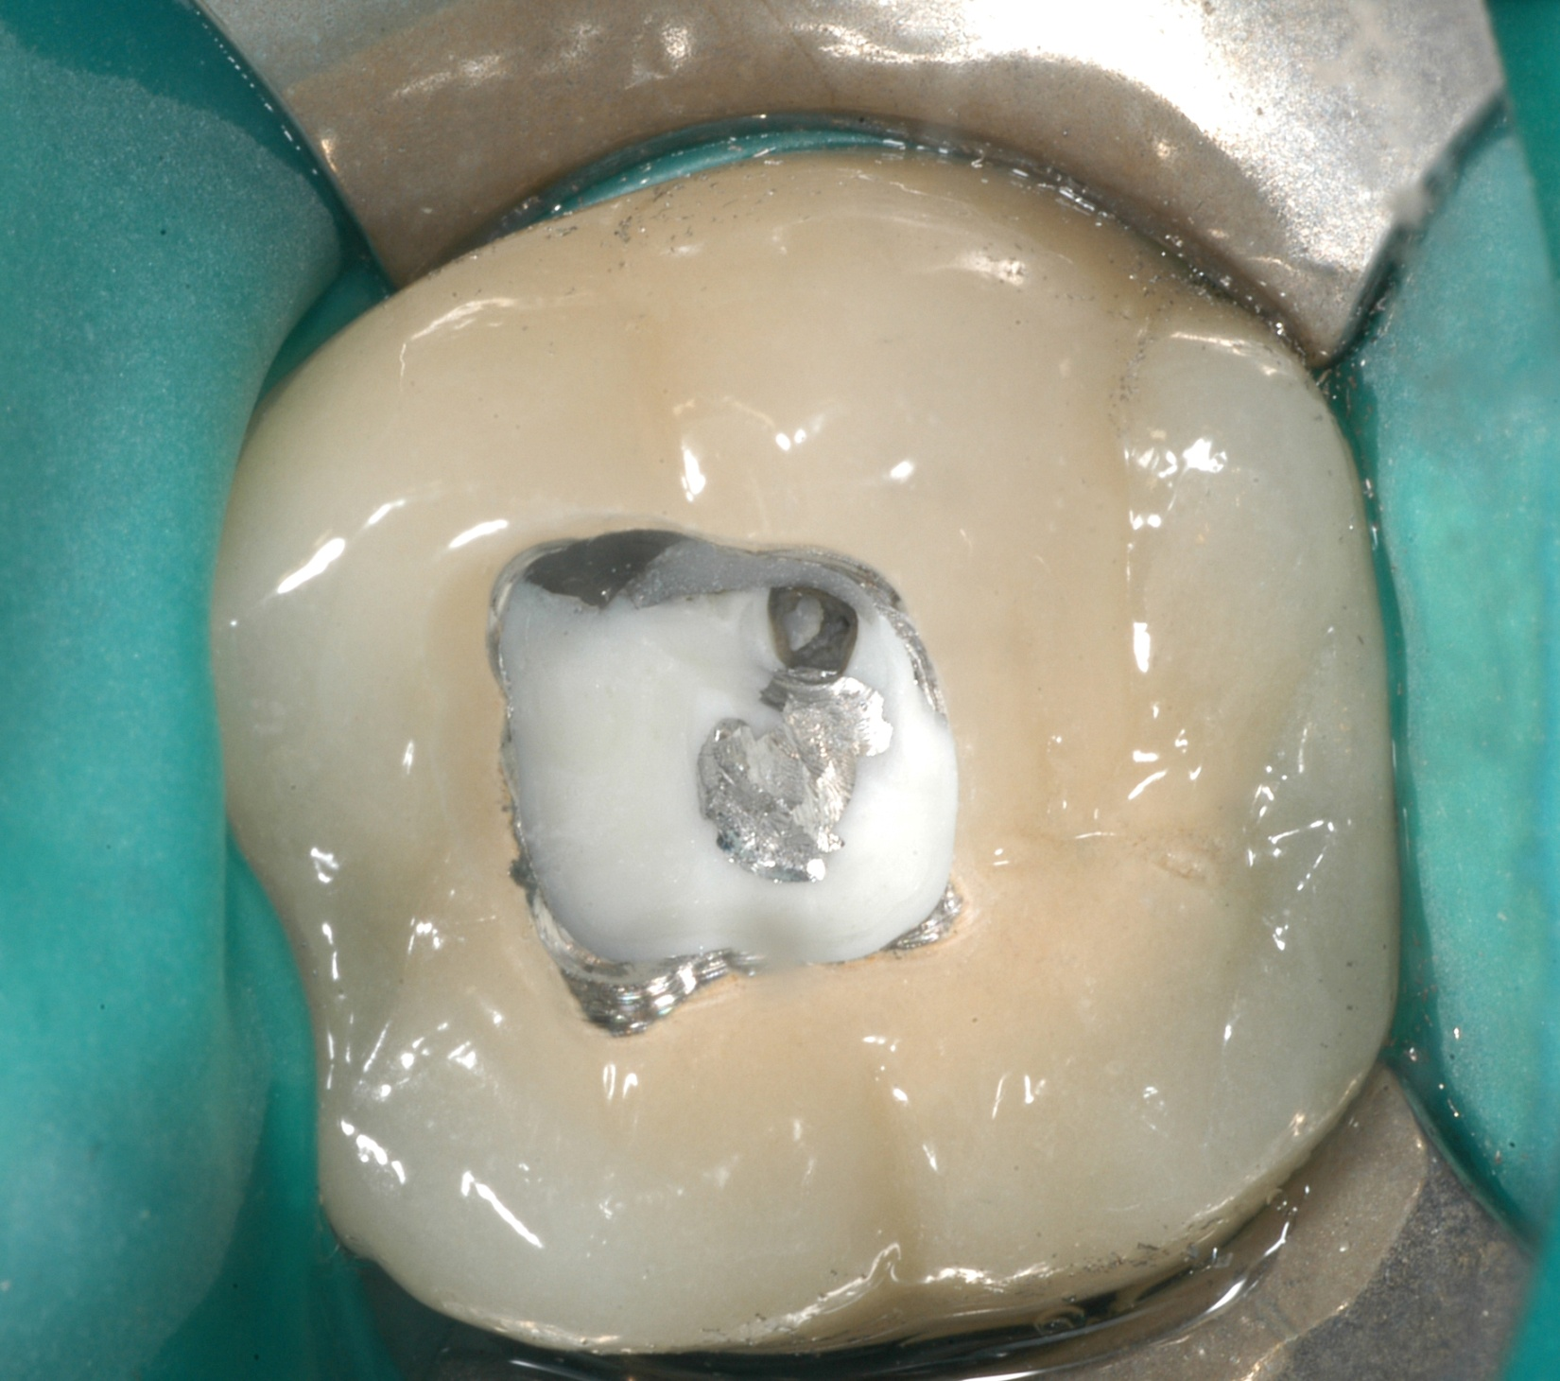

Slide 33
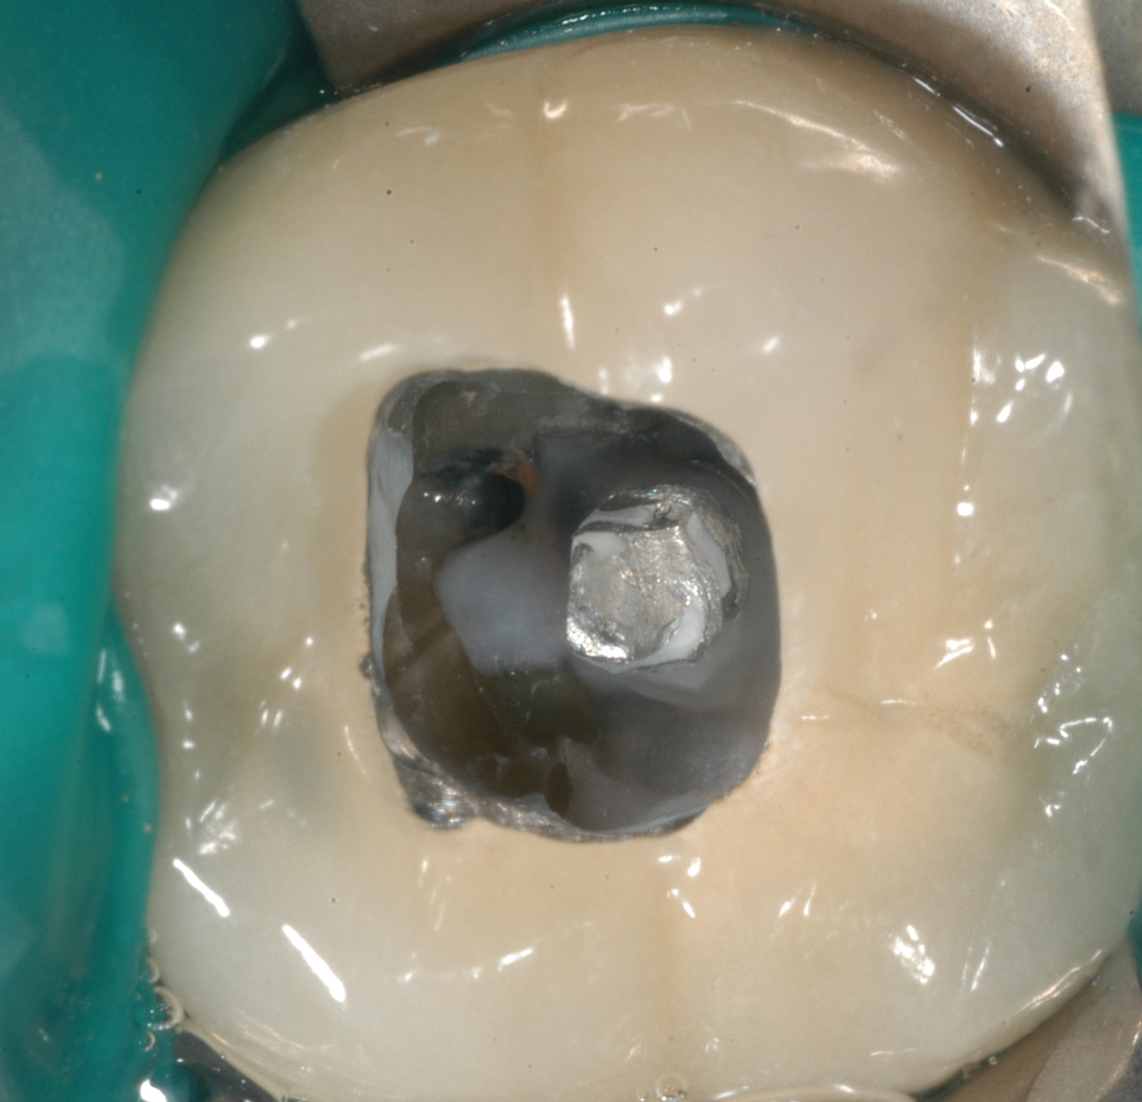

Slide 34
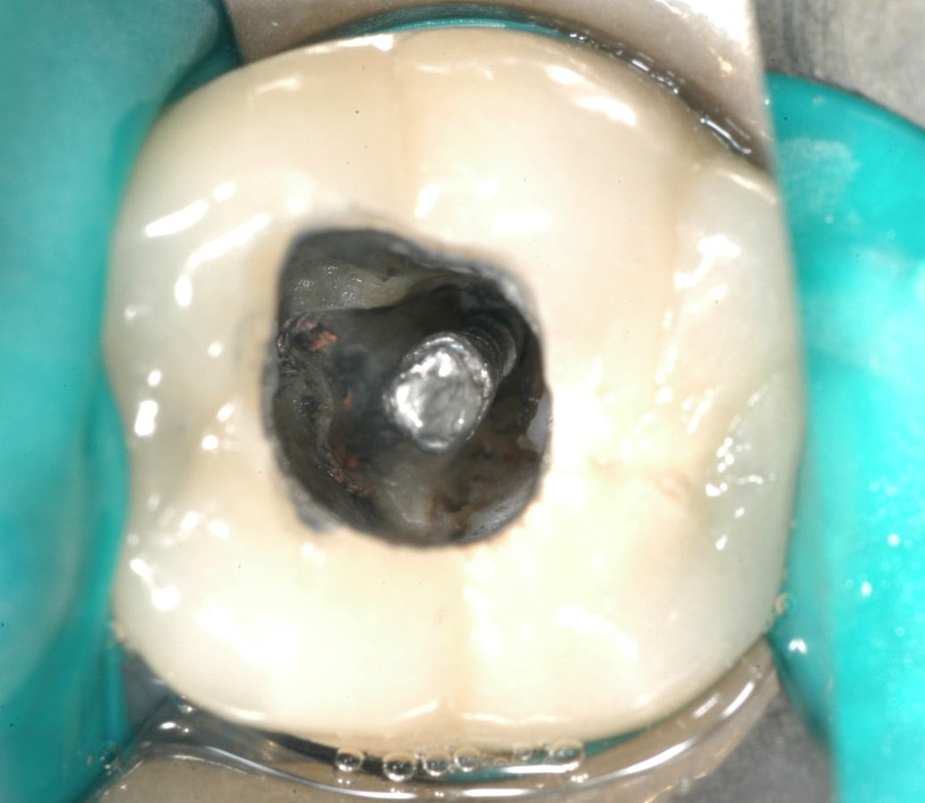
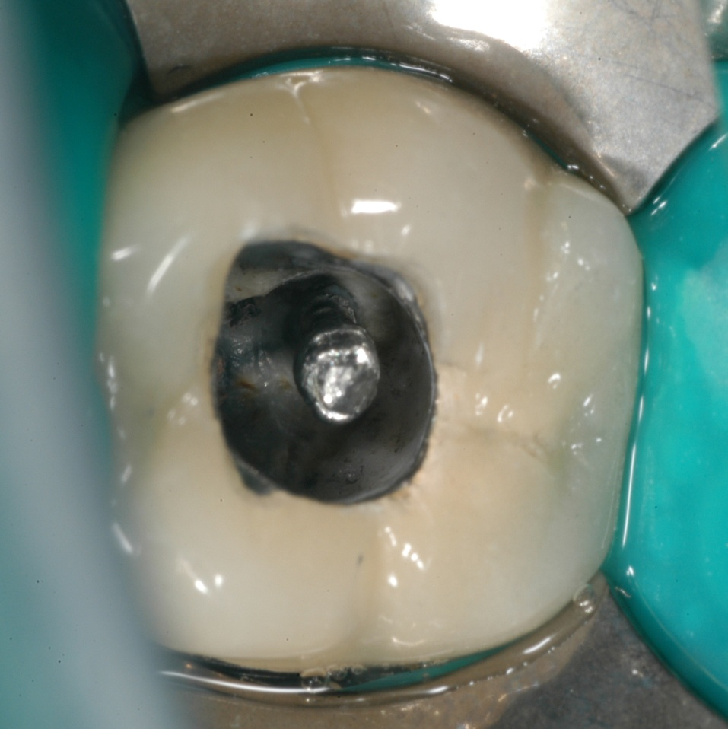

Slide 35
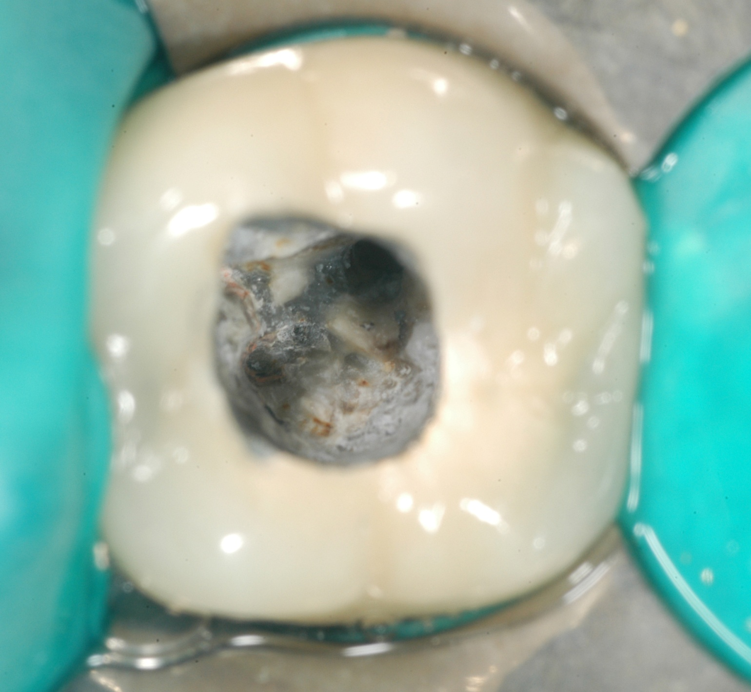

Slide 36
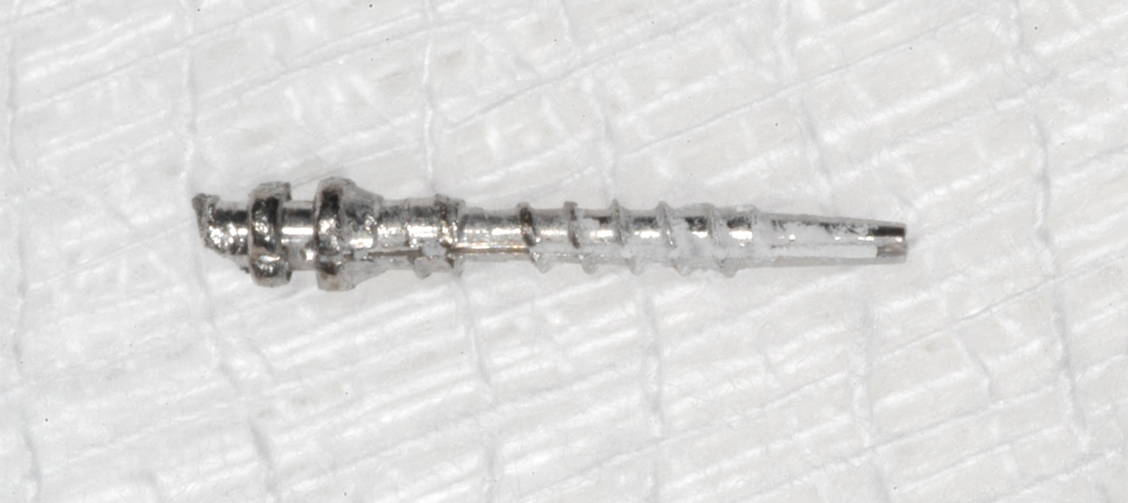

Slide 37
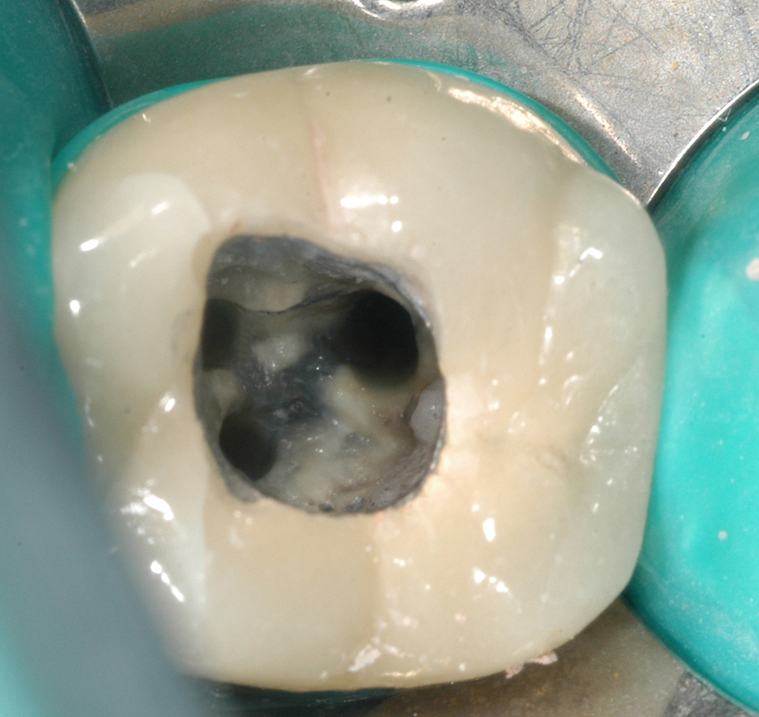

Slide 38
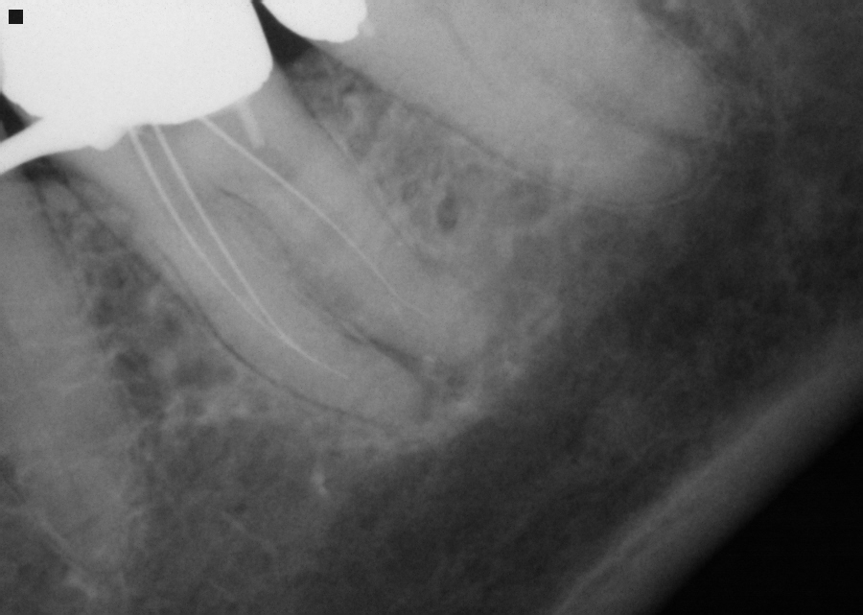

Slide 39
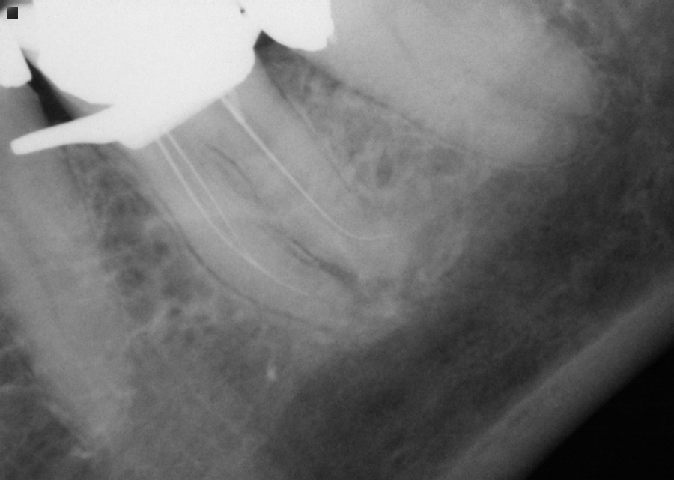

Slide 40
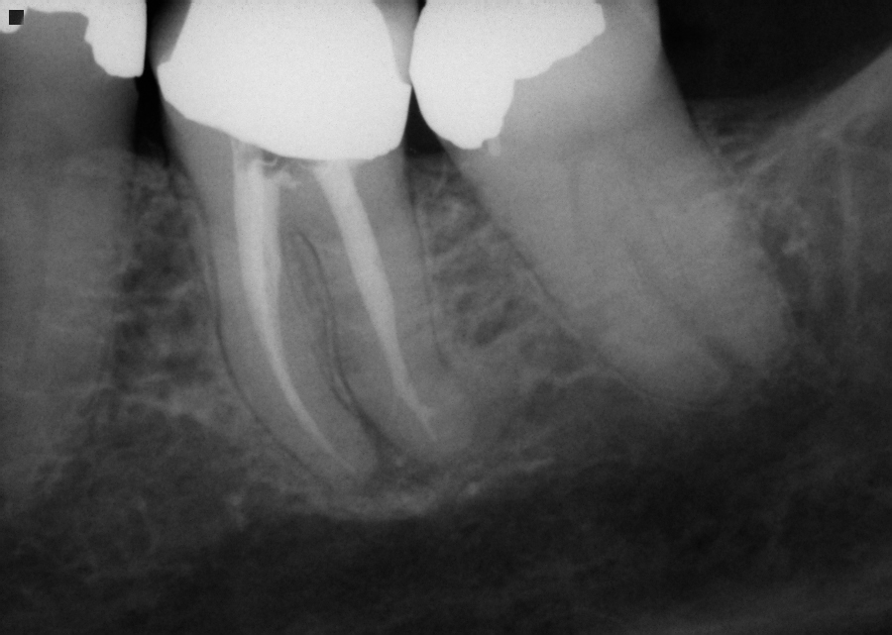
Postoperative Radiograph
26 February 2009

Slide 41
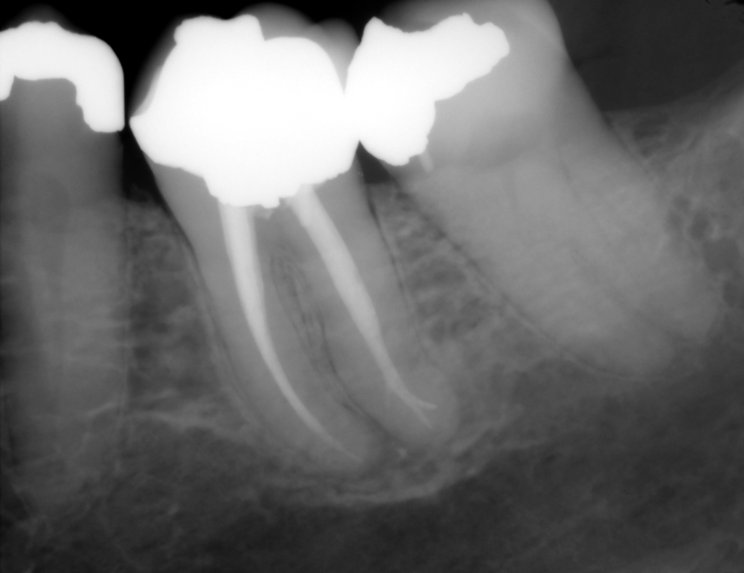
Recall Radiograph
2 September 2009

Slide 42
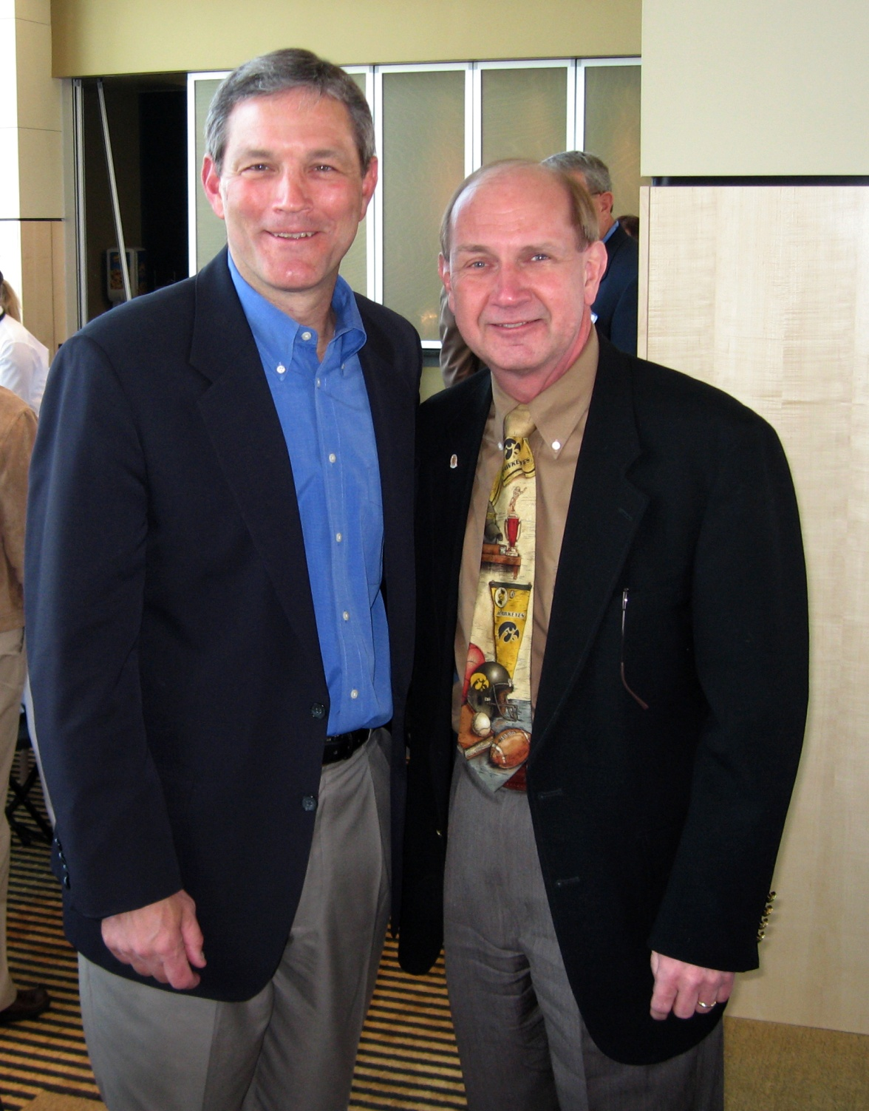

Slide 43


